Slide 1
WHAT GIFT WILL
YOU BRING JESUS?
MATTHEW 2:1-12

Slide 2
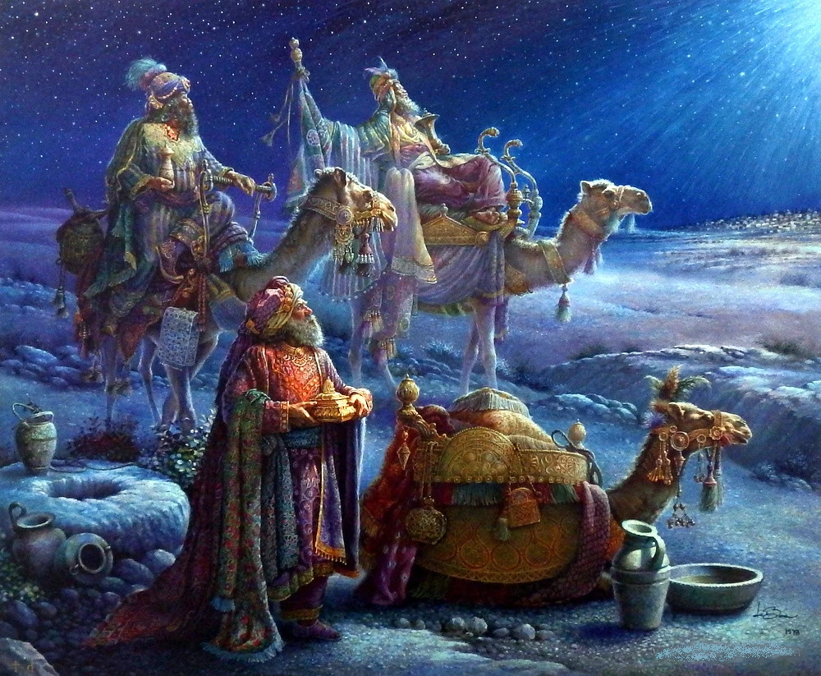

Slide 6
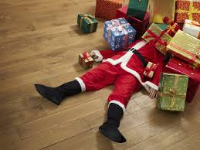
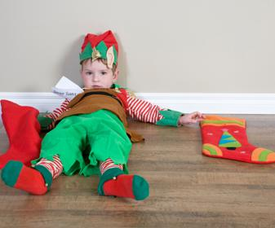

Slide 8
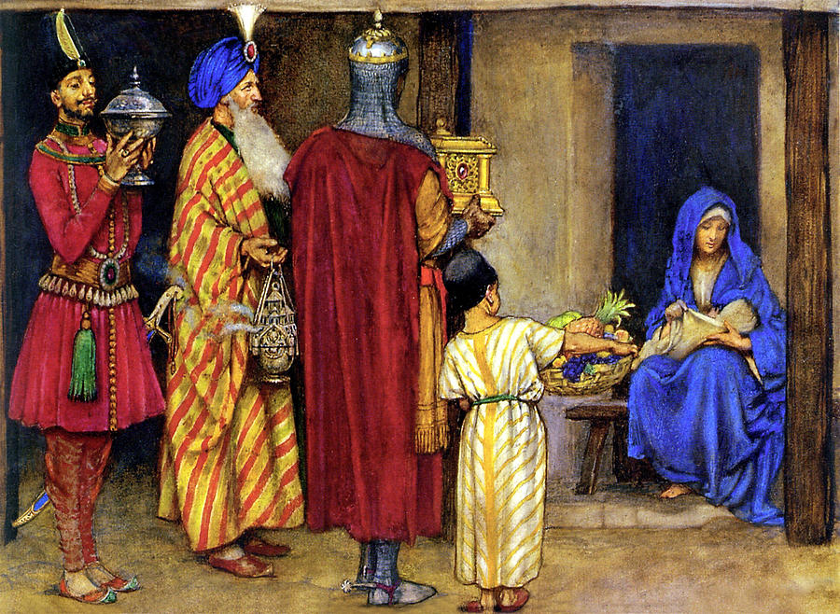

Slide 9
What Gift Can I bring to Jesus?

Slide 13
The Kingdom of God

Slide 15
The Gift of
Bringing Others
To Jesus

Slide 16
MATTHEW 25:34-40
“One day I will come and say to those on my right hand, ‘Come you blessed of My Father, inherit the kingdom prepared for you from the foundation of the world:

Slide 17
³⁵ for I was hungry and you gave Me food; I was thirsty and you gave Me drink; I was a stranger and you took Me in; ³⁶ I was naked and you clothed Me; I was sick and you visited Me

Slide 18
I was in prison and you came to Me.' ³⁷ Then the righteous will answer Him, saying, 'Lord, when did we see You hungry and feed You, or thirsty and give You drink?

Slide 19
³⁸ When did we see You a stranger and take You in, or naked and clothe You? ³⁹ Or when did we see You sick, or in prison, and come to You?'

Slide 20
⁴⁰ And the King will answer and say to them, 'Assuredly, I say to you, inasmuch as you did it to one of the least of these My brethren, you did it to Me.'

Slide 21
“Assuredly, I say to you,
inasmuch as you did it
to one of the least of these
My brethren, you did it to me.”

Slide 22
Matthew 10:42
A cup of cold water…

Slide 23
John 6:8-14

Slide 24
In helping others
We are giving a gift
To Jesus

Slide 25
Some will do that this Christmas
Time
Treasure
Talent

Slide 26
“The only TRUE gift
is a portion of thyself.”
Ralph Waldo Emerson

Slide 27
Give Jesus Your Heart!

Slide 28
The wise men gave
of themselves!

Slide 29
What Gift Will
You Bring to Jesus?

