Slide 1
DISCERNING
Numbers 9:15-23 / Romans 12:1-5

Slide 2
Present your bodies as a living sacrifice, holy and acceptable to God, which is your spiritual worship. Do not be conformed to this world, but be transformed by the renewal of your mind, that by testing you may discern what is the will of God, what is good and acceptable and perfect and, thus, live a life of spiritual worship.
^{Romans 12:1-2 ESV}

Slide 3
2 Timothy 3:16-17 (NLT)
¹⁶ All Scripture is inspired by God and is useful to teach us what is true and to make us realize what is wrong in our lives. It corrects us when we are wrong and teaches us to do what is right. ¹⁷ God uses it to prepare and equip his people to do every good work.

Slide 5
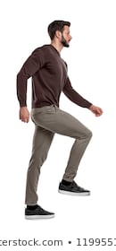
GOD’S
WILL
The first step in discerning God’s will for my life is to….
Acknowledge the
Necessity of FAITH

Slide 6
We should never pursue the Lord’s will above pursuing Him!

Slide 7
GOD’S
WILL
The second step in discerning God’s will for my life is to….
2. Acknowledge the
Necessity of OBEDIENCE

Slide 8
GOD’S
WILL
The second step in discerning God’s will for my life is to….
Obedience?

Slide 9
GOD’S
WILL
The third step in discerning God’s will for my life is to….
3. Acknowledge the
Need for WISDOM!

Slide 10
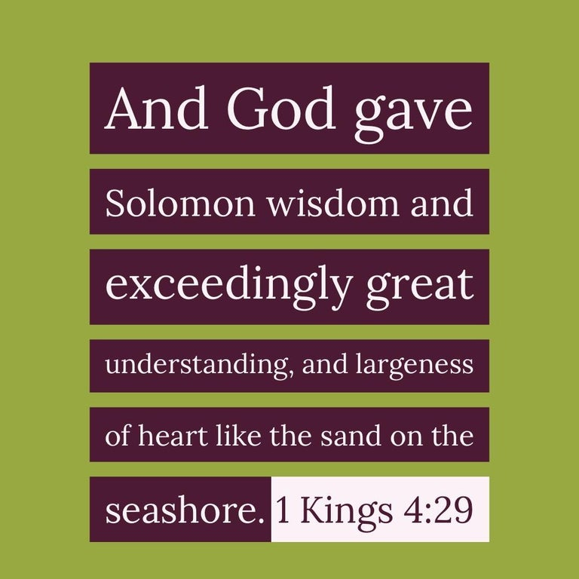

Slide 12
James 1:5
“If any of you lacks wisdom, let him ask of God, who gives to all liberally and without reproach, and it will be given to him.”

Slide 13
James 1:6-7
But let him ask in faith…for the man that doubts will not receive anything from the Lord.

Slide 14
GOD’S
WILL
The fourth step in discerning God’s will for my life is to….
4. Acknowledge the
Need for PATIENCE

Slide 15
James 1:4
“Let patience have its perfect work, that you may be perfect and complete, lacking nothing.”

Slide 16
GOD’S
WILL
The fifth step in discerning God’s will for my life is to….
5. Acknowledge the
KNOWN will of God

Slide 18
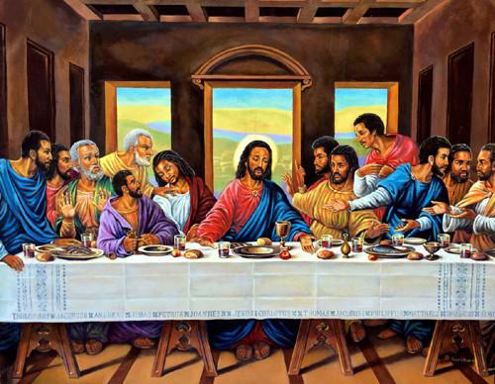
The Purpose of the Lord’s Supper

Slide 19
First, it is an expression of our FAITH

Slide 20
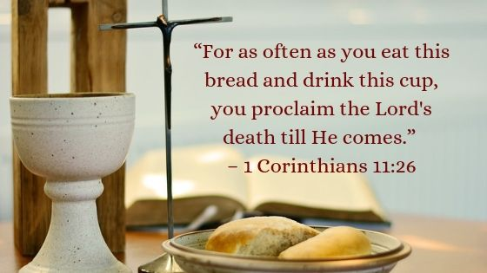

Slide 21
Second, it is a COMMAND

Slide 22
It’s a matter of obedience

Slide 23
Third, we demonstrate WISDOM

Slide 24
Fourth, we practice PATIENCE

Slide 25
…
²¹ For in eating, each one goes ahead with his own meal. One goes hungry, another gets
drunk.

Slide 26
To be filled with the Spirit means to be under the Holy Spirit’s influence.

Slide 27
Fifth, our attention is on Jesus

Slide 28
12 "Look, I am coming soon, and my reward is with me to repay each person according to his work. 13 I am the Alpha and the Omega, the first and the last, the beginning and the end. 14 "Blessed are those who wash their robes, so that they may have the right to the tree of life and may enter the city by the gates. 15 Outside are the dogs, the sorcerers, the sexually immoral, the murderers, the idolaters,
^{Revelation 22:12-17}

Slide 29
and everyone who loves and practices falsehood. 16 "I, Jesus, have sent my angel to attest these things to you for the churches.
I am the root and descendant of David, the bright morning star.“ 17 Both the Spirit and the bride say, "Come!" Let anyone who hears, say, "Come!" Let the one who is thirsty come. Let the one who desires take the water of life as a gift.
^{Revelation 22:12-17}

Slide 32
