Slide 1
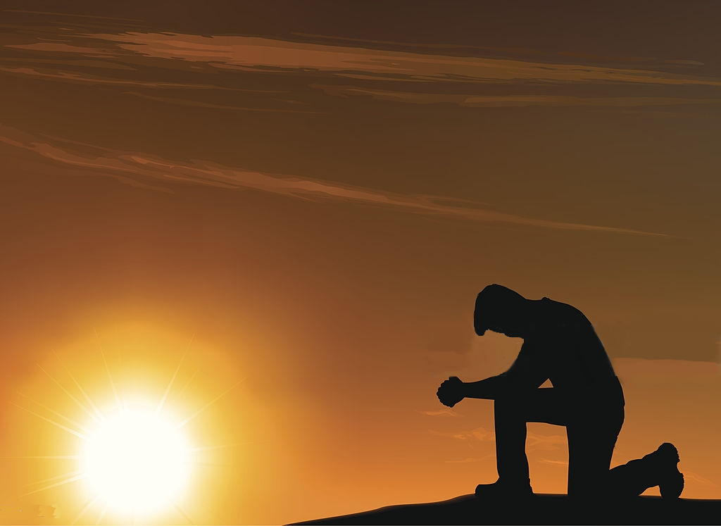
A REASON TO KNEEL
Ephesians 3:14-21

Slide 5
⁶ However, we speak wisdom among those who are mature, yet not the wisdom of this age, nor of the rulers of this age, who are coming to nothing. ⁷ But we speak the wisdom of God in a mystery, the hidden wisdom which God ordained before the ages for our glory, ⁸ which none of the rulers of this age knew; for had they known, they would not have crucified the Lord of glory.
1 Corinthians 2:6-8 (NKJV)

Slide 6
⁹ But as it is written: "Eye has not seen, nor ear heard, Nor have entered into the heart of man The things which God has prepared for those who love Him." ¹⁰ But God has revealed them to us through His Spirit. For the Spirit searches all things, yes, the deep things of God.
1 Corinthians 2:9-10 (NKJV)

Slide 7
According to God’s eternal purpose
accomplished in Christ Jesus our Lord.
Ephesians 3:11(NKJV)

Slide 8
See also Isaiah 6:10

Slide 9
¹⁴ For this reason I kneel before the Father, ¹⁵ from whom the whole family in heaven and earth is named, ¹⁶ that He would grant you, according to the riches of His glory, to be strengthened with power through His Spirit in the inner man,
Ephesians 3:14-19 (NKJV)

Slide 10
¹⁷ that Christ may dwell in your hearts through faith; that you, being rooted and grounded in love, ¹⁸ may be able to comprehend with all the saints what is the width and length and depth and height of God’s love ¹⁹ and know Christ’s love that surpasses knowledge; so that you may be filled with all the fullness of God.
Ephesians (NKJV)

Slide 12
What is Paul’s reason for kneeling?

Slide 13
COME, LET US WORSHIP AND BOW DOWN, LET US KNEEL BEFORE THE LORD OUR MAKER
PSALM 95:6

Slide 14
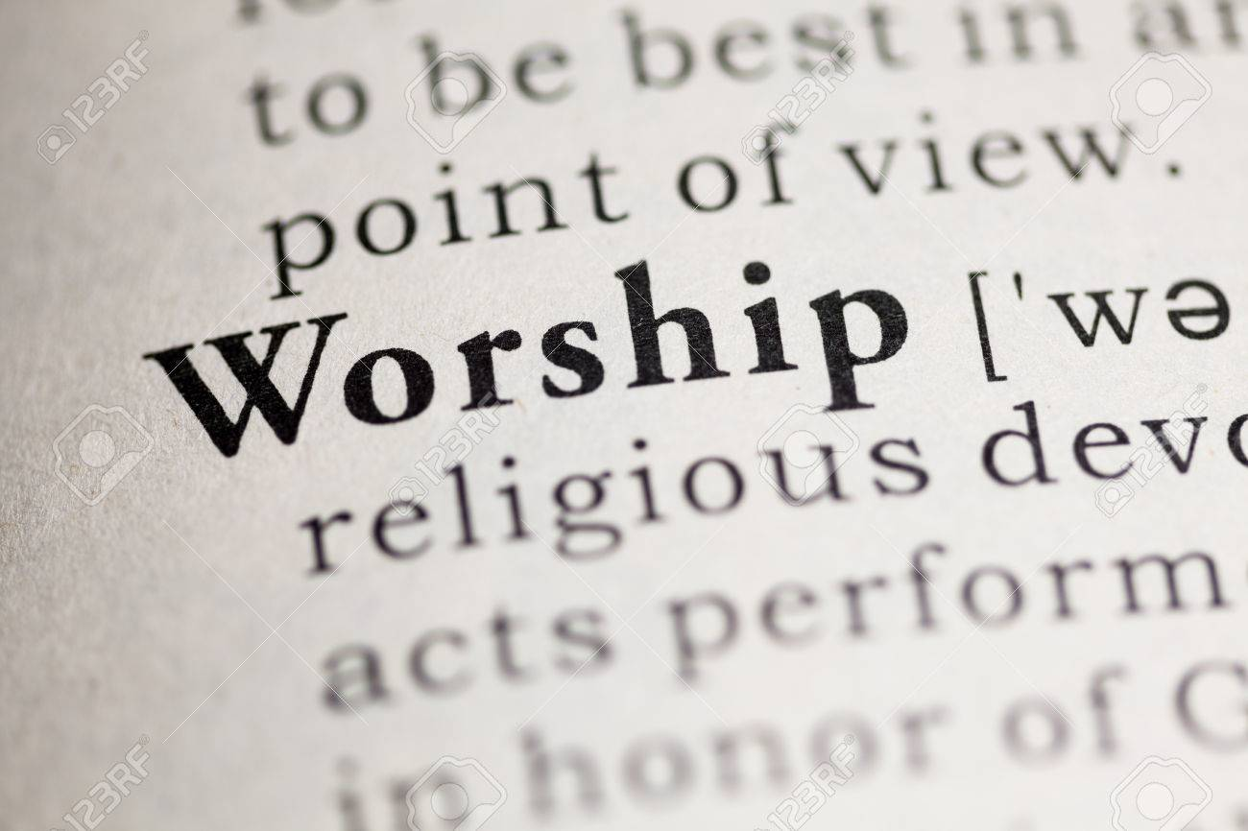

Slide 16
Kneeling can be a demonstration of humility.
A declaration of God’s supremacy.

Slide 17
A demonstration of submission to God
A sign of deference – a symbol of reverence

Slide 18
A demonstration of one’s sincerity!

Slide 20
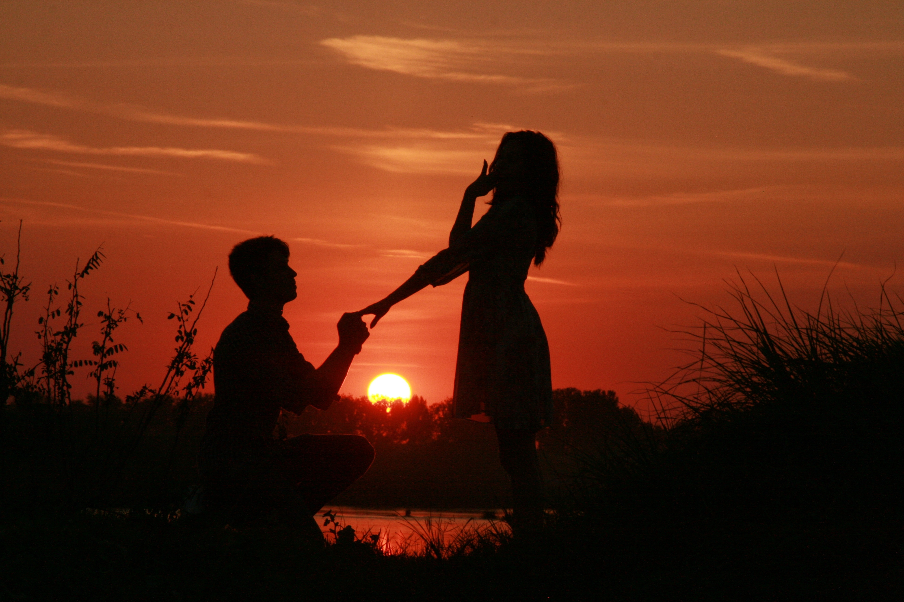
Is your prayer intended to be
a declaration of adoration?

Slide 23
John 17:1
Jesus spoke these words, lifted up His eyes to heaven, and said: "Father, the hour has come. Glorify Your Son, that Your Son also may glorify You,

Slide 27
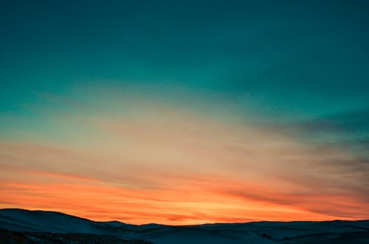
It really comes down to what one’s intentions are.

Slide 28
Prayer can be an expression of dependency
Prayer can be an expression of worship
Prayer can be an expression of surrender
Prayer can be an expression of humility
Prayer can be just a casual conversation and exchange of thoughts…

Slide 30
Others are watching!

