Slide 1
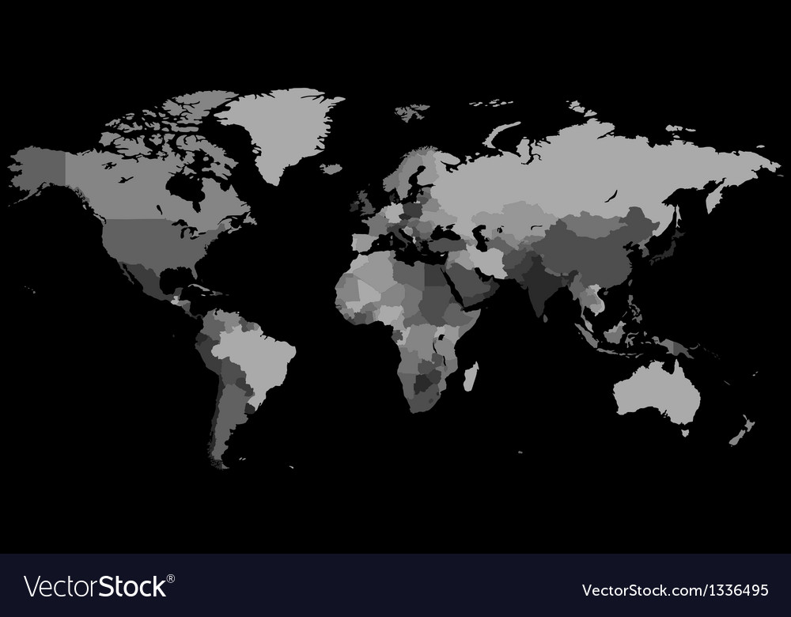
THE HOUR IS COMING
Matthew 10:16-26

Slide 2
Why are Americans so angry with each other?
The United States is caught in a partisan hyperconflict that divides
politicians, communities—and even
families. Politicians from the
president to state and local office-
holders play to strongly-held beliefs and sometimes even pour fuel on the resulting inferno. This polarization has become so intense that many people no longer trust anyone from a differing perspective.

Slide 3
The devil’s agenda is to create division!

Slide 4
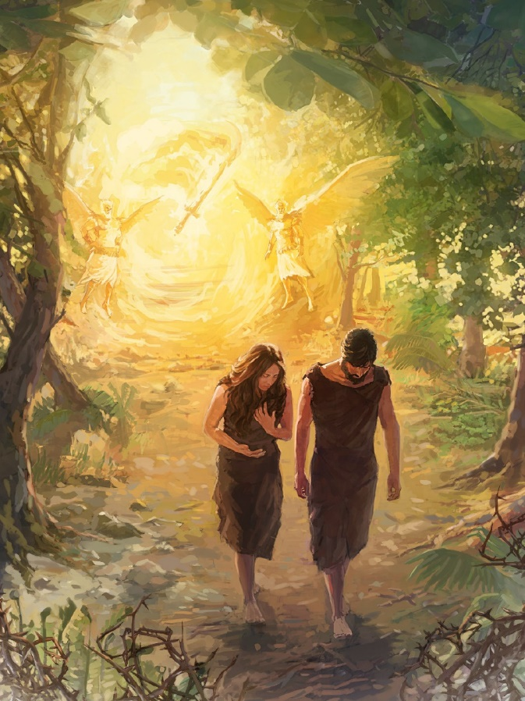
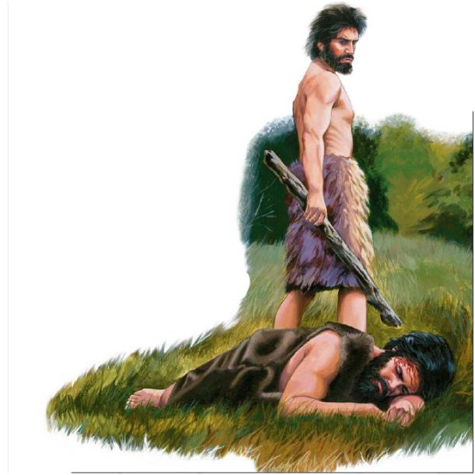
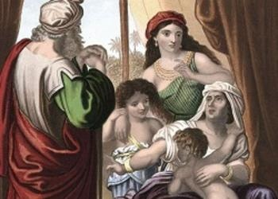
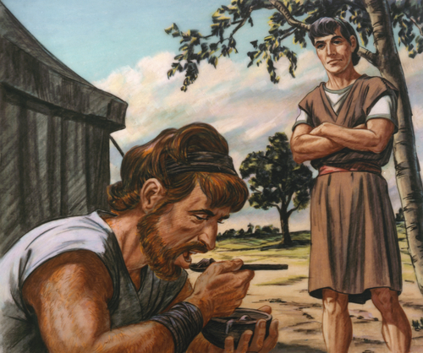
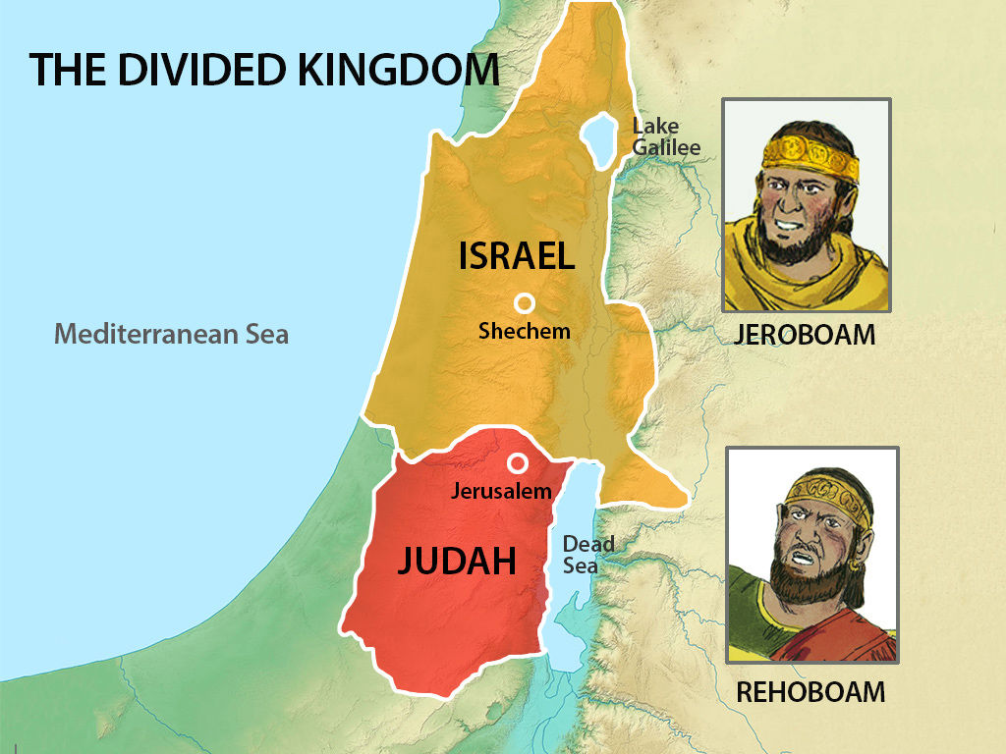
Adam & Eve
Cain
and
Able
Ishmael & Isaac
Jacob & Esau

Slide 5
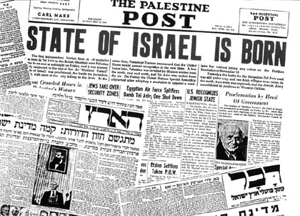

Slide 7
⁴²All the believers devoted themselves to the apostles’ teaching, and to fellowship, and to sharing in meals (including the Lord’s Supper), and to prayer. ⁴³A deep sense of awe came over them all, and the apostles performed many miraculous signs and wonders.
^{Acts 2:42-47 (NLT2)}

Slide 8
⁴⁴And all the believers met together in one place and shared everything they had. ⁴⁵ They sold their property and possessions and shared the money with those in need. ⁴⁶ They worshiped together at the Temple each day, met in homes for the Lord’s Supper,
^{Acts 2:42-47 (NLT2)}

Slide 9
and shared their meals with great joy and generosity— ⁴⁷ all the while praising God and enjoying the goodwill of all the people. And each day the Lord added to their fellowship those who were being saved.
^{Acts 2:42-47 (NLT2)}

Slide 10
³² All the believers were united in heart and mind. And they felt that what they owned was not their own, so they shared everything they had. ³³ The apostles testified powerfully to the resurrection of the Lord Jesus, and God’s great blessing was upon them all.
^{Acts 4:32-35 (NLT2)}

Slide 11
³⁴ There were no needy people among them, because those who owned land or houses would sell them ³⁵ and bring the money to the apostles to give to those in need.
^{Acts 4:32-35 (NLT2)}

Slide 16
MORE IS CAUGHT THAN TAUGHT
Don’t just
give advice
Live it!

Slide 20
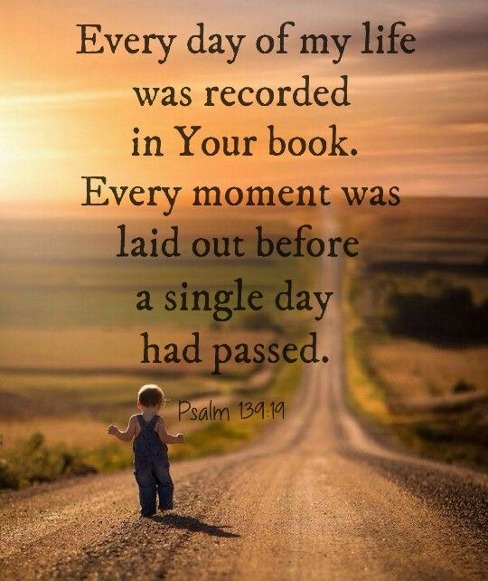

Slide 21
“The man of true faith may live in the absolute assurance that his steps are ordered by the Lord. For him accident is outside the bounds of possibility. He cannot be torn from this earth one hour ahead of the time which God has appointed, and he cannot be detained on earth one moment after God is done with him here.”

Slide 22
MATTHEW 10:24-25

Slide 23
They will deliver you up to tribulation and put you to death, and you will be hated by all nations for my name’s sake. And then many will fall away, betray one another and hate one another. Then many false prophets will rise up and lead many astray.
^{Matthew 24:9-14}

Slide 24
And because wickedness is multiplied, most men’s love will grow cold. But he who endures to the end will be saved. And this gospel of the kingdom will be preached throughout the whole world as a testimony to all nations, and then the end will come.
^{Matthew 24:9-14}

Slide 25
At that time shall arise Michael, the great prince who has charge of your people [the great angel who has charge over Israel and the affairs of God’s government] and there shall be a time of trouble, such as never has been since there was a nation till that time.
^{Daniel 12:1-4}

Slide 26
But at that time your people shall be delivered, every one whose name shall be found written in the book. And many of those who sleep in the dust of the earth shall awake, some to everlasting life and some to shame and everlasting contempt.
^{Daniel 12:1-4}

Slide 27
And those who are wise shall shine like the brightness of the firmament, and those who turn many to righteousness like the stars forever and ever. But you, Daniel, shut up the words, and seal the book until the time of the end; many shall run to and fro, and knowledge shall be increased.”
^{Daniel 12:1-4}

Slide 28
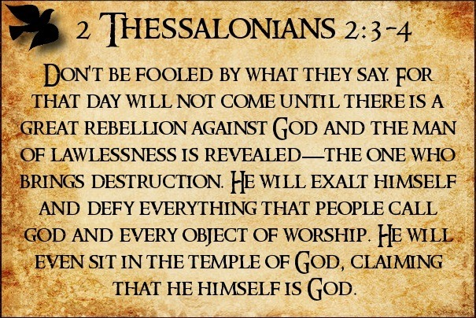

Slide 30
What am I to believe?

Slide 31
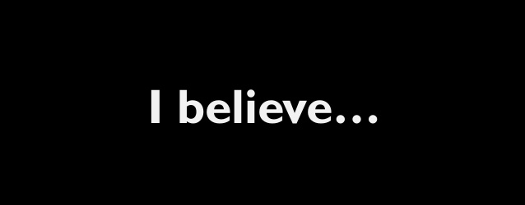
All authority comes from God!

Slide 32
God’s providence does not
Equal God’s approval.

Slide 33
John 19:6
No man takes my life, but I give it up freely
John 10:14

Slide 34
We were created for
such a season as this.

Slide 35
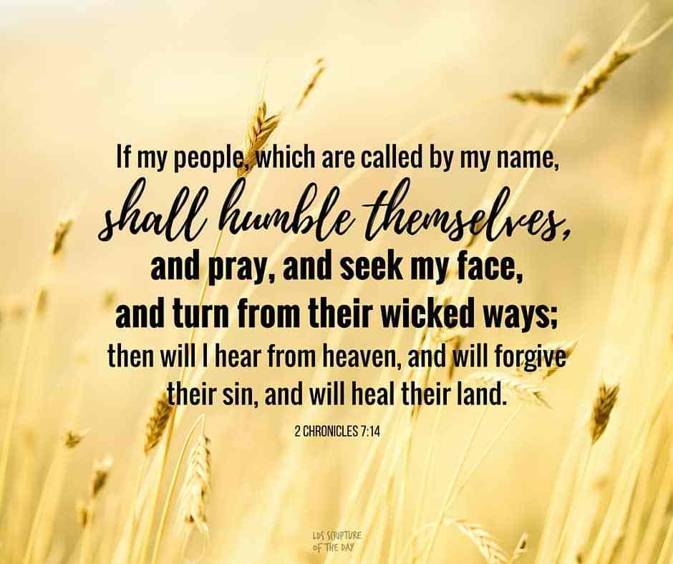

Slide 36
If we could just see the bigger picture!

Slide 37
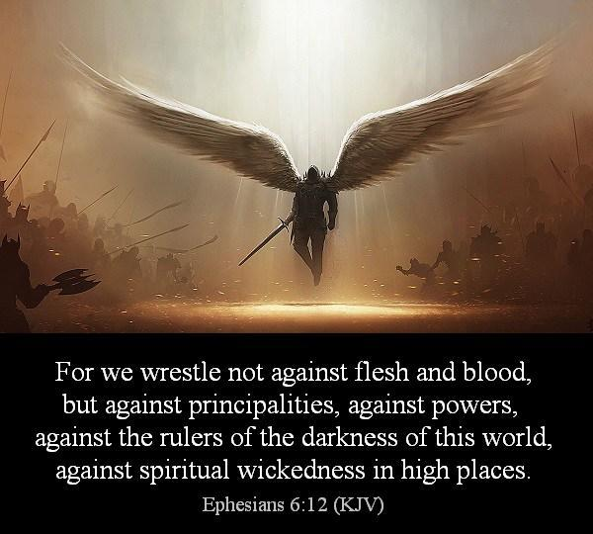

Slide 38
Focus as a family on what we each hold in common with God’s Word, and each other, and not on what we don’t. ^{John 17}
What Should Christian’s Do?

Slide 39
Strive for peace with all men, inasmuch as it is within your power to do so.
^{Rom. 12:8, Heb. 12:14}
What Should Christian’s Do?

Slide 40
Continue to do the good work God gives us to do. And know, that there is no greater work than evangelism.
What Should Christian’s Do?

Slide 41
Do not become weary in doing good.
Galatians 6:9
What Should Christian’s Do?

Slide 42
Avoid those who want to stir up dissension and are divisive.
Romans 16:17-18, 1 Cor. 1:10-13, Titus 3:9-11
What Should Christian’s Do?

Slide 43
Keep in mind who the real enemy of God is, and what the devil is seeking to do.
^{1 Peter 5:8}
What Should Christian’s Do?

Slide 44
Pray for the Holy Spirit’s help in the battle to stay faithful, fruitful and free from the entanglements of the flesh. ^{Hebrews 12:1}
What Should Christian’s Do?

