Slide 1
The Christ of God
Matthew 16:13-16, Mark 8:27-30, Luke 9:18-20

Slide 2
Matthew 16:16
“You are the Christ, the Son of the living God”

Slide 3
Mark 8:29
“You are the Christ”

Slide 4
Mark 8:20
He said to them,
"But who do you say that I am?"
Peter answered and said,
"The Christ of God."
“The Christ of God”

Slide 5
THE SON OF GOD
SON OF MAN
LORD

Slide 6
CHRIST

Slide 7
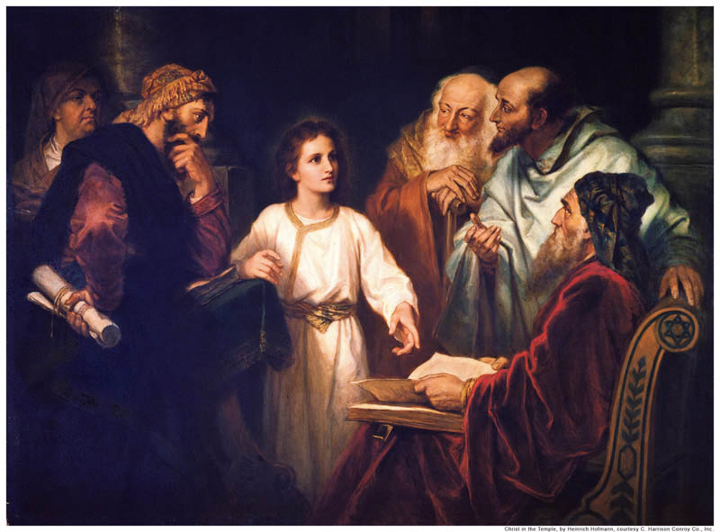
“Jesus Bar-Joseph”

Slide 8
CHRIST
is the supreme title!

Slide 9
“to anoint”

Slide 10
Daniel 9:25

Slide 11
CHRIST
“Jesus the Anointed One.”
a prophet, priest or king

Slide 12
A special anointing from God that set that person apart in a unique way, from anyone else, for a divine purpose.

Slide 13
While Peter and the other disciples recognized God’s special anointing of Jesus as a prophet, perhaps even the Messiah, but at first, they rejected
the “mission” of.

Slide 15
See also Mark 8:31-33

Slide 18
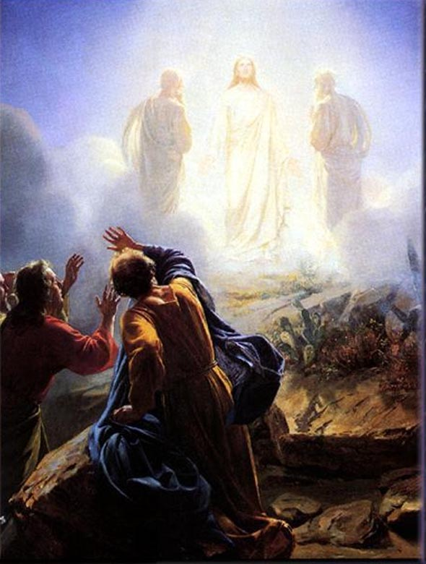
Matthew 17:1-3 (NKJV) ¹ Now after six days Jesus took Peter, James, and John his brother, led them up on a high mountain by themselves; ² and He was transfigured before them. His face shone like the sun, and His clothes became as white as the light. ³ And behold, Moses and Elijah appeared to them, talking with Him.

Slide 21
A great teacher, or even a prophet???

Slide 23
Listen
to Him!
Faith Frequency

Slide 24
BORN FROM ABOVE

Slide 29
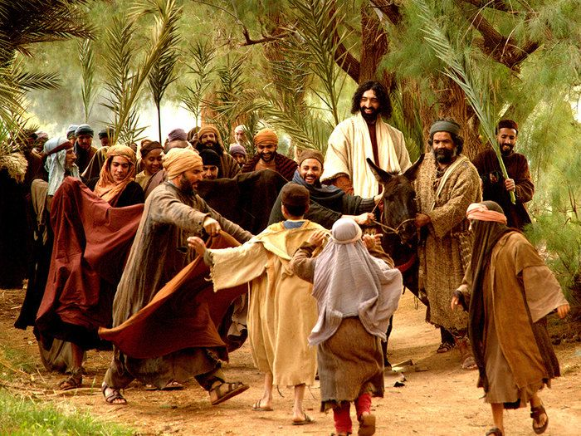

Slide 31
The Mission of the Christ of God
“HOSANNA” – PLEASE DELIVER US!

Slide 32
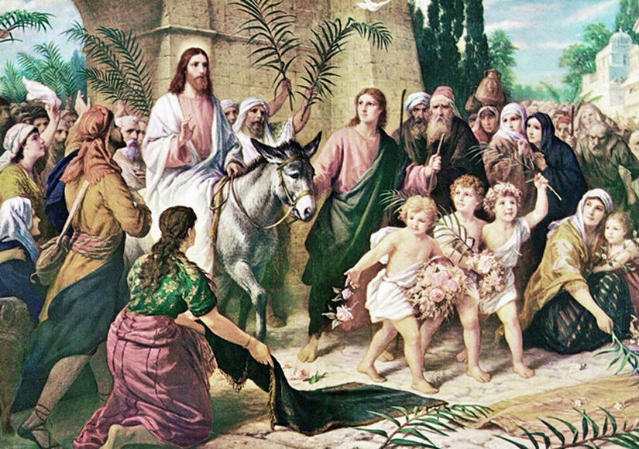
HOSANNA TO THE SON OF DAVID
MATTHEW 21:15

Slide 35
Gaither Vocal Band: It Is Finished
https://www.youtube.com/watch?v=TxaAmNuL7BU
Start at 3:39 mark

