Slide 1
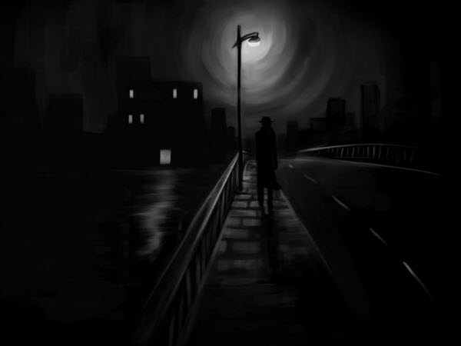
WALKING IN DARKNESS
Genesis 37:1-8

Slide 2
Genesis 37

Slide 5
Hatred in the heart is the moral equivalent of murderer

Slide 6
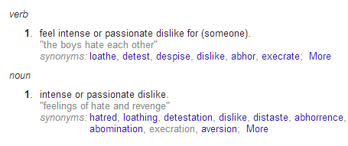
To hate is to walk in darkness…

Slide 7
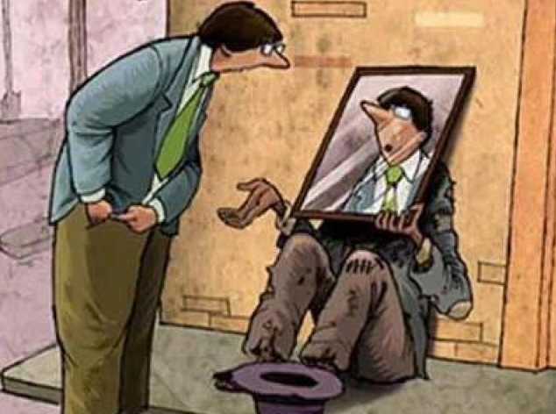
Loving others
is a mark of spiritual maturity.

Slide 8
Hating others
is an indicator of the absence of love
and spiritual emptiness.

Slide 9
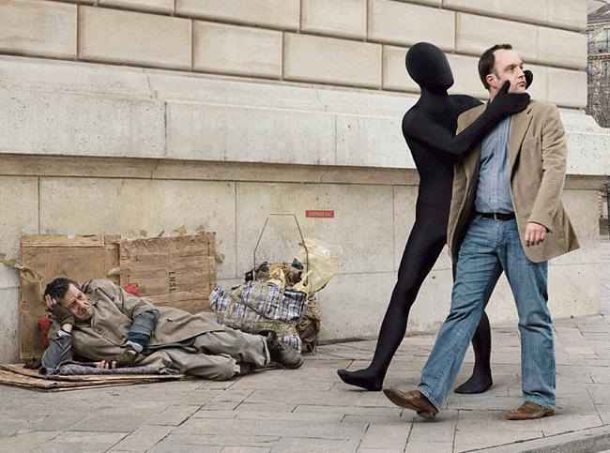
Acting like people don’t exist
is an expression of hate.

Slide 13
To
is to walk in the truth,
to walk in love,
to walk in obedience,
to walk with God

Slide 14
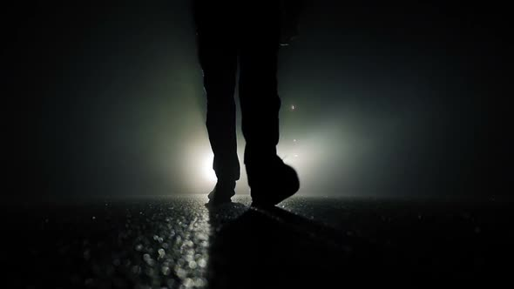
To walk in darkness is to walk in hate, to walk in disobedience.
To walk with the devil.

Slide 15
If anyone walks in darkness, he stumbles, because the light is not in him.
John 11:10

Slide 16
John 12:46
I have come into the world
as a light, so that no one who believes
In me should stay in darkness.

Slide 18
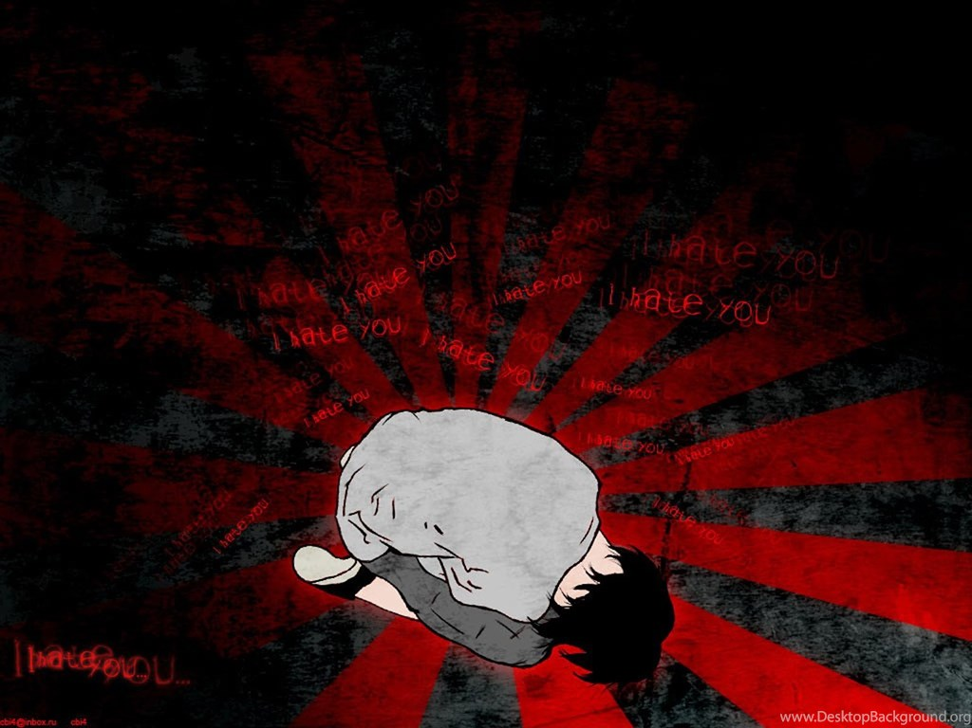
There’s no help for hate!

Slide 19
Quotes on Hate by…

Slide 20
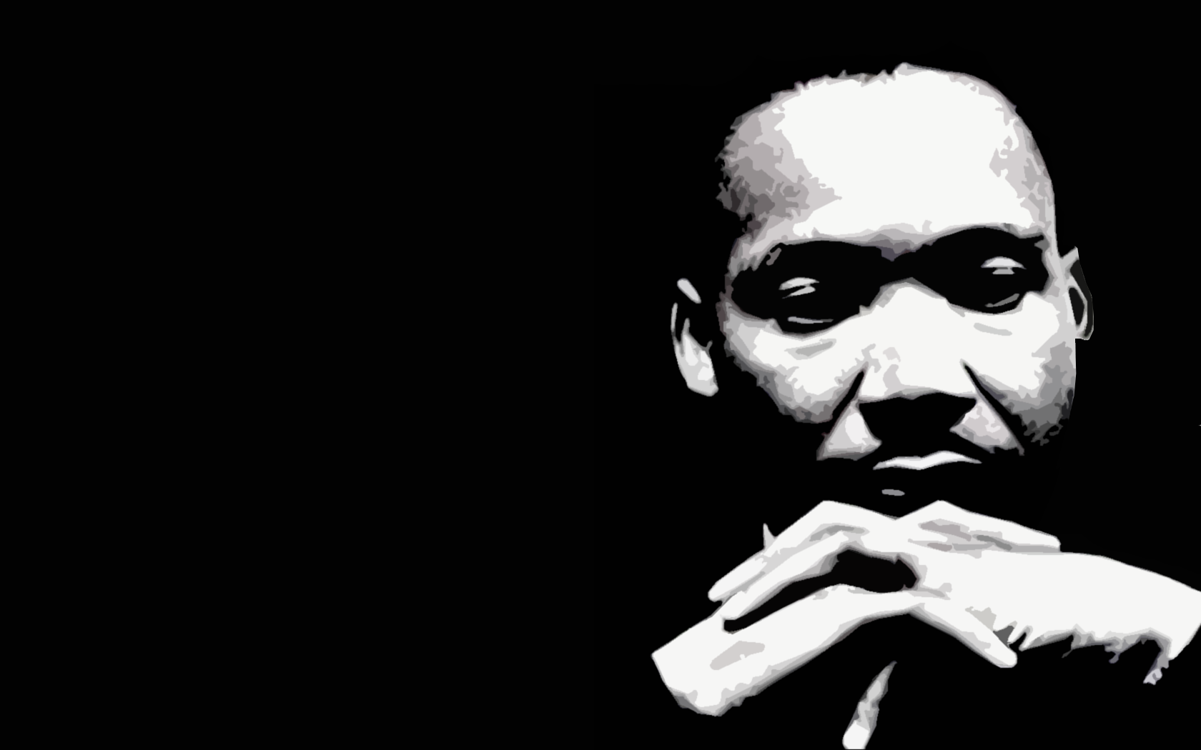
“Returning hate for hate multiplies hate, adding deeper darkness to a night already devoid of stars. Darkness cannot drive out darkness; only light can do that. Hate cannot
drive out hate; only love
can do that.”

Slide 21
“I’ve seen too much hate to want to hate, myself, and every time I see it, I say to myself, hate is too great a burden to bear.”

Slide 22
“Somehow we must be able to stand up against our most bitter opponents and say: “We shall match your capacity to inflict suffering by our capacity to endure suffering. We will meet your physical force with soul force. Do to us
what you will and we
will still love you…

Slide 23
But be assured that we’ll wear you down by our capacity to suffer, and one day we will win our freedom. We will not only win freedom for ourselves; we will appeal to your heart and conscience that
we will win you in the
process, and our victory
will be a double victory.”

Slide 24
“I have decided to stick with love…
hate’s too great a burden to bear.”
“Every genuine expression of love grows out of a consistent and total surrender to God.”

Slide 26
“Nonviolence means avoiding not only external physical violence but also internal violence of spirit. You not only refuse to shoot a man, but you refuse to hate him.”

Slide 27
Our response must not include hate!

Slide 28
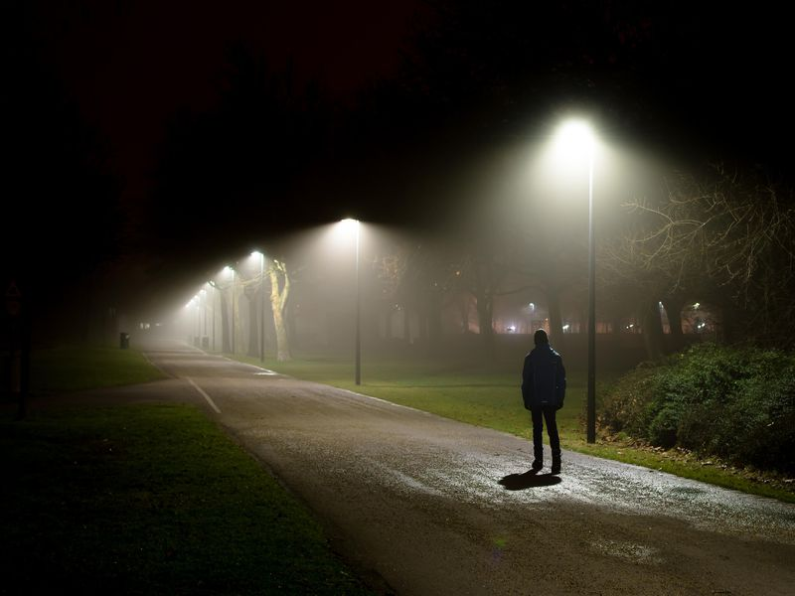
You avoid walking in darkness by making sure you have the light.

Slide 29
You avoid walking in darkness by making sure you have the light.
Jesus is the light and we are walking in the light of His truth. In obedience to the
truth.
^{(John 8:12, 12:35-36)}

Slide 30
You avoid walking in darkness by
not letting hurt fester in your life.

Slide 31
You avoid walking in darkness by
not letting hurt fester in your life.
You ask God for help to forgive and to let go of the pain. life.

Slide 32
You avoid walking in darkness by loving others as Christ loved you!.
He love you sacrificially.

Slide 33
You avoid walking in darkness by walking in the light!.
The light of His love.
The light of His Word
The light of His
PROMISES!

Slide 34
We
by turning the
other cheek.

Slide 36
Psychologists tell us that violence is born of weakness, not strength. It is the strong man who can love and suffer hurt it is the weak man who thinks only of himself and hurts others to protect himself. He hurts others and
then runs away to protect
himself.
The Warren Wiersby Commentary
on the New Testament, pg. 21

Slide 38
We
by not returning
evil for evil.

Slide 39
Jesus and Joseph both gave
A
EXPLANATION

Slide 40
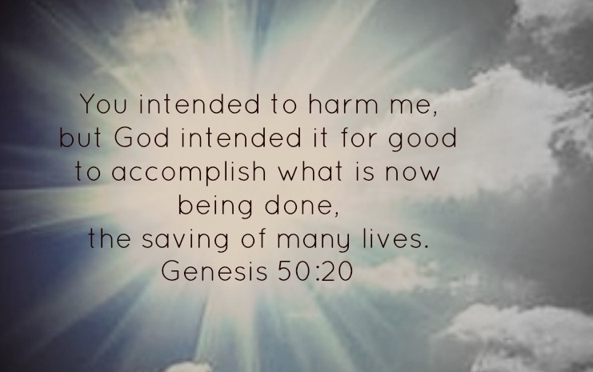

Slide 41
That’s a generous explanation!

Slide 42
A GRACIOUS EXPLANATION

Slide 43
When we are
ing
We overcome evil
by doing good!

Slide 44
We
By obeying His
Commands
By loving others.
By living the truth
By observing His supper

