Slide 1
1 Peter 4:7-11 and James 5:7-20

Slide 2
James 1:2 (KJV) My brethren, count it all joy when ye fall into divers temptations;
1 Peter 1:22 (KJV) Seeing ye have purified your souls in obeying the truth through the Spirit unto unfeigned love of the brethren, see that ye love one another with a pure heart fervently:

Slide 3
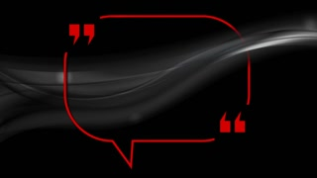
“Brothers” who love other brothers do things for “one another”.

Slide 4
James 1:1 (NLT)
This letter is from James, a slave of God and of the Lord Jesus Christ. I am writing to the “twelve tribes”—Jewish believers scattered abroad. Greetings!
1 Peter 1:1 (NLT)
This letter is from Peter, an apostle of Jesus Christ. I am writing to God’s chosen people who are living as foreigners in the provinces of Pontus, Galatia, Cappadocia, Asia, and Bithynia.

Slide 5
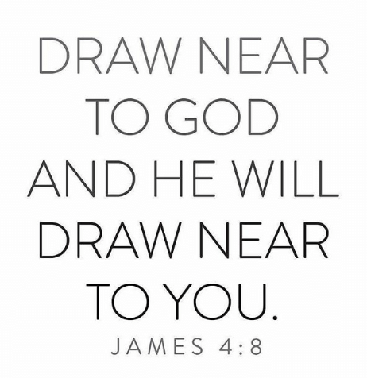

Slide 7
For the love of Christ!

Slide 8
^{4:1} Therefore, since Christ suffered for us in the flesh, arm yourselves also with the same mind,
James 5:8
James 5:20

Slide 9
WHAT DOES “FERVENT LOVE” LOOK LIKE?
PETER 4:7-11
1 Will cover a multitude of sins.
2. Will be hospitable to others.
3. Will minister to one another.
JAMES 5:7-20
1. Will not grumble against one another.
2. Prays for and sings with others.
3. Seeks to restore a wandering brother and cover a multitude of sins.

Slide 10
James 5:7-9 (NKJV)
⁷ Therefore be patient, brethren, until the coming of the Lord. See how the farmer waits for the precious fruit of the earth, waiting patiently for it until it receives the early and latter rain. ⁸ You also be patient. Establish your hearts, for the coming of the Lord is at hand. ⁹ Do not grumble against one another, brethren, lest you be condemned.
Behold, the Judge is standing at the door!

Slide 11
James 5:13-18 (NKJV)
¹³ Is anyone among you suffering? Let him pray. Is anyone cheerful? Let him sing psalms. ¹⁴ Is anyone among you sick? Let him call for the elders of the church, and let them pray over him, anointing him with oil in the name of the Lord. ¹⁵ And the prayer of faith will save the sick, and the Lord will raise him up. And if he has committed sins, he will be forgiven. ¹⁶ Confess your trespasses to one another, and pray for one another, that you may be healed. The effective, fervent prayer of a righteous man avails much. ¹⁷ Elijah was a man with a nature like ours, and he prayed earnestly that it would not rain; and it did not rain on the land for three years and six months. ¹⁸ And he prayed again, and the heaven gave rain, and the earth produced its fruit.

Slide 12
James 5:19-20 (NKJV)
¹⁹ Brethren, if anyone among you wanders from the truth, and someone turns him back, ²⁰ let him know that he who turns a sinner from the error of his way will save a soul from death and cover a multitude of sins.

Slide 13
WHAT JAMES AND PETER
ARE NOT SAYING.

Slide 14
Psalm 103:12 (NKJV) ¹² As far as the east is from the west, So far has He removed our transgressions from us.
Micah 7:19 (NKJV) ¹⁹ He will again have compassion on us, And will subdue our iniquities. You will cast all our sins Into the depths of the sea.

Slide 15
The Believers
LOVE
Badge

Slide 16
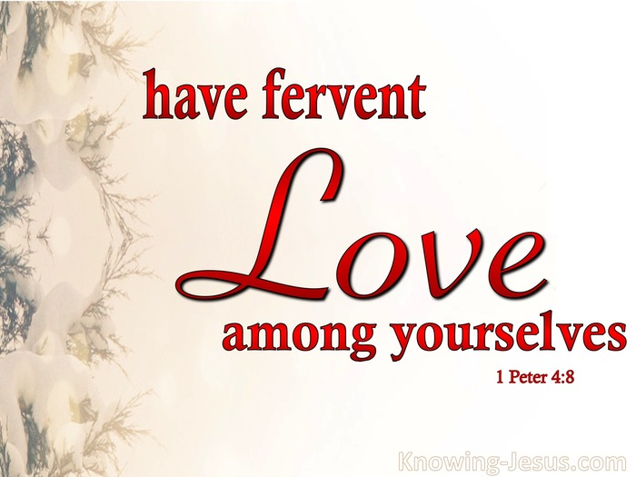

Slide 19
James 5:19-20 (NKJV)
¹⁹ Brethren, if anyone among you wanders from the truth, and someone turns him back, ²⁰ let him know that he who turns a sinner from the error of his way will save a soul from death and cover a multitude of sins.

Slide 20
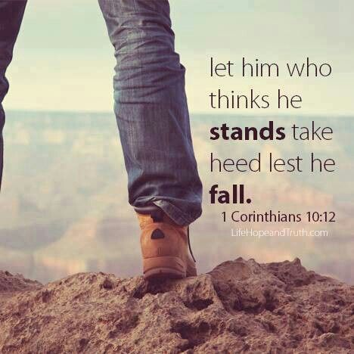

Slide 23
Don‘t Misunderstand What
James and Peter are Saying.

Slide 24
Don‘t Misunderstand What
James and Peter are Saying.
Sin is Sin
James 4:17 (NKJV) ¹⁷ Therefore, to him who knows to do good and does not do it, to him it is sin.

Slide 25
Don‘t Misunderstand What
James and Peter are Saying.

Slide 26
APPLICATION

Slide 28
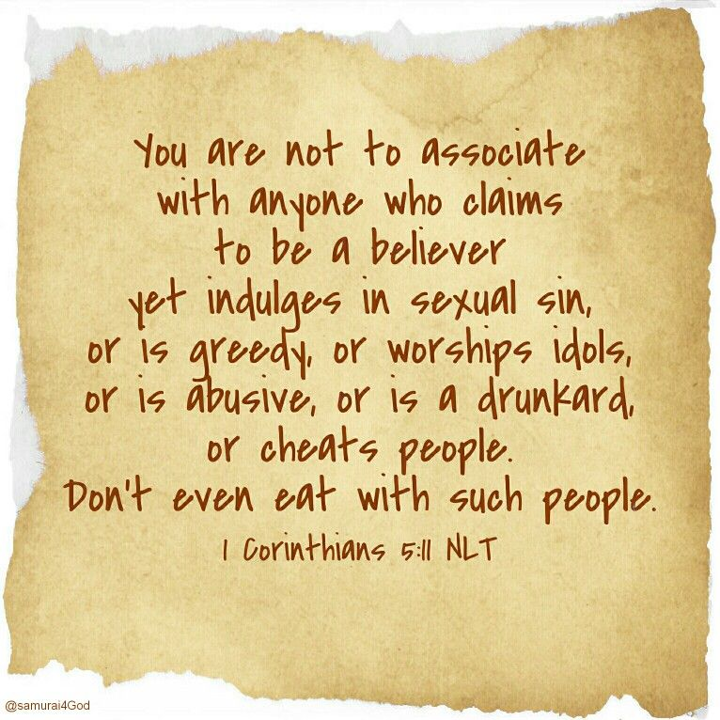

Slide 31
Isaiah 59:2

Slide 33
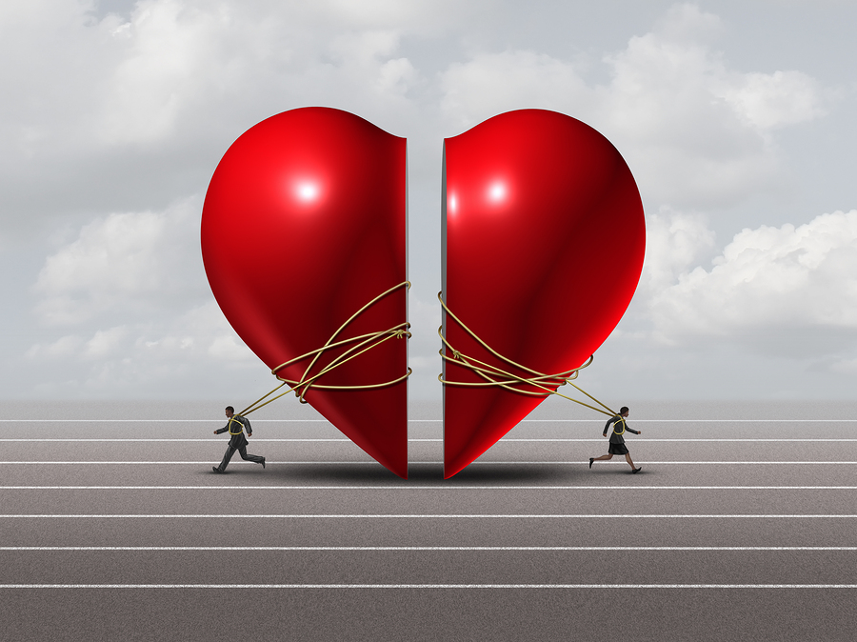
UNHEALTHY RELATIONSHIPS

Slide 34
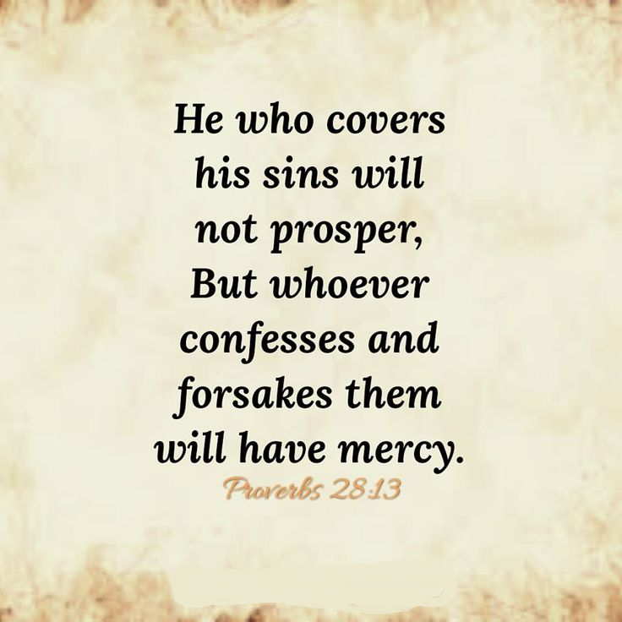

Slide 35
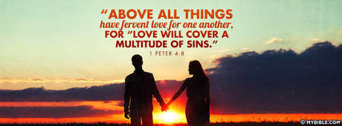
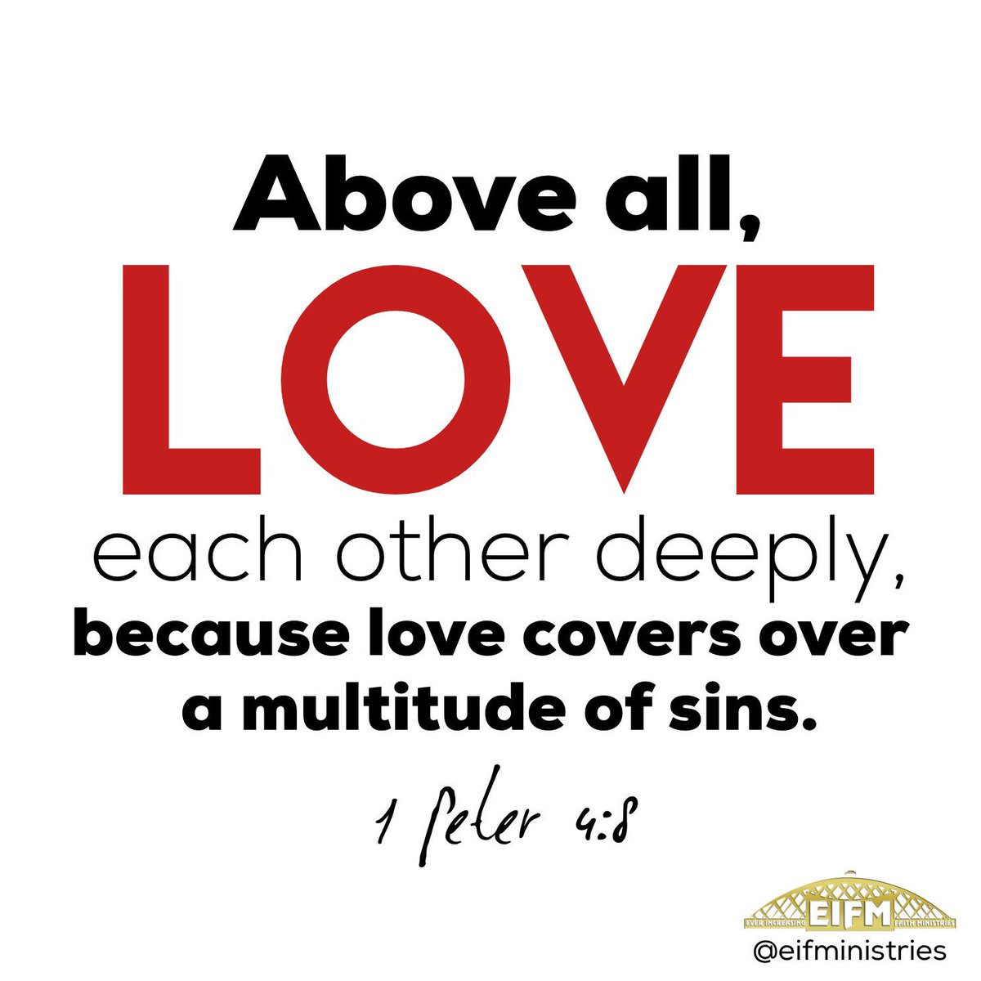
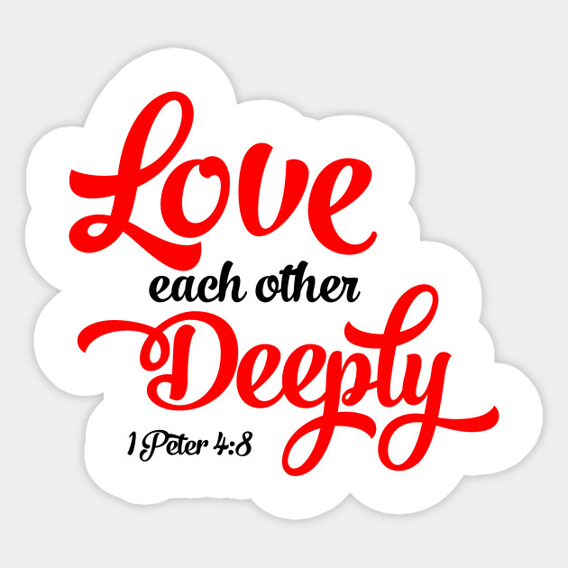

Slide 36
Confronting someone and/or implementing tough consequences should never be done to scold, shame, condemn, or punish.

Slide 37
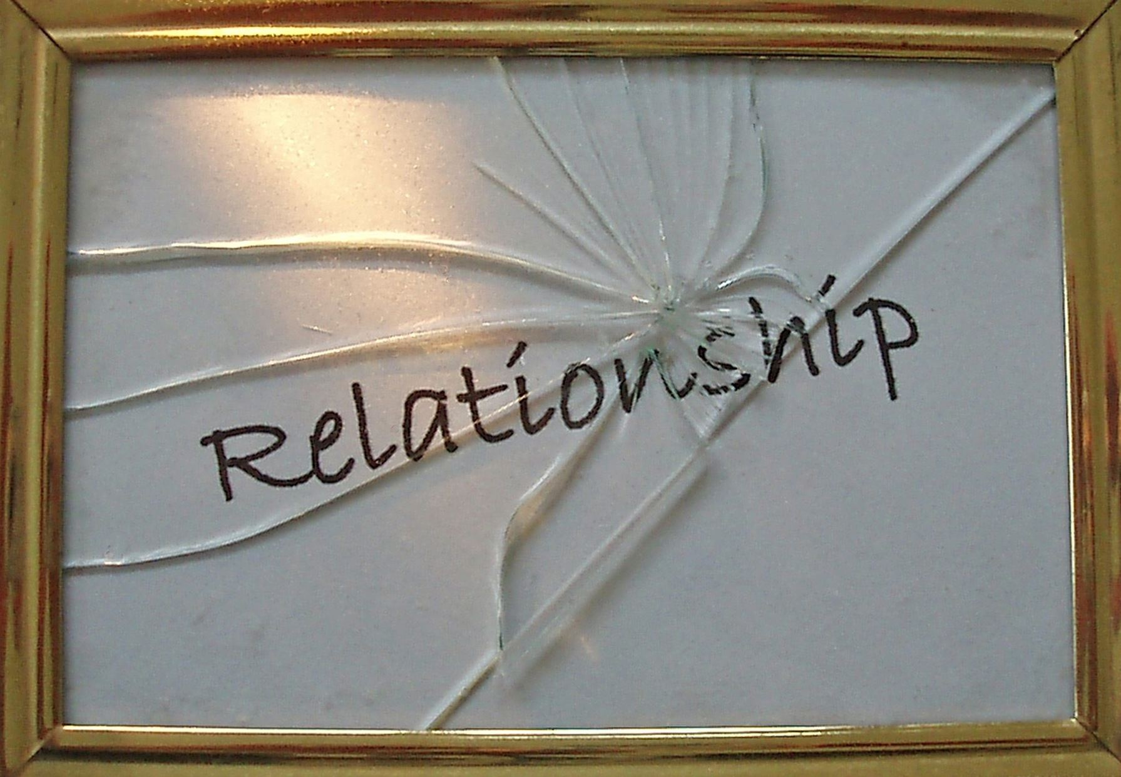
As Christian’s our goal
is to restore relationships

Slide 38
