Slide 1
Eternal Principles

Slide 2
⁶ Yet when I am among mature believers,
I do speak with words of wisdom, but not the kind of wisdom that belongs to this world or to the rulers of this world, who are soon forgotten. ⁷ No, the wisdom we speak of is the mystery of God—His plan that was previously hidden, even though he made it for our ultimate glory before the world began.
1 Corinthians 2:6-16 (NLT)

Slide 3
⁸ But the rulers of this world have not understood it; if they had, they would not have crucified our glorious Lord. ⁹ That is what the Scriptures mean when they say, “No eye has seen, no ear has heard, and no mind has imagined what God has prepared for those who love him.” ¹⁰ But it was to us that God revealed these things by his Spirit.
1 Corinthians 2:6-16 (NLT)

Slide 4
For his Spirit searches out everything and shows us God’s deep secrets. ¹¹ No one can know a person’s thoughts except that person’s own spirit, and no one can know God’s thoughts except God’s own Spirit. ¹² And we have received God’s Spirit (not the world’s spirit), so we can know the wonderful things God has freely given us.
1 Corinthians 2:6-16 (NLT)

Slide 5
¹³ When we tell you these things, we do not use words that come from human wisdom. Instead, we speak words given to us by the Spirit, using the Spirit’s words to explain spiritual truths. ¹⁴ But people who aren’t spiritual can’t receive these truths from God’s Spirit.
1 Corinthians 2:6-16 (NLT)

Slide 6
It all sounds foolish to them and they can’t understand it, for only those who are spiritual can understand what the Spirit means. ¹⁵ Those who are spiritual can evaluate all things, but they themselves cannot be evaluated by others.
1 Corinthians 2:6-16 (NLT)

Slide 7
¹⁶ For, “Who can know the LORD’s thoughts? Who knows enough to teach him?” But we understand these things,
for we have the mind of Christ.
1 Corinthians 2:6-16 (NLT)

Slide 8
2 Corinthians 4:18

Slide 9
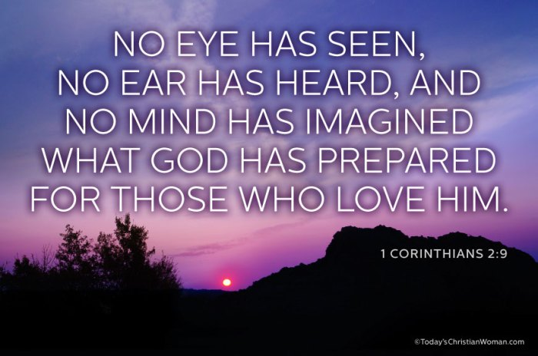

Slide 10
Eternal principles to live by

Slide 11
Good
Overcomes
Evil

Slide 12
Matthew 16:18, Mark. 4:41, 18:18,
Luke 10:19, 11:22; John 1:5, 16:25
GOOD OVERCOMES EVIL

Slide 13
King James
Be not overcome of evil,
but overcome evil with good.
New King James Do not be overcome by evil,
but overcome evil with good.
New Living Translation Don't let evil conquer you,
but conquer evil by doing good.
ROMANS 12:21

Slide 14
Today’s Living Bible
Don’t let evil get the upper hand, but conquer evil by doing good.
The Message 21 Don't let evil get the best of you; get the best of evil by doing good.
ROMANS 12:21

Slide 15
¹⁴ Bless those who persecute you; bless and do not curse. ¹⁵ Rejoice with those who rejoice, and weep with those who weep. ¹⁶ Be of the same mind toward one another. Do not set your mind on high things, but associate with the humble. Do not be wise in your own opinion.
ROMANS 12:14-21

Slide 16
¹⁷ Repay no one evil for evil. Have regard for good things in the sight of all men. ¹⁸ If it is possible, as much as depends on you, live peaceably with all men. ¹⁹ Beloved, do not avenge yourselves, but rather give place to wrath; for it is written, "Vengeance is Mine, I will repay," says the Lord.
ROMANS 12:14-21

Slide 17
²⁰ Therefore "If your enemy is hungry, feed him; If he is thirsty, give him a drink; For in so doing you will heap coals of fire on his head." ²¹ Do not be overcome by evil, but overcome evil with good.
ROMANS 12:14-21

Slide 18
You are the light of the world…
Let your light (your good works) so shine before men, that they may see your good works and glorify your Father in Heaven.
Matthew 5:14-16

Slide 19
⁴⁶ If you love only those who love you, what reward is there for that? Even corrupt tax collectors do that much. ⁴⁷ If you are kind only to your friends, how are you different from anyone else?
Even pagans do that.
Matthew 5:46-47

Slide 21
WE

Slide 22
IT
REQUIRES
FAITH

Slide 23
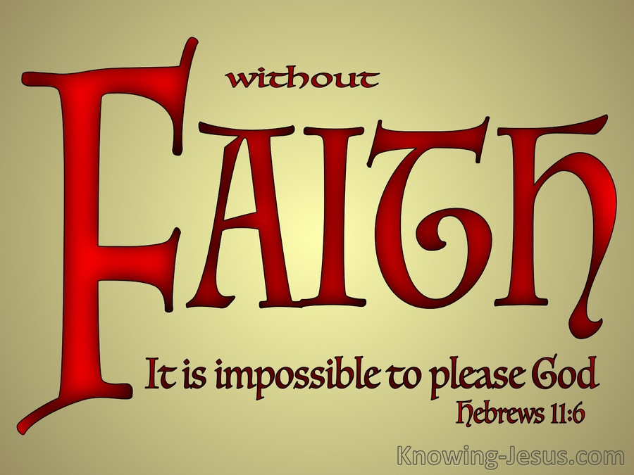

Slide 24
What is the most recent thing you have done by FAITH??

Slide 25
The most common
act of FAITH is…

Slide 27
LORD, I want to be a part of overcoming evil by doing good!

Slide 28
Jesus said,
IS GOOD
^{Mark 10:18}

Slide 29
Perhaps no truth is more powerful in the life of a follower of Jesus Christ then to believe this TRUTH…

Slide 30
James tells us that this world if full of moral filth and overflows with evil.

Slide 32
PRACTITIONERS OF

Slide 33
HOW TO ACT UPON

Slide 34
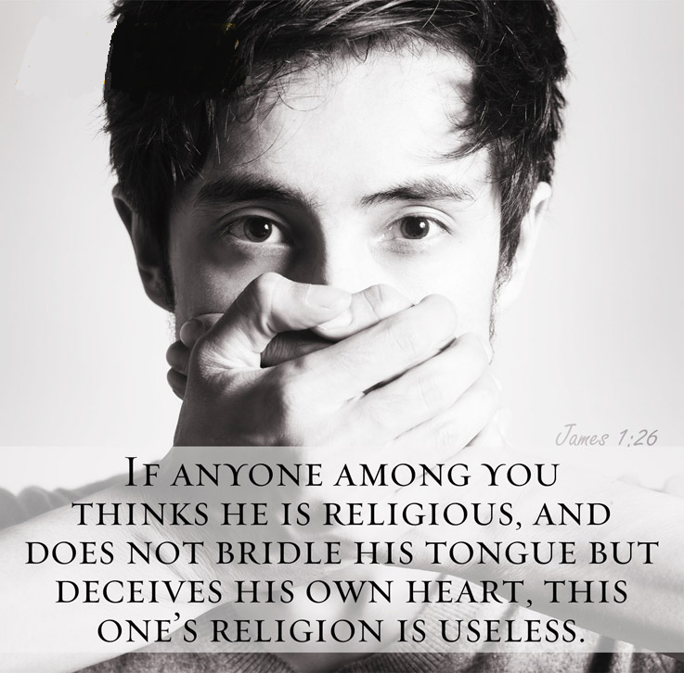

Slide 36
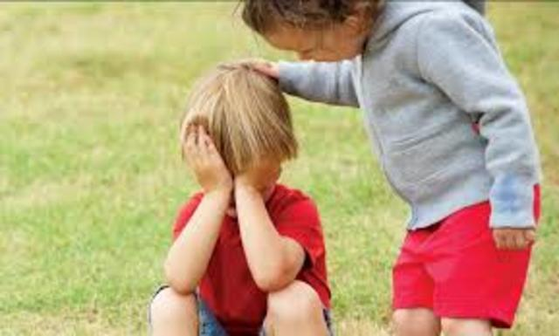
next
Concerned about others…

Slide 39
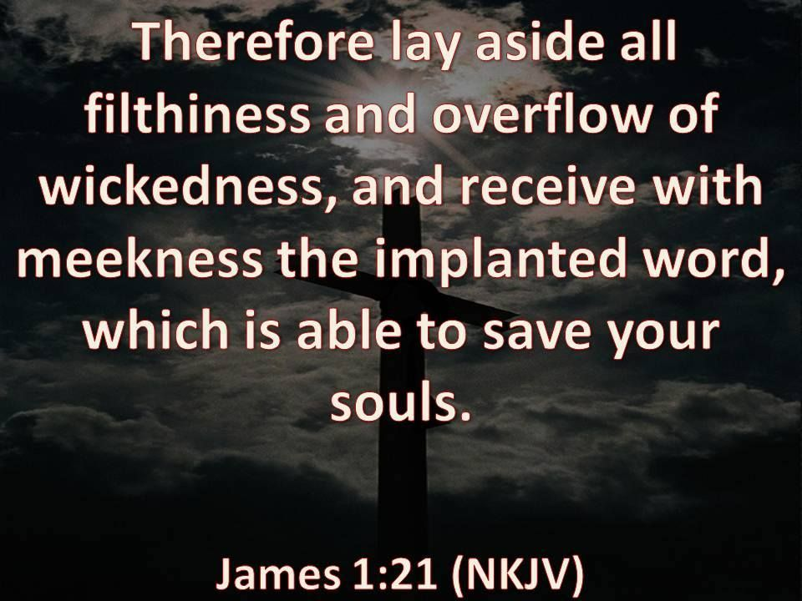

Slide 42
Pure religion will lead to a life of practical

Slide 44
1 How well God must like you— you don’t hang out at Sin Saloon, you don’t slink along Dead-End Road, you don’t go to Smart-Mouth College.²⁻³ Instead you thrill to God’s Word, you chew on Scripture day and night.
PSALM 1:1-3

Slide 45
You’re a tree replanted in Eden, bearing fresh fruit every month, Never dropping a leaf, always in blossom. ⁴⁻⁵ You’re not at all like the wicked, who are mere windblown dust—Without defense in court, unfit company for innocent people. ⁶ God charts the road you take. The road they take is Skid Row.
PSALM 1:1-3

Slide 46
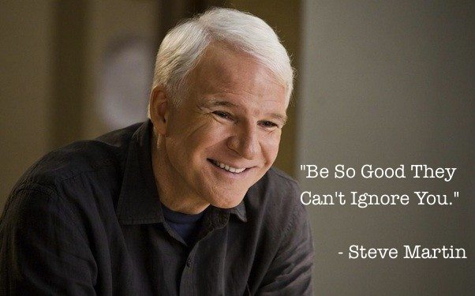

Slide 47
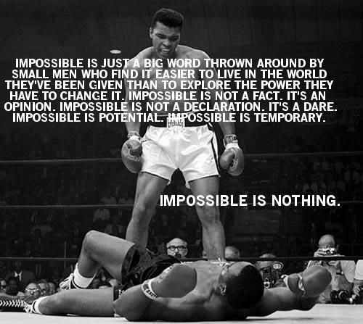

Slide 48
FOR THE LOVE OF CHRIST…

Slide 49
Don’t Just
Be Good,
Do Good!

