Slide 1
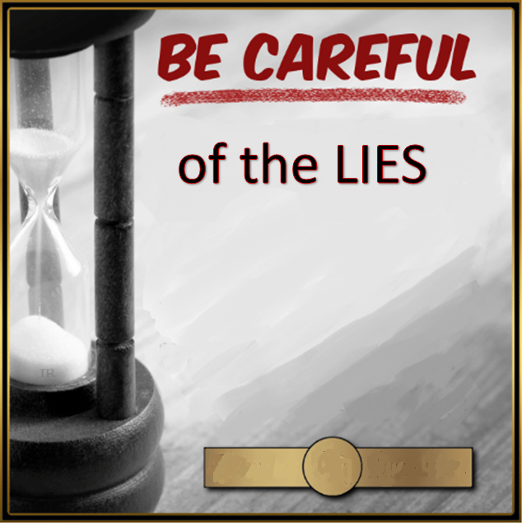
Who has bewitched you?
Who has cast a spell on you?
John
8
37-44

Slide 2
Galatians 2:14
The word Judaizer comes from a Greek verb meaning “to live according to Jewish customs, Jewish laws.”

Slide 3
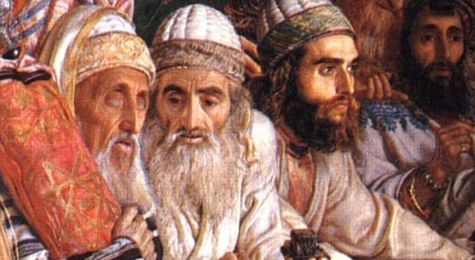
The Jewish religious leaders viewed God as a “legalist”, and in their effort to be like God, they became legalistic.

Slide 4
To be righteous in God’s eyes
To the 10 Commandments they added 613 commandments

Slide 5
(1) The devil lies to us about who God is.

Slide 6
The devil lies to us about who God is.
(2) He lies to us about who we are in God’s eyes

Slide 7
The devil lies to us about who God is.
(2) He lies to us about who we are in God’s eyes
(3) He lies about Heaven.

Slide 8
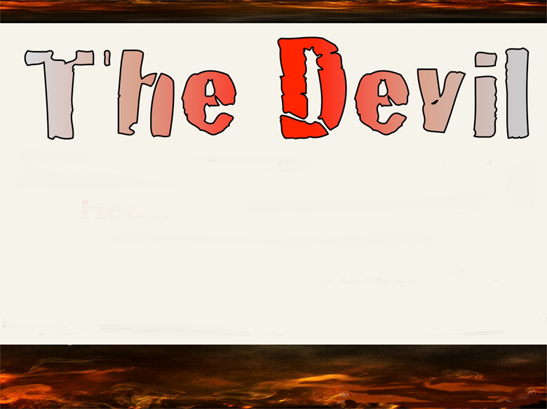
The Message
He was a killer from the very start. He couldn't stand the truth because there wasn't a shred of truth in him. When the Liar speaks, he makes it up out of his lying nature and fills the world with lies.
John 8:44

Slide 10
The Message
He was a killer from the very start. He couldn't stand the truth because there wasn't a shred of truth in him. When the Liar speaks, he makes it up out of his lying nature and fills the world with lies.
John 8:44

Slide 11
³ and he cast him into the bottomless pit, and shut him up, and set a seal on him, so that he should deceive the nations no more till the thousand years were finished. But after these things he must be released for a little while.
¹⁰ The thief does not come except to steal, and to kill, and to destroy. I have come that they may have life, and that they may have it more abundantly.
Revelation 20:3 & John 10:10 NKJV

Slide 12
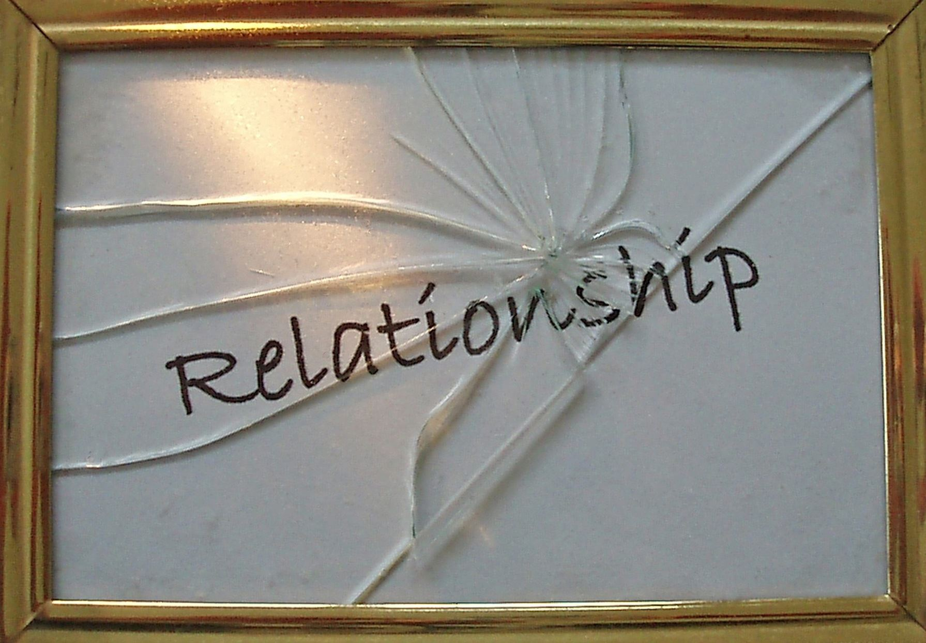
THE DEVIL IS ALL ABOUT RULES
Rules
Rules
Rules
Rules

Slide 15
He will distort our image of God,
He will distort our self-image, and
He will distort our image of Heaven.

Slide 16
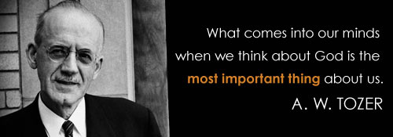

Slide 17
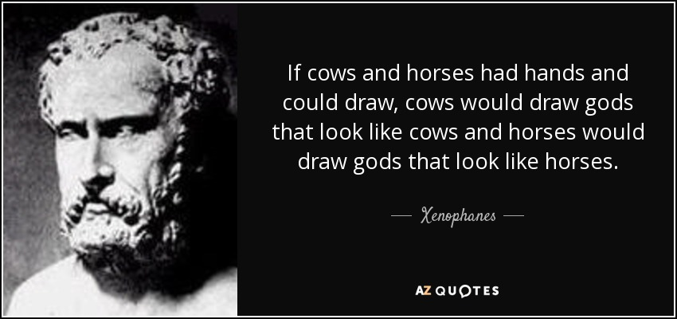
“Men always create gods in their own image.”

Slide 19
UNFORGIVING

Slide 21
God is unfair…
God doesn’t care,
God is nowhere near,

Slide 22
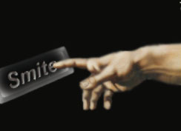
When we view God as a
cosmic killjoy
scorekeeper
unknowable

Slide 23
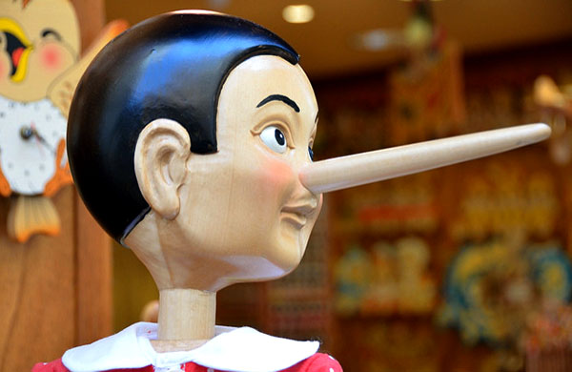
Be careful of the lies!

Slide 24
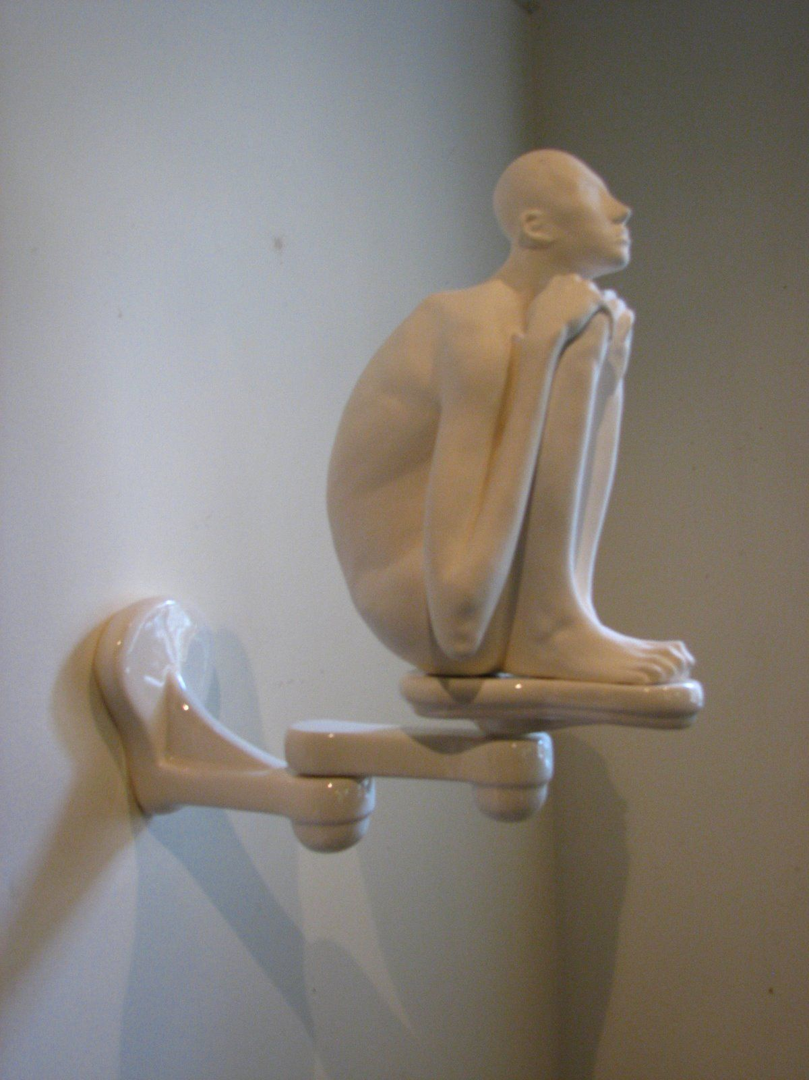
Distorts
our view
of Heaven

Slide 26
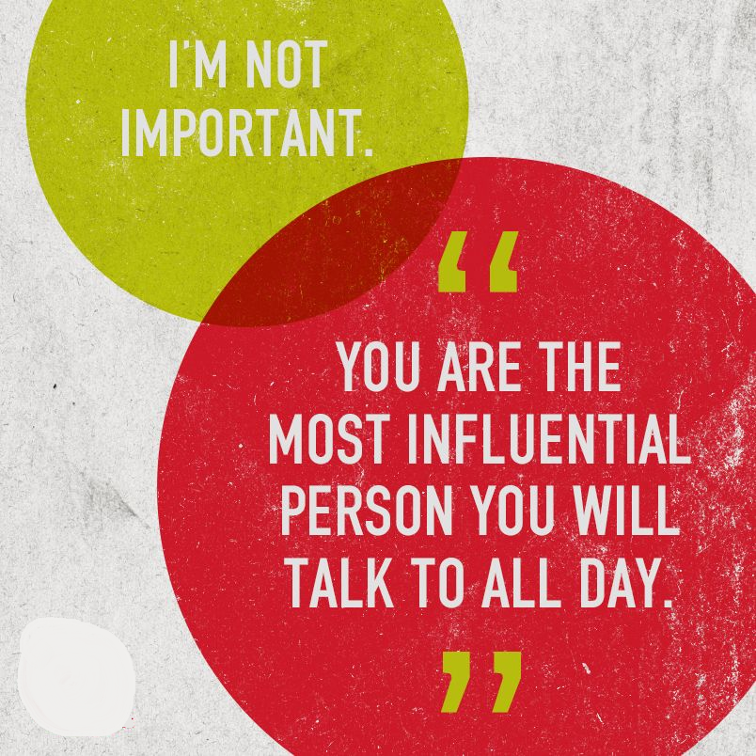
Be careful
what you say
to you!
ZIG ZIGLAR

Slide 27
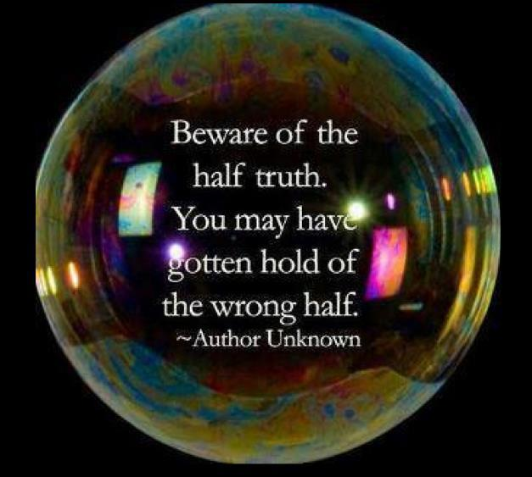

Slide 28
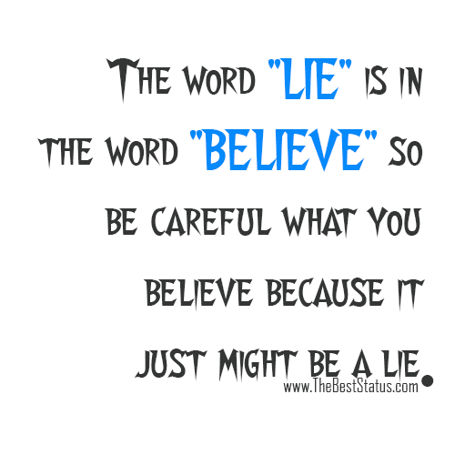

Slide 29
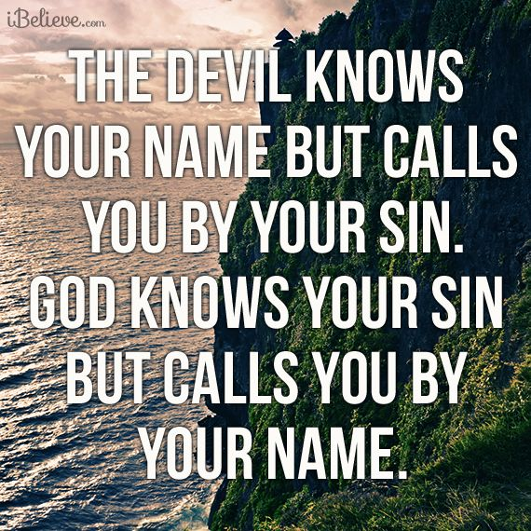

Slide 30
REGRET
DEFEAT

