Slide 1
Putting
Psalm 131:3

Slide 5
What might the
of
Spring up from?

Slide 6
rudeness
critical
animosity

Slide 7
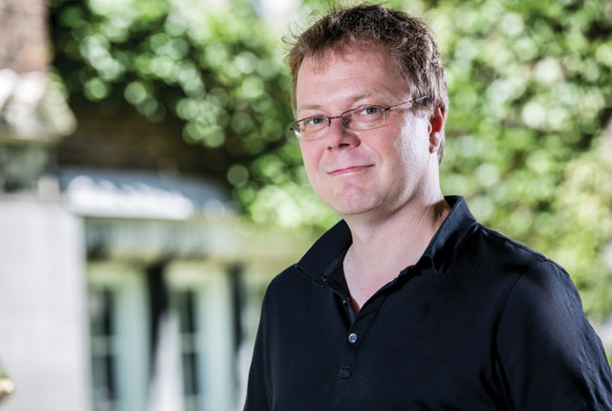
Carsten Wrosch, psychology professor and member of the Centre for Research on Human Development | Photo by Concordia University

Slide 12
"For if you forgive men their trespasses, your heavenly Father will also forgive you. ¹⁵ But if you do not forgive men their trespasses, neither will your Father forgive your trespasses.
Matthew 6:14-15

Slide 13
Take heed to yourselves. If your brother sins against you, rebuke him; and if he repents, forgive him. ⁴ And if he sins against you seven times in a day, and seven times in a day returns to you, saying, 'I repent,' you shall forgive him."
Luke 17:3-4

Slide 14
"And whenever you stand praying, if you have anything against anyone, forgive him, that your Father in heaven may also forgive you your trespasses.”
Mark 11:25

Slide 15
"Judge not, and you shall not be judged. Condemn not, and you shall not be condemned. Forgive, and you will be forgiven.”
Luke 6:37

Slide 16
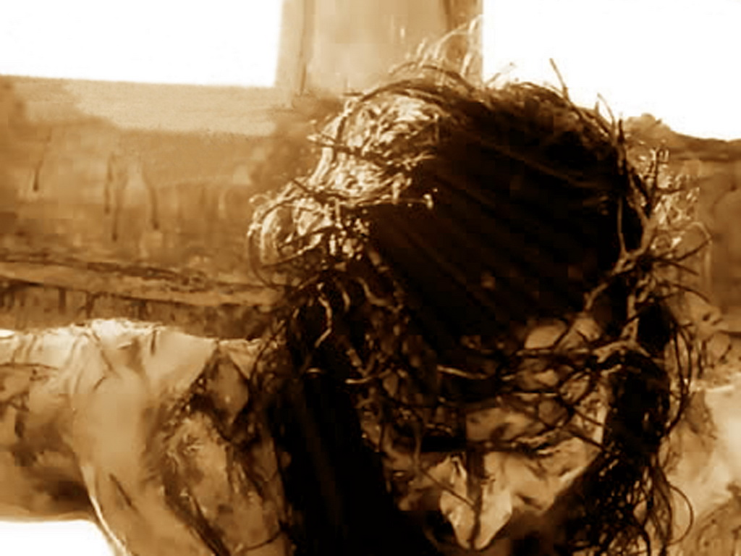
“Father, forgive them for they
know not what they do.”
Luke 22:24

Slide 17
Christ is the
And our hope is…
that the world will see Christ in us.

Slide 22
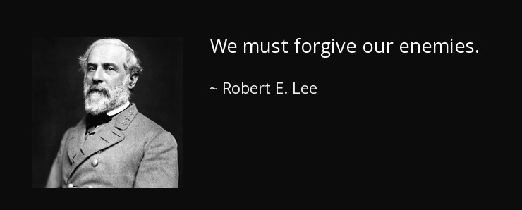
"Cut it down, my dear Madam, and forget it.”
It is better to forgive the injustices of the past than to allow them to remain, let bitterness take root and poison the rest of our life.
Robert E. Lee

