Slide 1
NEXT SUNDAY’S SERMON
WHAT MAKES A GOOD FATHER?
WHAT IS A GOOD FATHER LIKE?

Slide 2
of
RECONCILIATION
2 Samuel 2:12-17 / 2 Corinthians 5:14-21

Slide 3
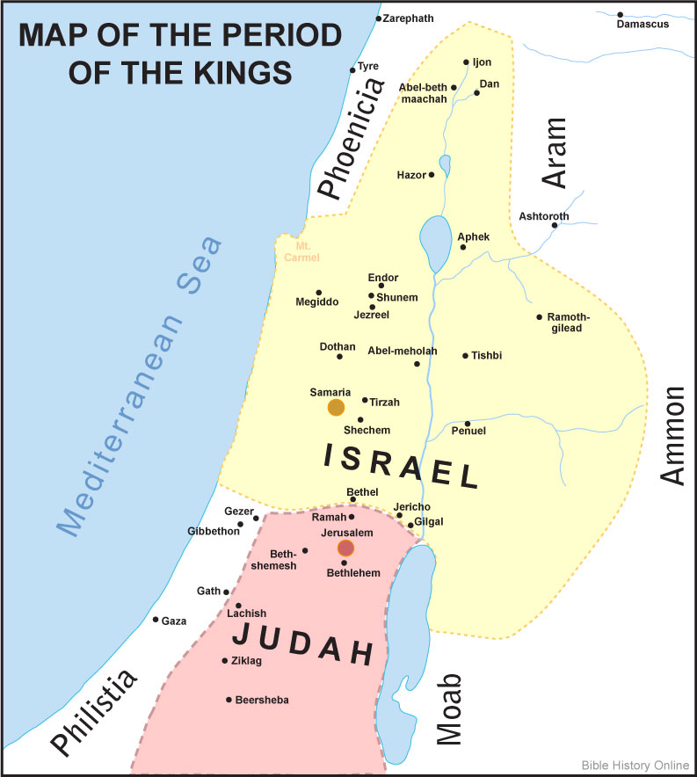
THE HOUSE OF
SAUL
VS
DAVID
THE HOUSE OF

Slide 4
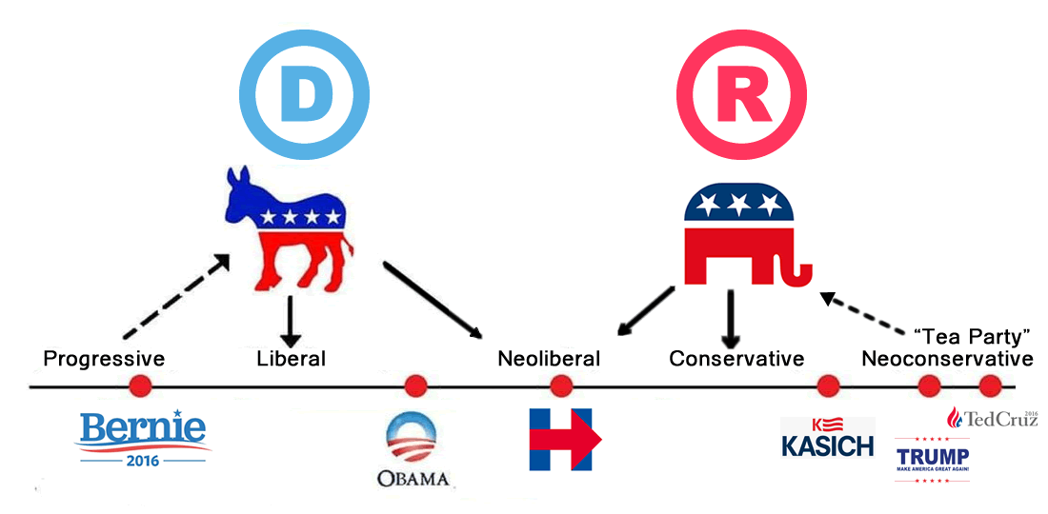

Slide 5
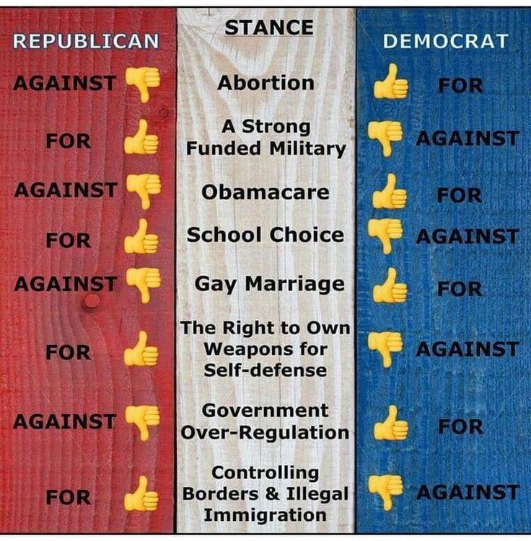
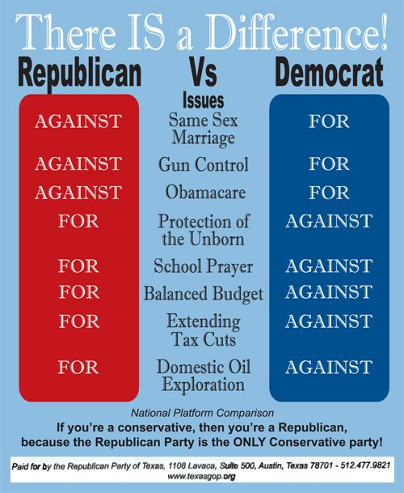

Slide 6
GAITHER VOCAL BAND
It Is Finished Lyrics
There is a line that is drawn thru the ages
On that line stands an old rugged cross
On that cross a battle is raging
To gain a mans soul or it’s loss
On one side march the forces of evil
All the demons all the devils of hell
On the other the angels of glory
And they meet on Golgotha’s hill

Slide 7
The American Civil War (1861–65)

Slide 10
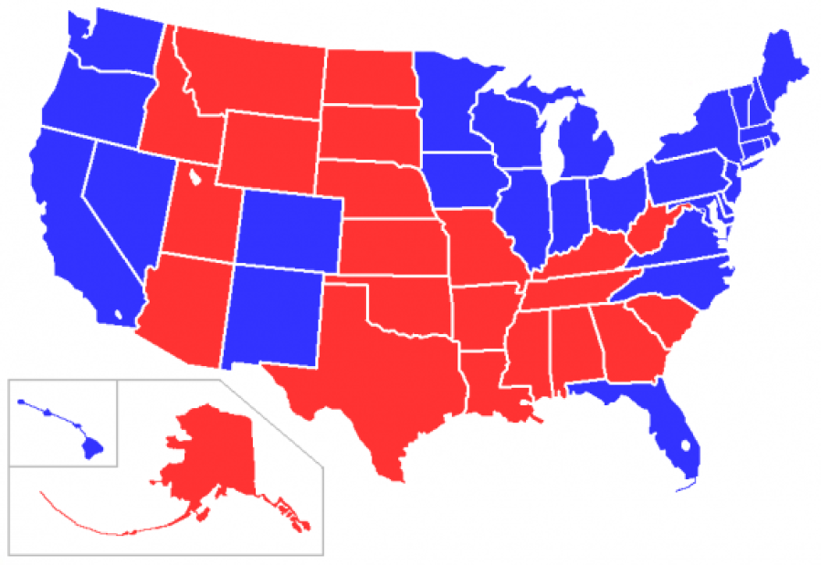

Slide 11
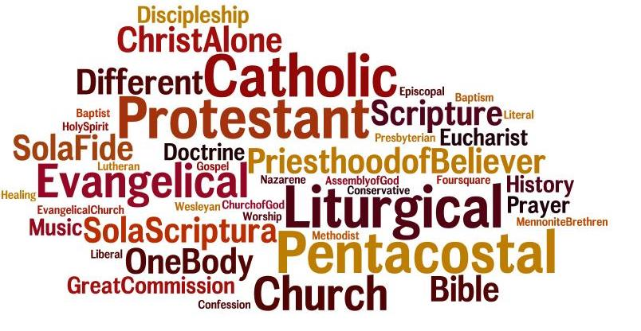
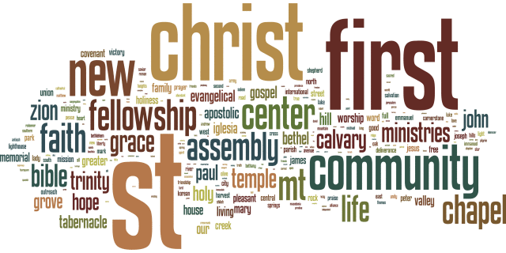
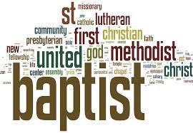

Slide 15
Are you a reconciler, a peacemaker,
a healer?
Or,
Are you an antagonizer, an agitator,
an aggravator?

Slide 17
¹⁴ For the love of Christ compels us, because we judge thus: that if One died for all, then all died; ¹⁵ and He died for all, that those who live should live no longer for themselves, but for Him who died for them and rose again.
2 Corinthians 5:14-21 (NKJV)

Slide 18
¹⁶ Therefore, from now on, we regard no one according to the flesh. Even though we have known Christ according to the flesh, yet now we know Him thus no longer. ¹⁷ Therefore, if anyone is in Christ, he is a new creation; old things have passed away; behold, all things have become new.
2 Corinthians 5:14-21 (NKJV)

Slide 19
¹⁸ Now all things are of God, who has reconciled us to Himself through Jesus Christ, and has given us the ministry of reconciliation, ¹⁹ that is, that God was in Christ reconciling the world to Himself, not imputing their trespasses to them, and has committed to us the word of reconciliation.
2 Corinthians 5:14-21 (NKJV)

Slide 20
²⁰ Now then, we are ambassadors for Christ, as though God were pleading through us: we implore you on Christ's behalf, be reconciled to God. ²¹ For He made Him who knew no sin to be sin for us, that we might become the righteousness of God in Him.
2 Corinthians 5:14-21 (NKJV)

Slide 21
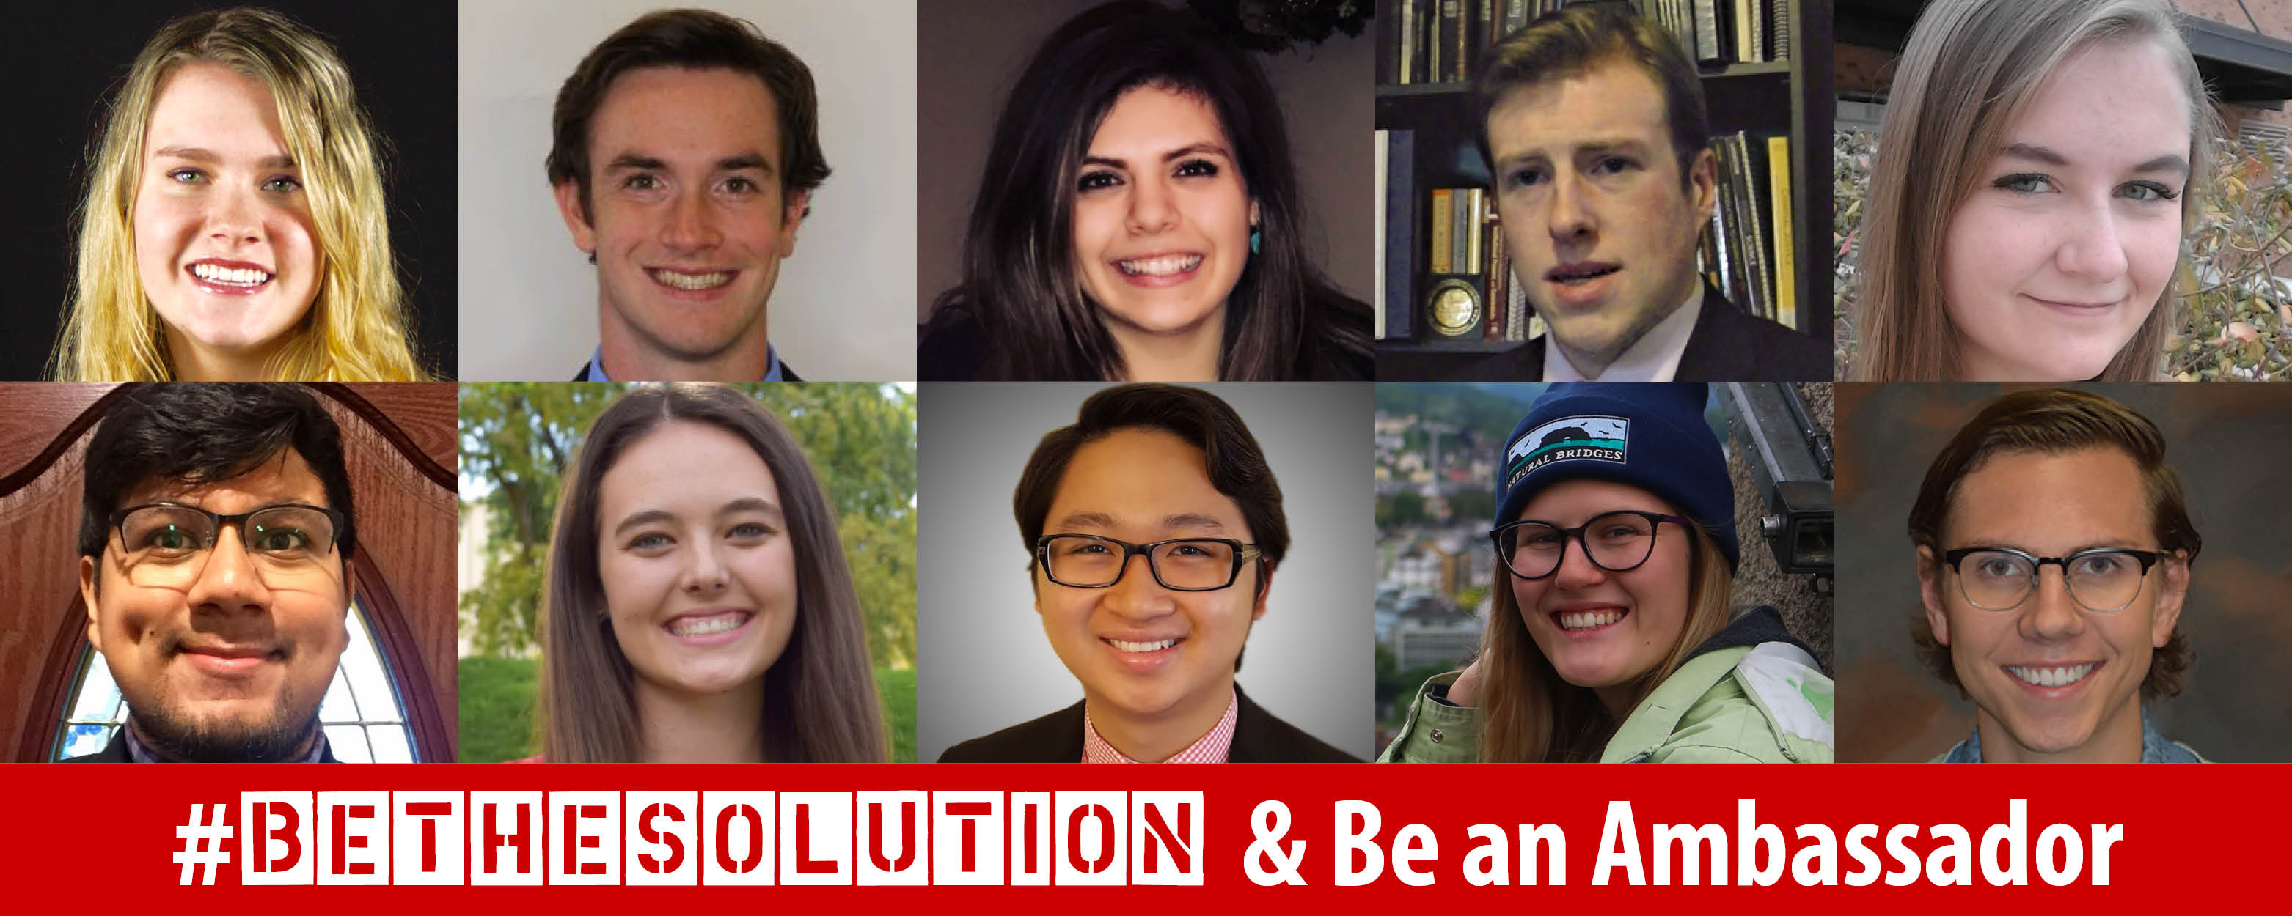
WE ARE CALLED TO BE
AMBASSADOR’S FOR CHRIST

Slide 22
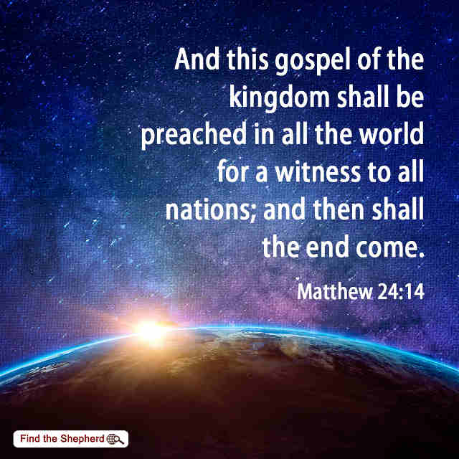

Slide 23
HOW WOULD OUR NEIGHBORS
DESCRIBE US?

Slide 25
It means to represent Christ!

Slide 26
THE WORD OF

Slide 27
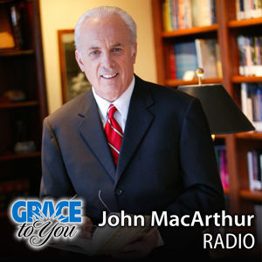

Slide 28
18
19
20
21

Slide 29
Is made possible
by the will of God

Slide 32
LUKE 15

Slide 33
Reconciliation is made possible
by an act of forgiveness.

Slide 34
18
19
20
21

Slide 37
Reconciliation is made possible
by faith in and obedience to
God’s Word.

Slide 39
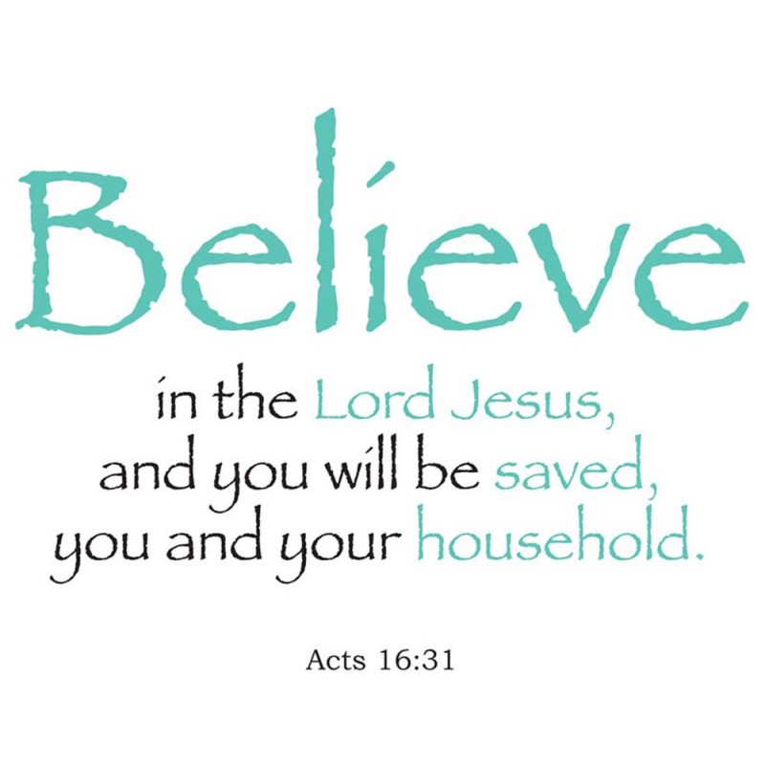

Slide 40
Reconciliation is made possible
by the sacrifice of Christ.

Slide 42
18
19
20
21

Slide 43
Pilate said, "I find no fault in him."
Others said;
"No one ever spoke like this man."

Slide 44
Matthew 3:17

Slide 47
WHAT KIND OF AMBASSADOR WILL YOU BE FOR CHRIST?

