Slide 1
A
Proverbs 17:6 and 22:6

Slide 2
WHAT MAKES A GOOD FATHER?
WHAT IS A GOOD FATHER LIKE?

Slide 3
WHAT MAKES A GOOD FATHER?
WHAT IS A GOOD FATHER LIKE?

Slide 4
A good father has room in his heart for all of his kids.

Slide 5
A good father is always there for you and will lovingly discipline you.

Slide 6
A good father is caring, willing to sacrifice anything, loving.

Slide 7
A good father is a father who shows the children what is right or wrong and guides them towards Christ.

Slide 8
A good father is like Pastor Dan, he raises us even if we aren’t really his kids, we know we can go to him for anything without being judged.

Slide 9
A good father demonstrates how to treat the opposite sex by his treatment of the women in his life.

Slide 10
A good father is sacrificial. He will sacrifice his time, money, and personal desires, for his children.

Slide 11
A good father loves without end, supports without fault and stands strong in the Lord.

Slide 12
My father was the kindest, most gentle man I’ve ever known. He never said an unkind word to me or my seven siblings. He loved us unconditionally.

Slide 13
A good father is one who is able to set aside selfishness and exercises patience.

Slide 14
A good father loves his children. He guides them in godliness.

Slide 15
A good father is one who loves the Lord, and teaches his children in the ways of God. Who is devoted to his wife and children and leads them as the spiritual leader. One who connects in love, one who is the man of Proverbs 20:7.

Slide 16
Proverbs 20:7 ⁷ A righteous person acts with integrity; his children who come after him will be happy.

Slide 17
A good father is one who listens with his heart, one who offers his child words of truth even if they are difficult to say or hear.

Slide 18
A good father will sacrifice for the betterment of his children.

Slide 19
A good father is someone who loves the Lord with all his heart, with all his soul, and with all his mind.

Slide 20
A good father spends time with his family.

Slide 21
A good father listens, and his child is given the gift of acceptance. The good father strives to be an example of a godly man. His child has a living example of how to live a godly life. They have someone that helps to define and point the way to a godly life.

Slide 22
A good father should #1 be there! #2 Be good to those God has given unto him. #3 Be good for those God has given unto his care.

Slide 23
A good father is a “dad” that lives a proven life that his children can always consider him their hero – selfless and truly tries to live rightly.

Slide 24
A good father is a mentor; always forgiving and loving and is there when you are in pain.

Slide 25
A good father teaches guidance and love. Brings them up in a way they should go. A good father has unconditional love for his children spending quality time with them.

Slide 26
A good father is an encourager, a leader, consistent, and a good husband.

Slide 27
A good father is loving, a good leader in the family. Nurturing, encouraging, humble, a Christ follower, loves his child’s mother, spends quality time with his children and loves enough to discipline.

Slide 28
A good father teaches, and shows the love of the Lord.

Slide 29
A good father sets a godly example for his children. He also hears and cares about their needs and is never afraid to say “I love you” to his family.

Slide 30
A good father is a man who hugs his children. He says “I love you”, He says “I’m proud of you”. He leads an example of a godly life. He prays for and over his children.

Slide 31
A good father lifts his children in prayer to the Lord and leads them in praise and worship.

Slide 32
A good father leads by example, walking the walk and talking the talk of a Christian father. He teaches compassion, strength and kindness and respect to his children. He is an example of what a husband should be biblically.

Slide 33
A good father is desperate for Jesus and seeks to know him, and know how to live.

Slide 34
A man who is faithful to God and helps bring up his children in the same way.

Slide 36
"It's just like Mother's Day only you don't spend as much."
A small boy was asked, “What is Father's Day” he said:

Slide 39
A GOOD GOOD FATHER IS…
not just a good father,
but a godly father,

Slide 40
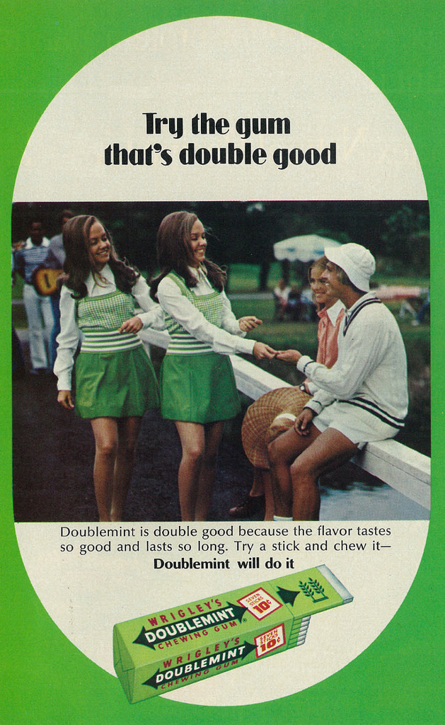

Slide 42
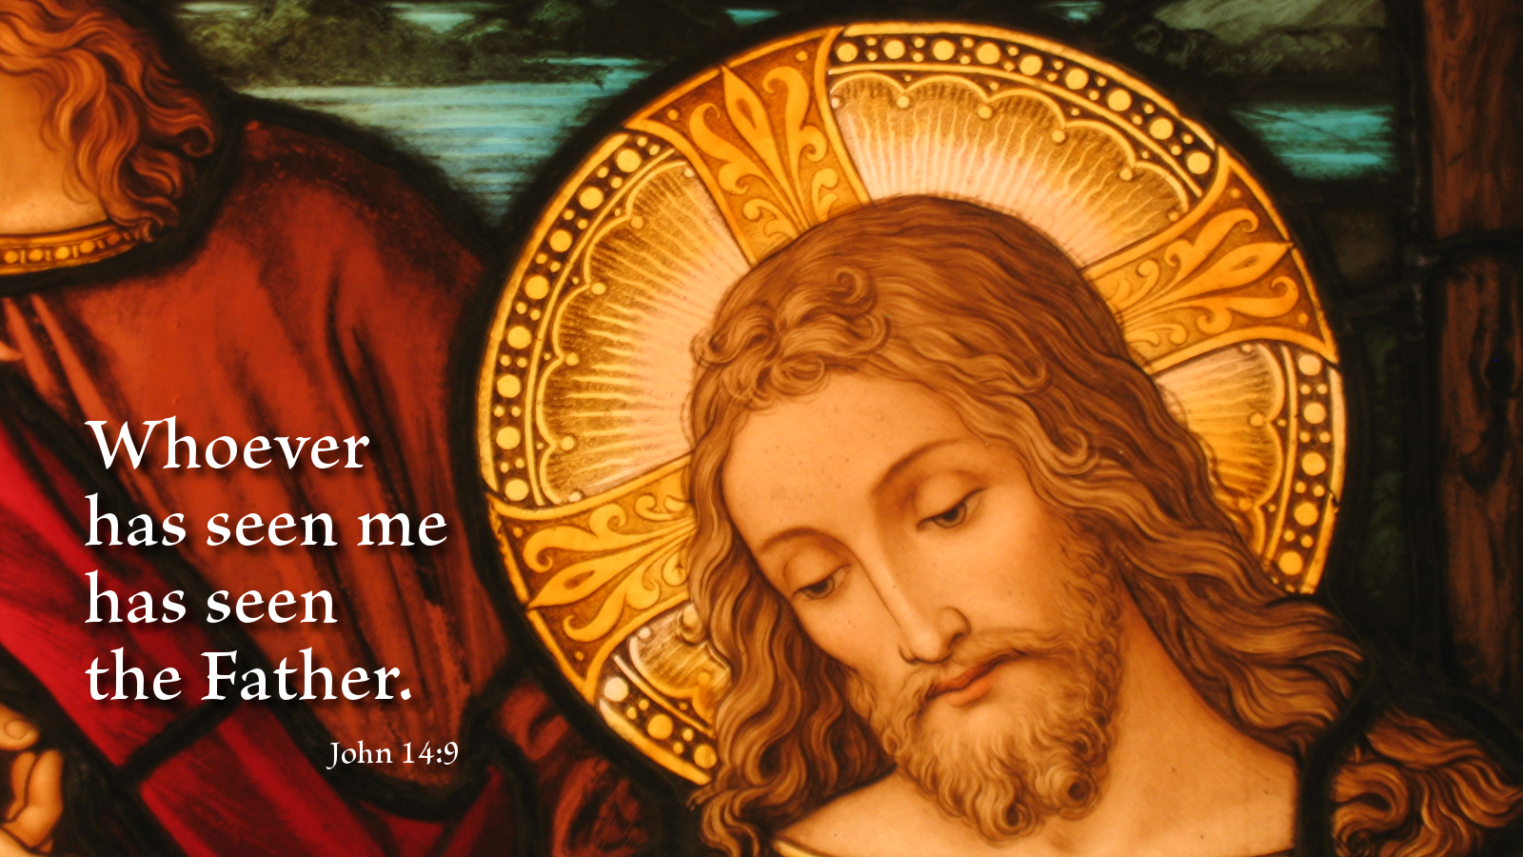

Slide 43
“He was in the beginning with God. All things were made through Him, and without Him nothing was made that was made. By whom all things were made.”
John 1:1-3

Slide 44
A GOOD GOOD FATHER …
Leads his children to do good!

Slide 45
A GOOD GOOD FATHER …
teaches his children
what Jesus taught!

Slide 46
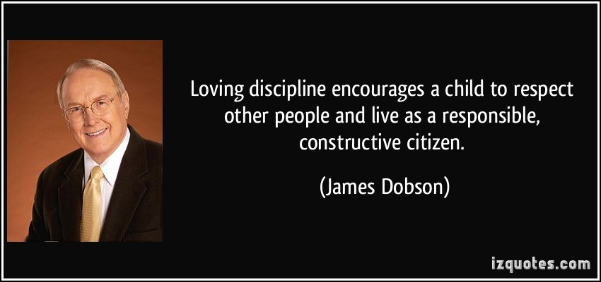
LOVING DISCIPLINE

Slide 47
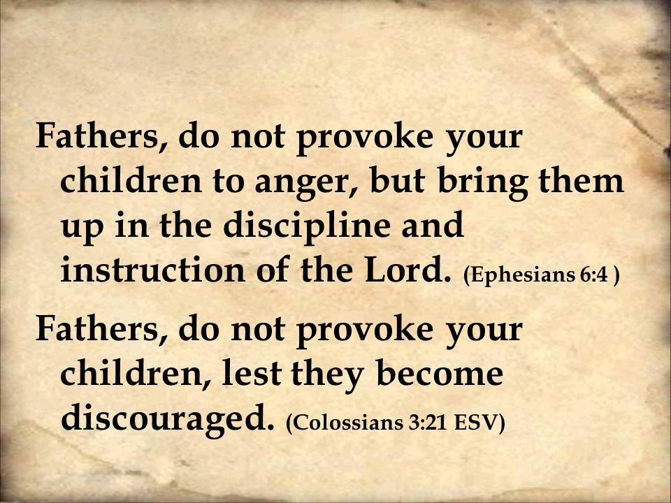

Slide 48
GOOD GOOD FATHERS …
Do not provoke their children
to anger, but bring them up in the
discipline and instruction of the Lord.

Slide 49
⁴ And now a word to you parents.
Don’t keep on scolding and nagging your children, making them angry and resentful. Rather, bring them up with the loving discipline the Lord himself approves, with suggestions and godly advice.
Ephesians 6:4 TLB

Slide 50
GOOD GOOD FATHERS …
Keep their word, just as our heavenly
Father keeps His.

Slide 51
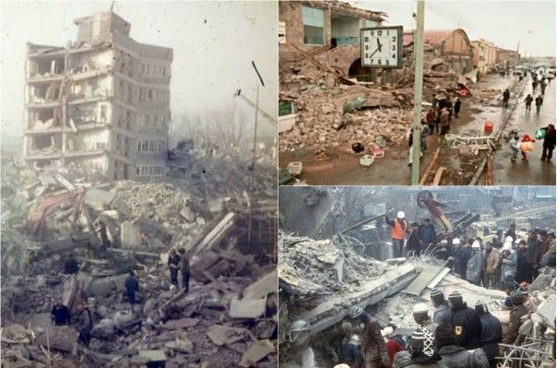

Slide 52
GOOD GOOD FATHERS …
LOVE UNCONDITIONALLY
(ENDURINGLY)

Slide 53
³⁵ Who shall separate us from the love of Christ? Shall tribulation, or distress, or persecution, or famine, or nakedness, or peril, or sword? ³⁶ As it is written, For thy sake we are killed all the day long; we are accounted as sheep for the slaughter.
Ephesians 6:4 TLB

Slide 54
³⁷ Nay, in all these things we are more than conquerors through him that loved us. ³⁸ For I am persuaded, that neither death, nor life, nor angels, nor principalities, nor powers, nor things present, nor things to come, ³⁹ Nor height, nor depth, nor any other creature, shall be able to separate us from the love of God, which is in Christ Jesus our Lord.
Ephesians 6:4 TLB

Slide 55
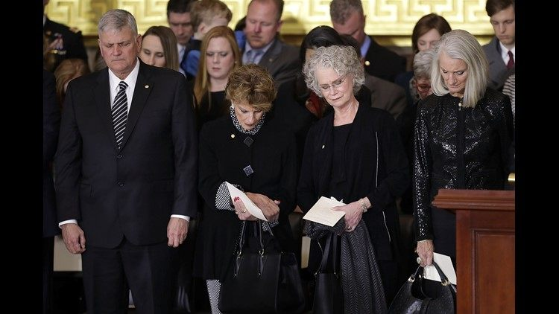
Billy Graham's children (L-R) Franklin Graham, Gigi Graham, Ruth Graham and Anne Graham Lotz

Slide 56
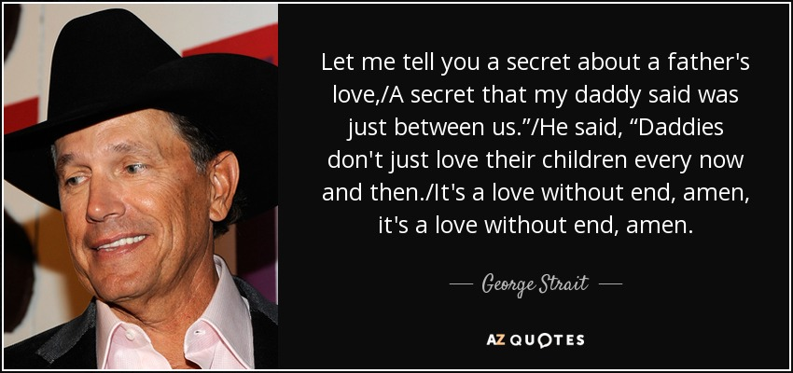
Closing with George Strait singing
A Fathers Love –
https://www.youtube.com/watch?v=k2af10YlLoc

