Slide 1
2 Timothy 4:1-5 (GW) ¹ I solemnly call on you in the presence of God and Christ Jesus, who is going to judge those who are living and those who are dead. I do this because Christ Jesus will come to rule {the world}….. ⁵ Be ready to spread the word whether or not the time is right. Do the work of a missionary. Devote yourself completely to your work.
Product

Slide 2
The Proof is in the Facts*:
Less than 2% of evangelical Christians in America witness weekly to unbelievers or annually lead someone to Christ.
90% of all Christians in America will never share their faith with anyone in their lifetime!
* Research from: George Barna and the Barna Research Group, Southern Baptist Life Commission, Josh McDowell and Campus Crusade for Christ, Focus on the Family, Church of the Nazarene Research, Evangelical Covenant Church study, The Journal for the Scientific Study of Religion

Slide 3
Only 21% of American evangelical Christians will invite anyone to church in a year.
Only 2% will invite an un-churched person to the church in a year.
95% of all Christian believers in America have NEVER led anybody to Christ!

Slide 4
Our American Christian report card looks something like:
N for Needs Improvement
D for Does Not Meet Expectations
F for FAIL
http://myhopewithbillygraham.org.

Slide 5
The greatest single
cause of atheism in
the world today is
Christians who
acknowledge Jesus
with their lips and
walk out the door
and deny Him by
their lifestyle. That is
what an unbelieving
world simply finds
unbelievable.
To most Christians, the
Bible is like a software
license. Nobody actually
reads it. They just scroll
to the bottom and click
‘I Agree’.

Slide 8
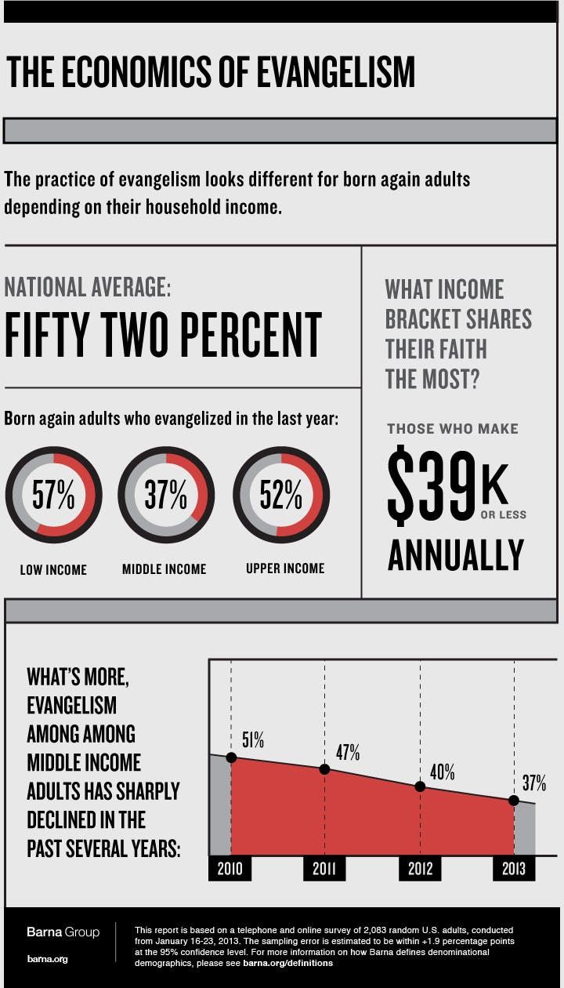

Slide 10
“It’s the Holy Spirit’s job to convict.
God’s job to judge, and my job to love.”

Slide 11
Some companies have “Product Evangelists” or “Brand Evangelists” in fact the president of the company is not just a CEO, he/she is referred to as the “Chief Evangelist” and/or “Chief Ambassador”.
Product

Slide 15
What Does a Product Evangelist Do?
What role do evangelists play today for companies and brands?
Answer by Guy Kawasaki, Chief evangelist of Canva, Mercedes-Benz brand ambassador, on Quora.
Evangelism comes from a Greek term that means “bringing the good news.” That’s what evangelists for a company or brand does. They bring the good news about how a product or service improves people’s lives.

Slide 17
“Behold I bring… good news of glad tidings of great joy” (Lu. 2:10)
Jesus proclaiming the Kingdom of Heaven (Mark 1:14-15).

Slide 20
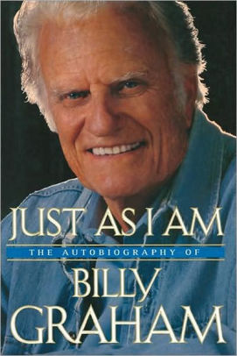

Slide 21
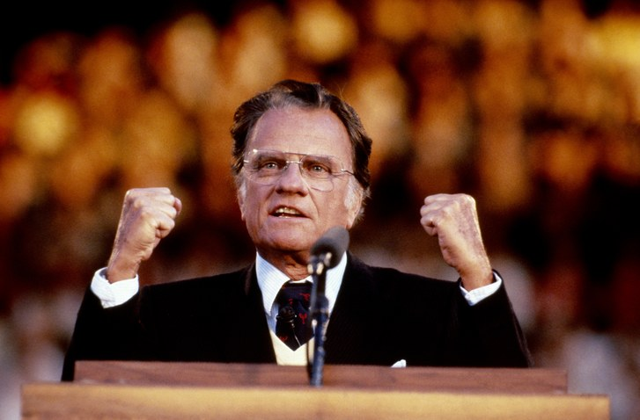
“Puff Graham”

Slide 25
KINGDOM AMBASSADORS
A kingdom AMBASSADOR is someone sent out by Jesus on behalf of God’s kingdom. Someone who wants to talk about the Kingdom of God and what the future holds for them.

Slide 26
KINGDOM AMBASSADORS
Someone who desires to get involved in kingdom causes.

Slide 27
KINGDOM AMBASSADORS
A kingdom AMBASSADOR is someone who is more than a professing Christian.

Slide 28
GOOD AMBASSADORS
Those who are highly satisfied.

Slide 29
GOOD AMBASSADORS
Those who have something to share.

Slide 30
Mark 19-20
“Go home to your family, and tell them how much the Lord has done for you and how he has had mercy on you.”
“He went away and began to tell those in the Decapolis how much Jesus had done for him, and all the people were amazed.”

