Slide 3
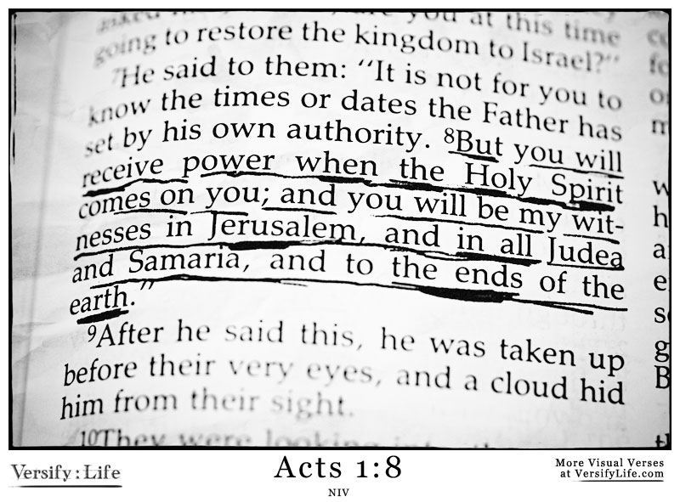

Slide 4
GUIDES
Romans 8:14

Slide 6
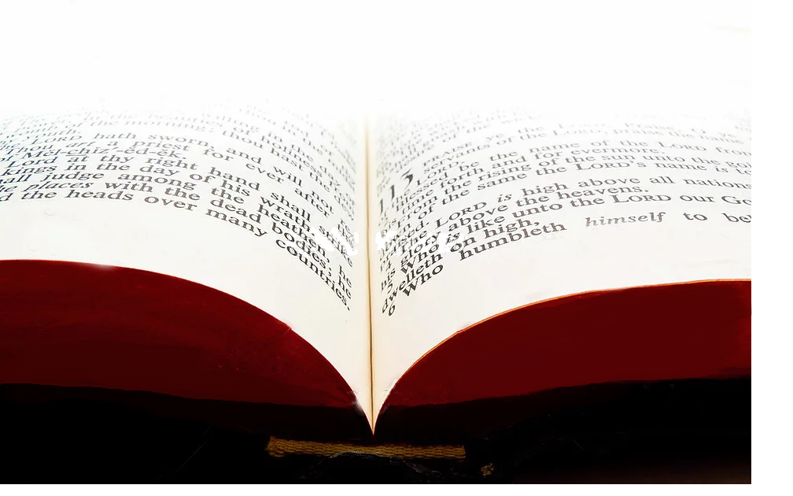
⁴ Once when he was eating with them, he commanded them, “Do not leave Jerusalem until the Father sends you the gift he promised, as I told you before. ⁵ John baptized with water, but in just a few days you will be baptized with the Holy Spirit.” ⁶ So when the apostles were with Jesus, they kept asking him,
Acts 1:4-8 NLT

Slide 7
“Lord, has the time come for you to free Israel and restore our kingdom?” ⁷ He replied, “The Father alone has the authority to set those dates and times, and they are not for you to know. ⁸ But you will receive power when the Holy Spirit comes upon you.
Acts 1:4-8 NLT

Slide 8
And you will be my witnesses, telling people about me everywhere—in Jerusalem, throughout Judea, in Samaria, and to the ends of the earth.”
Acts 1:4-8 NLT

Slide 10
The only way we ever fail in our witness is if we fail to witness.

Slide 11
“You shall be witnesses to Me”

Slide 12
34 Then Peter opened his mouth and said: "In truth I perceive that God shows no partiality. 35 But in every nation whoever fears Him and works righteousness is accepted by Him. 36 The word which God sent to the children of Israel, preaching peace through Jesus Christ--He is Lord of all--
Acts 10:34-38 NKJV

Slide 13
37 that word you know, which was proclaimed throughout all Judea, and began from Galilee after the baptism which John preached: 38 how God anointed Jesus of Nazareth with the Holy Spirit and with power, who went about doing good and healing all who were oppressed by the devil, for God was with Him.
Acts 10:34-38 NKJV

Slide 14
39 And we are witnesses of all things which He did both in the land of the Jews and in Jerusalem, whom they killed by hanging on a tree (what we saw). 40 Him God raised up on the third day, and showed Him openly, 41 not to all the people, but to witnesses chosen before by God, even to us who ate and drank
Acts 10:34-38 NKJV

Slide 15
with Him after He arose from the dead. 42 And He commanded us to preach to the people, and to testify that it is He who was ordained by God to be Judge of the living and the dead. 43 To Him all the prophets witness that, through His name, whoever believes in Him will receive remission of sins.“
Acts 10:34-38 NKJV

Slide 16
44 While Peter was still speaking these words, the Holy Spirit fell upon all those who heard the word.
Acts 10:34-38 NKJV

Slide 17
CHAPTER 26

Slide 18
ACTS 26: 6-8 NKJV
⁶ And now I stand and am judged for the hope of the promise made by God to our fathers. ⁷ To this promise our twelve tribes, earnestly serving God night and day, hope to attain. For this hope's sake, King Agrippa, I am accused by the Jews. ⁸ Why should it be thought incredible by you that God raises the dead?

Slide 19
ACTS 26: 12-18 NKJV
¹² "While thus occupied, as I journeyed to Damascus with authority and commission from the chief priests, ¹³ at midday, O king, along the road I saw a light from heaven, brighter than the sun, shining around me and those who journeyed with me.

Slide 20
ACTS 26: 12-18 NKJV
¹⁴ And when we all had fallen to the ground, I heard a voice speaking to me and saying in the Hebrew language, 'Saul, Saul, why are you persecuting Me? It is hard for you to kick against the goads.'

Slide 21
ACTS 26: 15-16 NKJV
¹⁵ So I said, 'Who are You, Lord?' And He said, 'I am Jesus, whom you are persecuting. ¹⁶ But rise and stand on your feet; for I have appeared to you for this purpose, to make you a minister and a witness both of the things which you have seen and of the things which I will yet reveal to you.

Slide 22
ACTS 26: 17-18 NKJV
¹⁷ I will deliver you from the Jewish people, as well as from the Gentiles, to whom I now send you, ¹⁸ to open their eyes, in order to turn them from darkness to light, and from the power of Satan to God, that they may receive forgiveness of sins and an inheritance among those who are sanctified by faith in Me.'

Slide 23
JOHN 9:13-33
¹³ They brought him who formerly was blind to the Pharisees. ¹⁴ Now it was a Sabbath when Jesus made the clay and opened his eyes. ¹⁵ Then the Pharisees also asked him again how he had received his sight. He said to them, "He put clay on my eyes, and I washed, and I see." ¹⁶ Therefore some of the Pharisees said, "This Man is not from God, because He does not keep the Sabbath."

Slide 24
JOHN 9:13-33
Others said, "How can a man who is a sinner do such signs?" And there was a division among them. ¹⁷ They said to the blind man again, "What do you say about Him because He opened your eyes?" He said, "He is a prophet." ¹⁸ But the Jews did not believe concerning him, that he had been blind and received his sight, until they called the parents of him who had received his sight.

Slide 25
JOHN 9:13-33
¹⁹ And they asked them, saying, "Is this your son, who you say was born blind? How then does he now see?" ²⁰ His parents answered them and said, "We know that this is our son, and that he was born blind; ²¹ but by what means he now sees we do not know, or who opened his eyes we do not know. He is of age; ask him. He will speak for himself."

Slide 26
JOHN 9:13-33
²² His parents said these things because they feared the Jews, for the Jews had agreed already that if anyone confessed that He was Christ, he would be put out of the synagogue. ²³ Therefore his parents said, "He is of age; ask him." ²⁴ So they again called the man who was blind, and said to him, "Give God the glory! We know that this Man is a sinner."

Slide 27
JOHN 9:13-33
²⁵ He answered and said, "Whether He is a sinner or not I do not know. One thing I know: that though I was blind, now I see." ²⁶ Then they said to him again, "What did He do to you? How did He open your eyes?" ²⁷ He answered them, "I told you already, and you did not listen. Why do you want to hear it again? Do you also want to become His disciples?"

Slide 28
JOHN 9:13-33
²⁸ Then they reviled him and said, "You are His disciple, but we are Moses' disciples. ²⁹ We know that God spoke to Moses; as for this fellow, we do not know where He is from." ³⁰ The man answered and said to them, "Why, this is a marvelous thing, that you do not know where He is from; yet He has opened my eyes!

Slide 29
JOHN 9:13-33
³¹ Now we know that God does not hear sinners; but if anyone is a worshiper of God and does His will, He hears him. ³² Since the world began it has been unheard of that anyone opened the eyes of one who was born blind. ³³ If this Man were not from God, He could do nothing."

Slide 30
¹ After this, I heard what sounded like a vast crowd in heaven shouting, “Praise the LORD! Salvation and glory and power belong to our God. ² His judgments are true and just. He has punished the great prostitute who corrupted the earth with her immorality. He has avenged the murder of his servants.”
REVELATION 19:1-10

Slide 31
³ And again their voices rang out: “Praise the LORD! The smoke from that city ascends forever and ever!” ⁴ Then the twenty-four elders and the four living beings fell down and worshiped God, who was sitting on the throne. They cried out, “Amen! Praise the LORD!”
REVELATION 19:1-10

Slide 32
⁵ And from the throne came a voice that said, “Praise our God, all his servants, all who fear him, from the least to the greatest.” ⁶ Then I heard again what sounded like the shout of a vast crowd or the roar of mighty ocean waves or the crash of loud thunder: “Praise the LORD! For the Lord our God, the Almighty, reigns.
REVELATION 19:1-10

Slide 33
⁷ Let us be glad and rejoice, and let us give honor to him. For the time has come for the wedding feast of the Lamb, and his bride has prepared herself. ⁸ She has been given the finest of pure white linen to wear.” For the fine linen represents the good deeds of God’s holy people.
REVELATION 19:1-10

Slide 34
⁹ And the angel said to me, “Write this: Blessed are those who are invited to the wedding feast of the Lamb.” And he added, “These are true words that come from God.” ¹⁰ Then I fell down at his feet to worship him, but he said, “No, don’t worship me.
REVELATION 19:1-10

Slide 35
I am a servant of God, just like you and your brothers and sisters who testify about their faith in Jesus. Worship only God. For the essence of prophecy is to give a clear witness for Jesus.”
REVELATION 19:1-10

Slide 36
¹ And he showed me a pure river of water of life, clear as crystal, proceeding from the throne of God and of the Lamb. ² In the middle of its street, and on either side of the river, was the tree of life, which bore twelve fruits, each tree yielding its fruit every month. The leaves of the tree were for the healing of the nations.
REVELATION 22:1-14 NKJV

Slide 37
³ And there shall be no more curse, but the throne of God and of the Lamb shall be in it, and His servants shall serve Him. ⁴ They shall see His face, and His name shall be on their foreheads. ⁵ There shall be no night there: They need no lamp nor light of the sun, for the Lord God gives them light.
REVELATION 22:1-14 NKJV

Slide 38
And they shall reign forever and ever. ⁶ Then he said to me, "These words are faithful and true." And the Lord God of the holy prophets sent His angel to show His servants the things which must shortly take place. ⁷ "Behold, I am coming quickly! Blessed is he who keeps the words of the prophecy of this book."
REVELATION 22:1-14 NKJV

Slide 39
⁸ Now I, John, saw and heard these things. And when I heard and saw, I fell down to worship before the feet of the angel who showed me these things. ⁹ Then he said to me, "See that you do not do that. For I am your fellow servant, and of your brethren the prophets, and of those who keep the words of this book. Worship God."
REVELATION 22:1-14 NKJV

Slide 40
¹⁰ And he said to me, "Do not seal the words of the prophecy of this book, for the time is at hand. ¹¹ He who is unjust, let him be unjust still; he who is filthy, let him be filthy still; he who is righteous, let him be righteous still; he who is holy, let him be holy still." ¹² "And behold, I am coming quickly, and My reward is with Me, to give to every one according to his work.
REVELATION 22:1-14 NKJV

Slide 41
¹³ I am the Alpha and the Omega, the Beginning and the End, the First and the Last." ¹⁴ Blessed are those who do what He commands, that they may have the right to the tree of life, and may enter through the gates into the city.
REVELATION 22:1-14 NKJV

Slide 42
Someone is waiting for you to share

Slide 43
Someone is waiting for you to share

Slide 44
Wait too long and their gone!

Slide 45
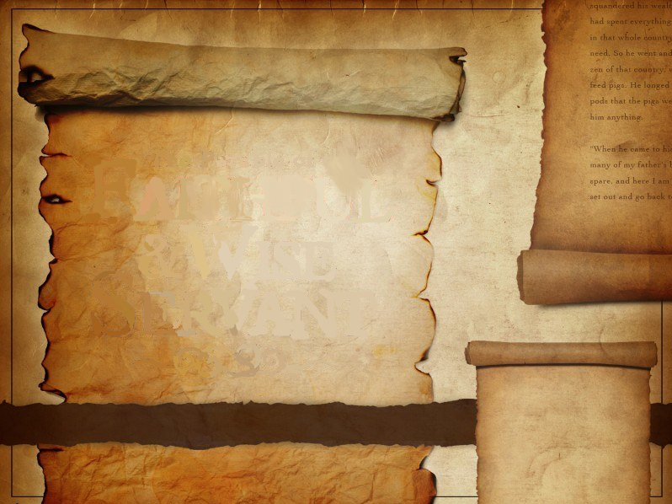
MATTHEW 24:46
The servant whose Lord finds him doing what He has been commanded to do, will be rewarded.
JESUS

