Slide 2
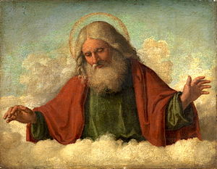
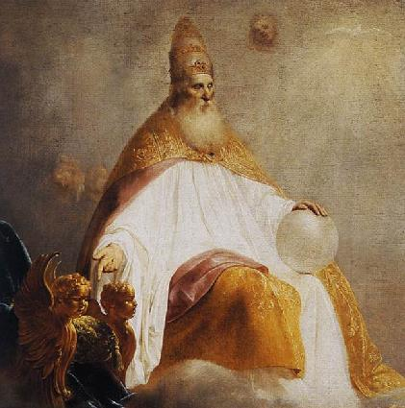
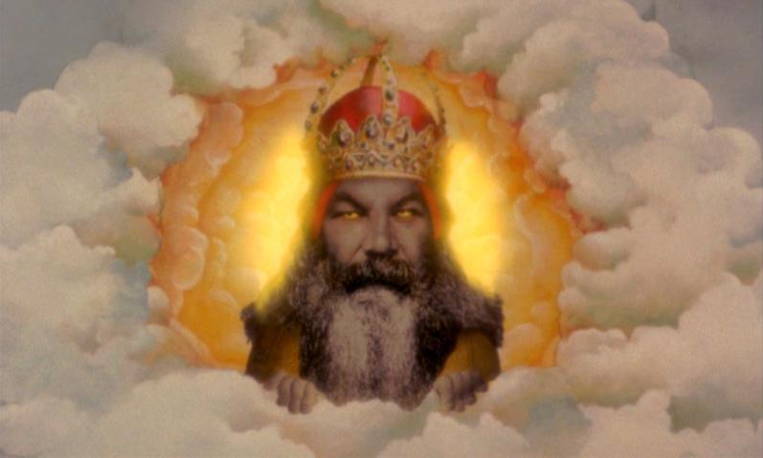
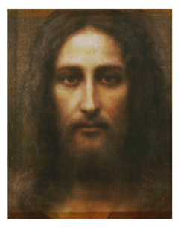
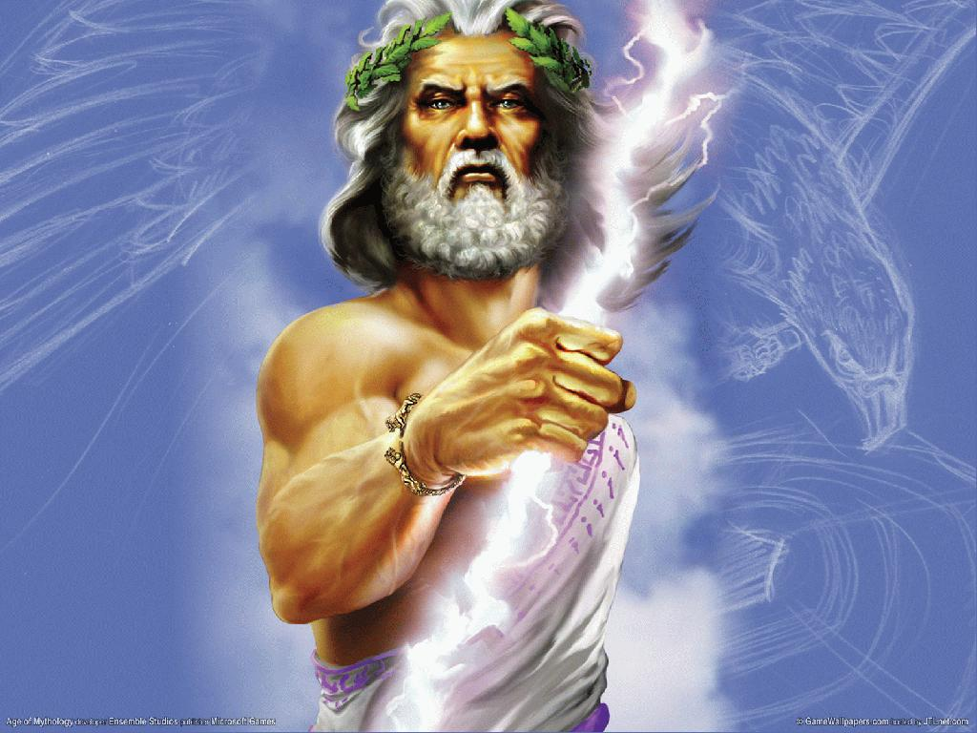
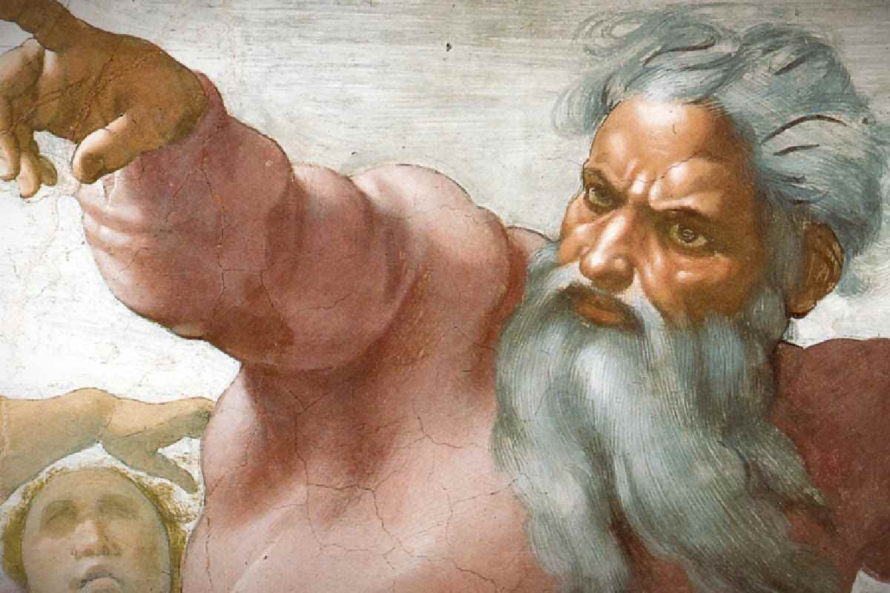
What is your image of God?

Slide 3
1997
2002

Slide 4
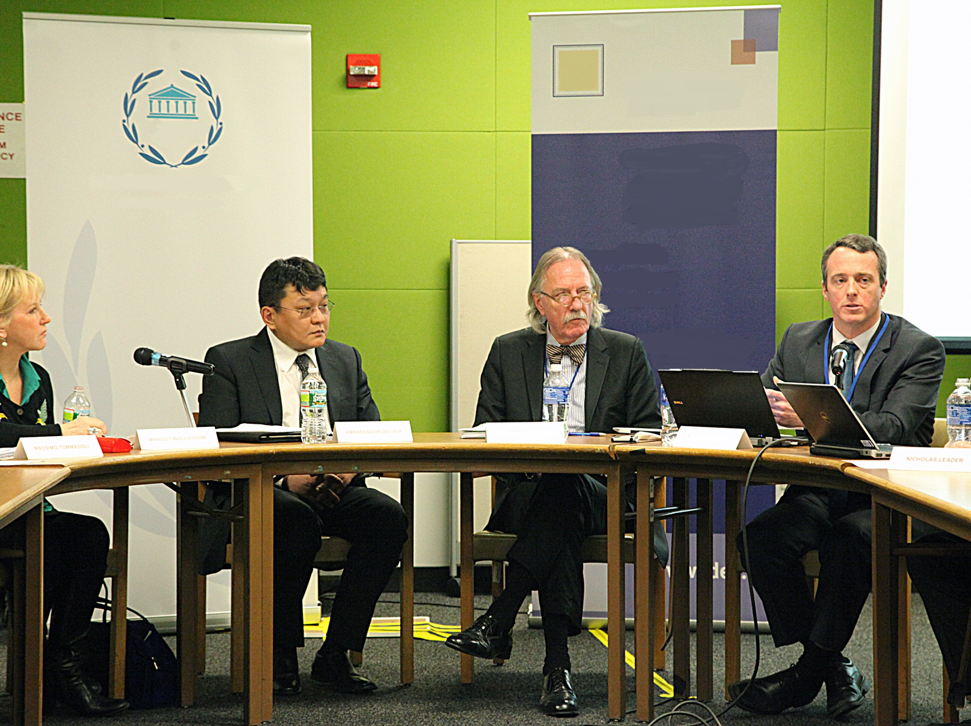
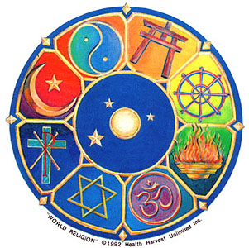
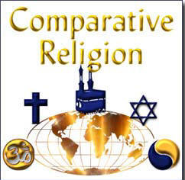
INCARNATION RESURRECTION

Slide 5
INCARNATION RESURRECTION
GRACE

Slide 6
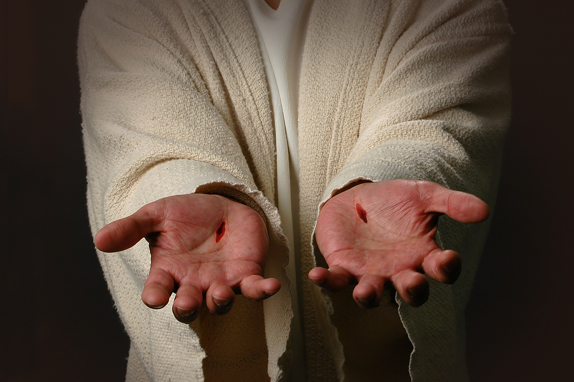
God’s arms are always extended.

Slide 8
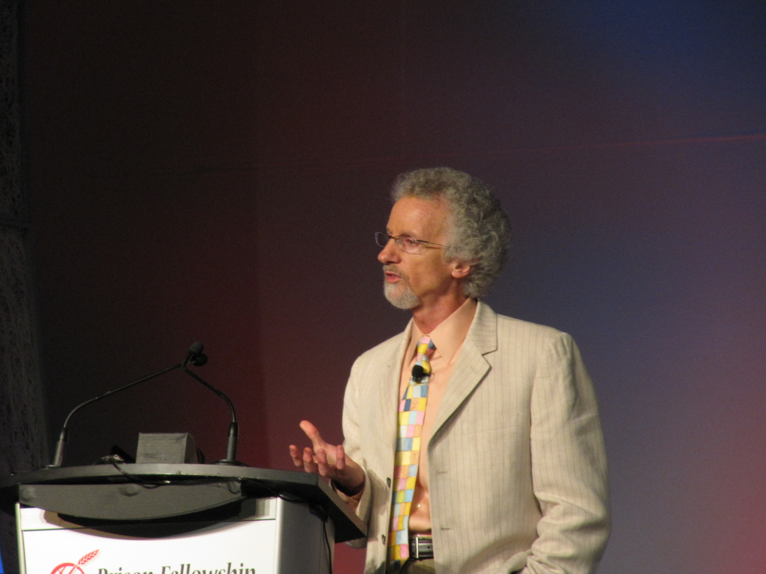
“Strangely, rediscovery may strike a deeper chord than discovery.”
Philip Yancey

Slide 9
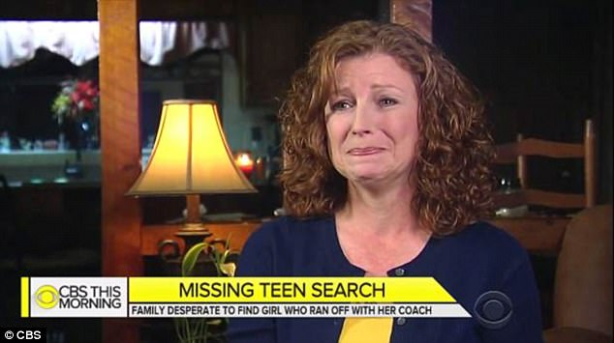
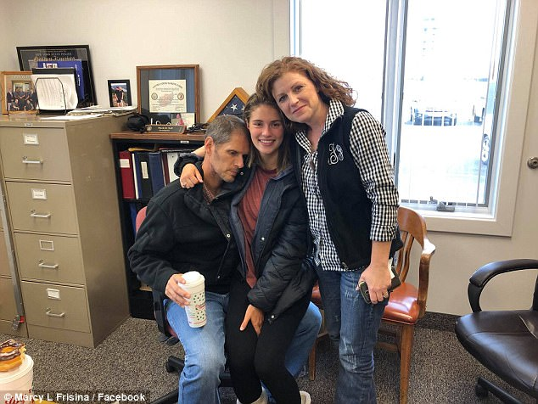
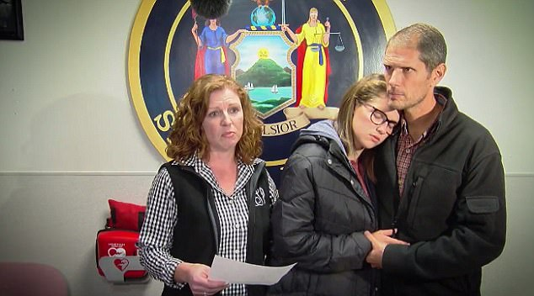
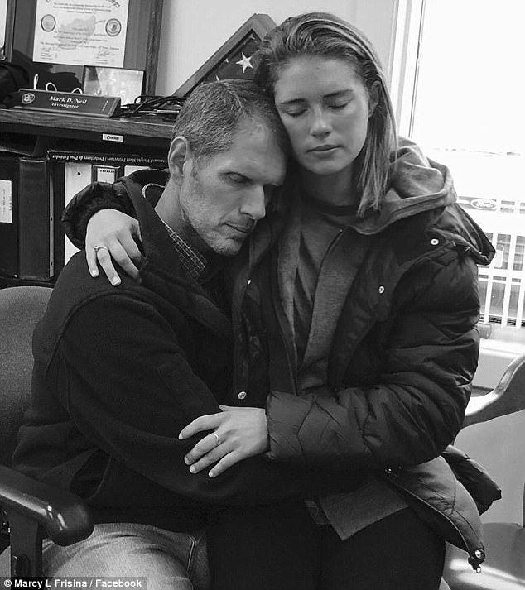

Slide 10
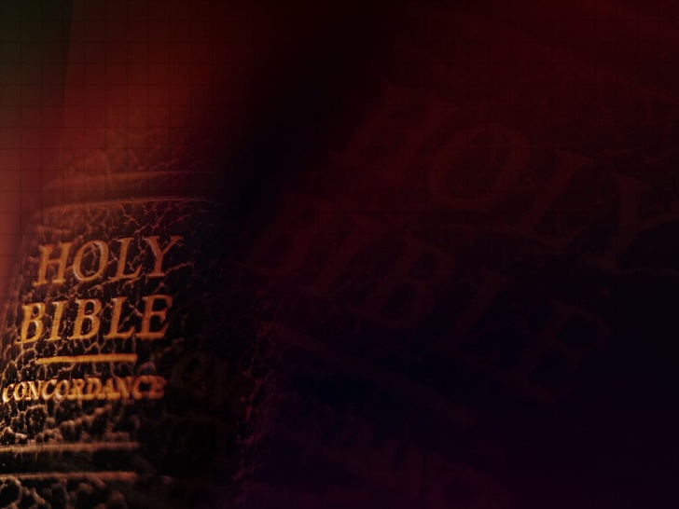
18 "Father, I have sinned against heaven and before you, 19 and I am no longer worthy to be called your son. Make me like one of your hired servants." ' 20 And he arose and
came to his father. But when
he was still a great way off,
his father saw him and had
compassion, and ran and fell
on his neck and kissed him.
Luke 15

Slide 11
21 And the son said to him, 'Father, I have sinned against heaven and in your sight, and am no longer worthy to be called your son.' 22 But the father said to his servants, 'Bring out the best robe
and put it on him,
and put a ring on his hand
and sandals on his feet.
Luke 15

Slide 12
23 And bring the fatted calf here and kill it, and let us eat and be merry; 24 for this my son was dead and is alive again; he was lost and is found.’
And they began to be merry.”
Luke 15

Slide 14
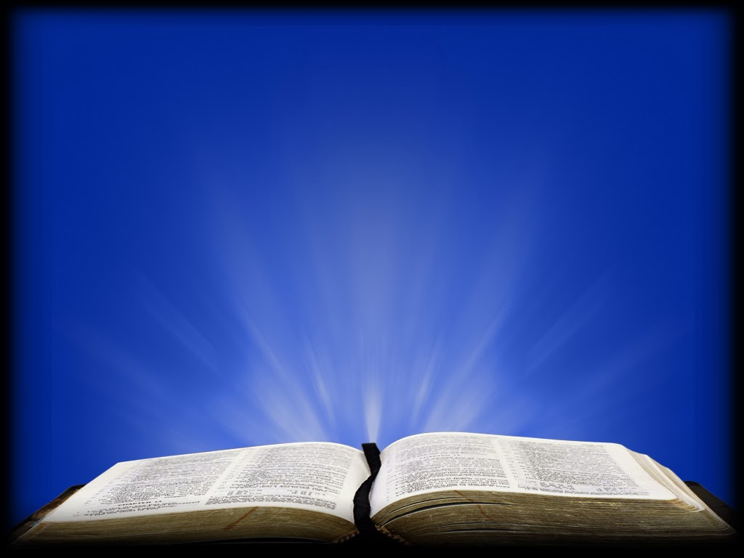
The light came into the world. He was in the world and the world was made through Him, and yet, the world did not know Him. He came to His own, and His own did not receive Him, But as many as did, He gave them the right to become children of God,
John 1:9-14

Slide 15
to those who believe in His name: who were born, not of blood, nor of the will of the flesh, nor of the will of man, but of God. And the Word became flesh and dwelt among us, and we beheld His glory (the real image of God),
John 1:9-14

Slide 16
the glory as of the only
begotten of the Father,
full of grace and truth.
John 1:9-14

Slide 17
"God rejoices. Not because the problems of the world have been solved, not because all human pain and suffering have come to an end, nor because thousands of people have been converted and are now praising him for his goodness. No, God rejoices because one of his children who was lost has been found."

Slide 18
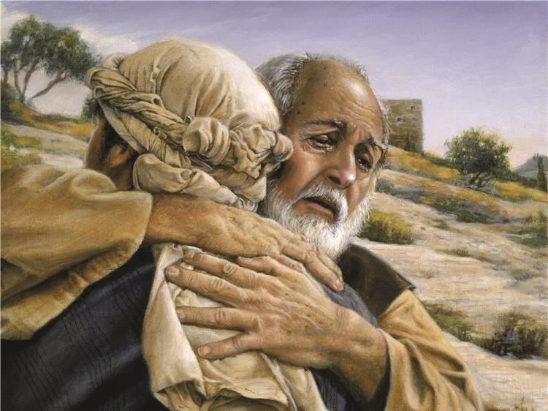

Slide 21
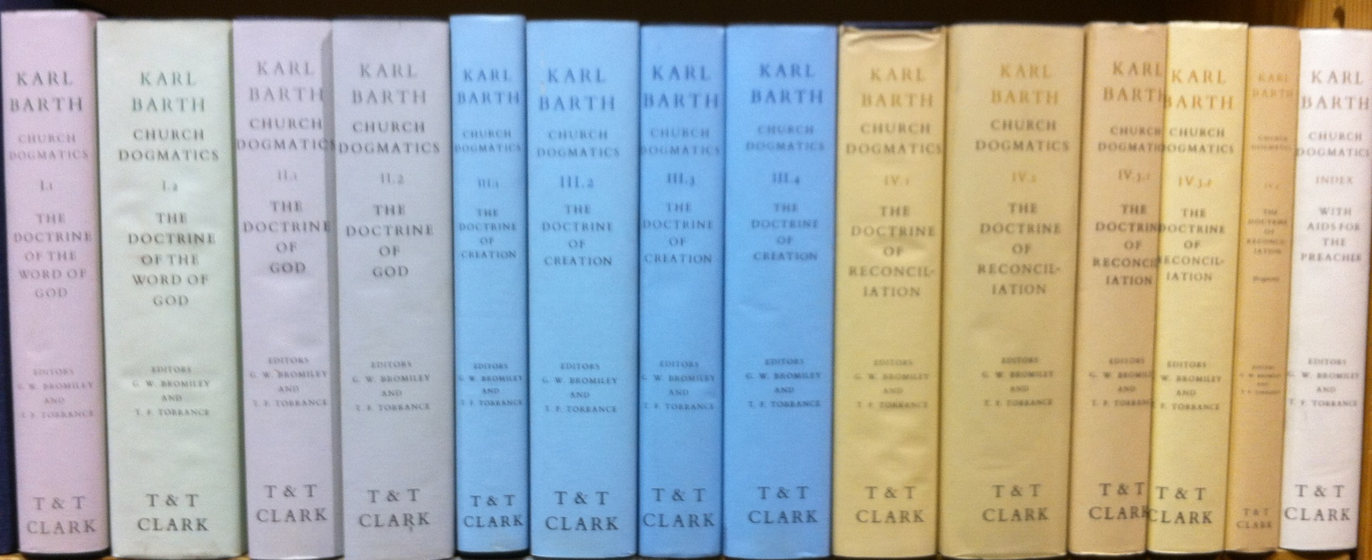
Theologian Karl Barth,
after writing thousands of pages in his Church Dogmatics, arrived at this simple definition of God: "the One who loves."

Slide 23
Grace cannot be earned.
It is simply undeserved.
Grace is getting better than what we deserve.

Slide 24
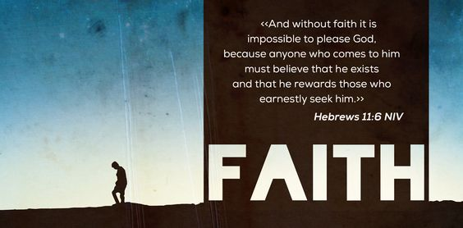
God rewards those who earnestly seek Him!

Slide 25
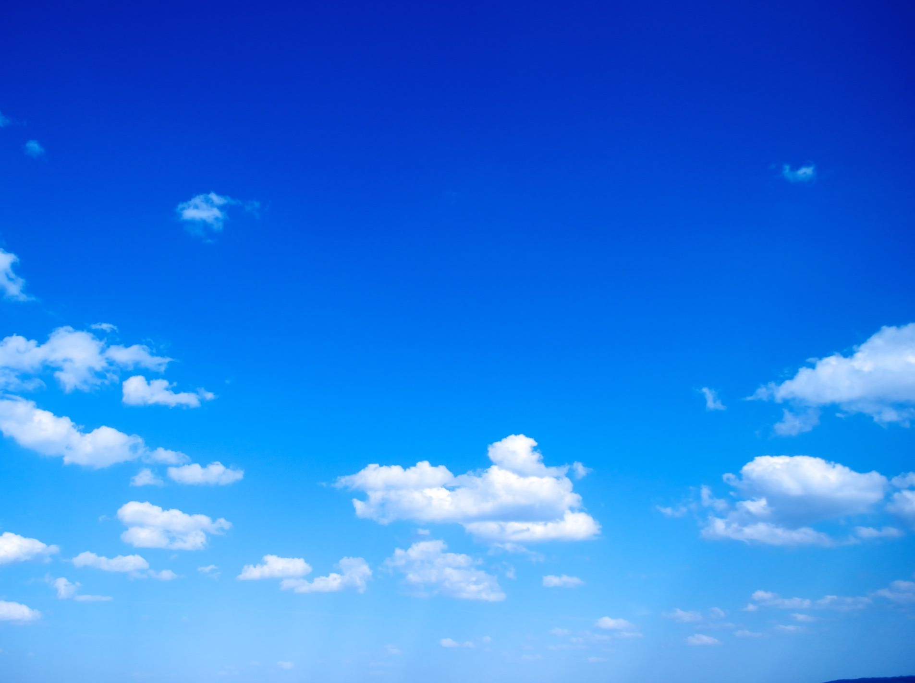
A call to be both grace filled in your behavior and grace filled in declaring the truth
of the Gospel.

Slide 28
