Slide 1
The Ultimate Relationship
Leviticus 1-5, Ephesians 5:18-23

Slide 2
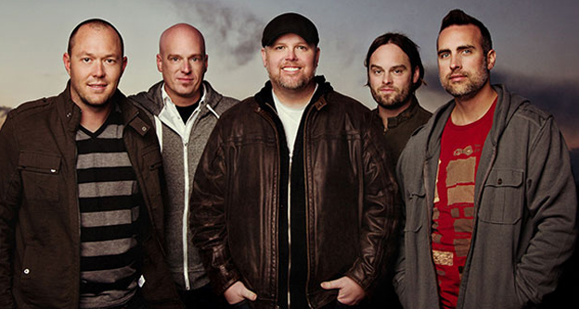

Slide 3
Ephesians 5 & Leviticus 1-5

Slide 4
COVENANT PROMISES
Provision, Protection, Presence

Slide 5
Ephesians 5:32
This is a great mystery,
but I speak concerning Christ and the church.

Slide 6
Ephesians 5
The apostle Paul says there is a mutual submission or sacrifice
that is part of the ongoing dynamic of this relationship.

Slide 9
Forsake not the assembling of yourselves together

Slide 10
Ephesians 6:8
“Whatever good anyone does,
whatever sacrifice one makes for another
they will receive the same from the Lord.

Slide 11
If You Love Me
Feed My Lambs
Tend My Sheep
Feed My Sheep
JOHN 21:15

Slide 12
Colossians 3:24 (NLT) ²⁴ Remember that the Lord will give you an inheritance as your reward, and that the Master you are serving is Christ.

Slide 14
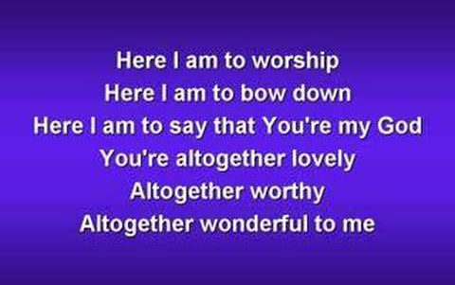

Slide 15
Ephesians 5:24-25
“Wives submit (sacrifice) for your husbands as unto the Lord and husbands
see to it that you love your wives
as Christ loved the church and gave
(sacrificed) himself for her.

Slide 16
Leviticus chapters 1-5
Five major sacrifices are described.
The burnt offering (1:1-17; 6:8-13);
The grain offering (2:1-16; 6:14-23);
The peace offering (3:1-17; 7:11-36);
The sin offering (4:1-5:13; 6:24-30); and
The guilt offering (5:14-6:7; 7:1-10).

Slide 17
Leviticus chapters 1-5
Five major sacrifices are described.
The burnt offering (1:1-17; 6:8-13);
The grain offering (2:1-16; 6:14-23);
The peace offering (3:1-17; 7:11-36);
The sin offering (4:1-5:13; 6:24-30); and
The guilt offering (5:14-6:7; 7:1-10).

Slide 18
Leviticus chapters 1-5
Five major sacrifices are described.
Each of these offerings pertains to a facet of our relationship with God and how we are to relate to God and each other.

Slide 19
Romans 12:10
“Show family affection to one another
With brotherly love. Outdo one another
in showing honor.

Slide 20
Romans 12:10
THE MESSAGE
“Be good friends who loves deeply; practicing playing second fiddle.”
GOD’S WORD
“Be devoted to each other like a loving family. Excel in showing respect for each other.”

Slide 21
LEVITICAL SACRIFICES
THE BURNT OFFERING
Leviticus 6:8-13

Slide 22
LEVITICAL SACRIFICES
THE BURNT OFFERING
A perpetual fire shall burn on the altar;
it shall never go out.
Leviticus 6:13

Slide 23
LEVITICAL SACRIFICES
THE BURNT OFFERING
THE GRAIN OFFERING
Leviticus 6:14-23

Slide 24
LEVITICAL SACRIFICES
THE BURNT OFFERING
THE GRAIN OFFERING
THE PEACE OFFERING
Leviticus 7:11-21

Slide 25
1 John 1:8
If we say, “We have no sin, we are deceiving ourselves, and the truth is not in us.”

Slide 26
James 5:16
Confess your faults one to another, and pray one for another, that ye may be healed. The effectual fervent prayer of a righteous man availeth much.

Slide 27
LEVITICAL SACRIFICES
THE BURNT OFFERING
THE GRAIN OFFERING
THE PEACE OFFERING
THE SIN OFFERING
Leviticus 6:24-30

Slide 28
LEVITICAL SACRIFICES
THE BURNT OFFERING
THE GRAIN OFFERING
THE PEACE OFFERING
THE SIN OFFERING
THE TREPASS OFFERING
Leviticus 7:1-10

Slide 29
Matthew 6:14-15
“For if you forgive men their trespasses, your heavenly Father will also forgive you: But if you do not forgive others their trespasses, neither will your Father forgive your trespasses.”

Slide 30
THE ASK
TODAY’S CHALLENGE:
I CHALLENGE YOU TO DO A RELATIONAL
EXERCISE EVERY DAY IN FIDELITY,
IN SERVICE, IN SELF-SACRIFICE.
So that you will experience real spiritual growth
In your relationship with God, with your
spouse and with others.

