Slide 1
Exodus 32:11-14

Slide 2
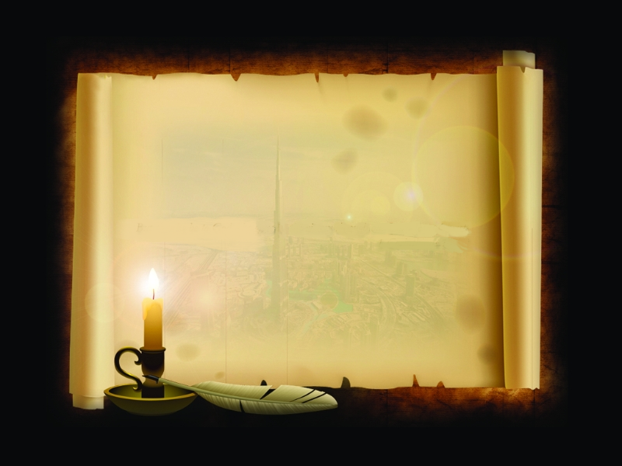
Moses modeled it, King David modeled it, the prophets modeled it, Jesus modeled it, the apostles modeled it, the early church modeled it…
PRAYER

Slide 3
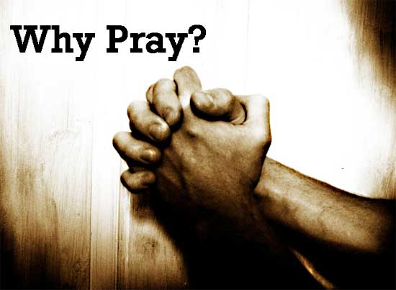

Slide 4
We pray because God commands us to pray.

Slide 5
Philippians 4:6-7
God commands us to pray!

Slide 6
We pray for solutions!

Slide 7
We pray in preparation for major decisions.

Slide 8
Luke 6:12-13
We pray to overcome demonic barriers.

Slide 9
Matthew 17:14-21
We pray for workers.

Slide 10
Matthew 26:41
We pray to overcome temptation.

Slide 11
Ephesians 6:10-19
To win spiritual battles.

Slide 12
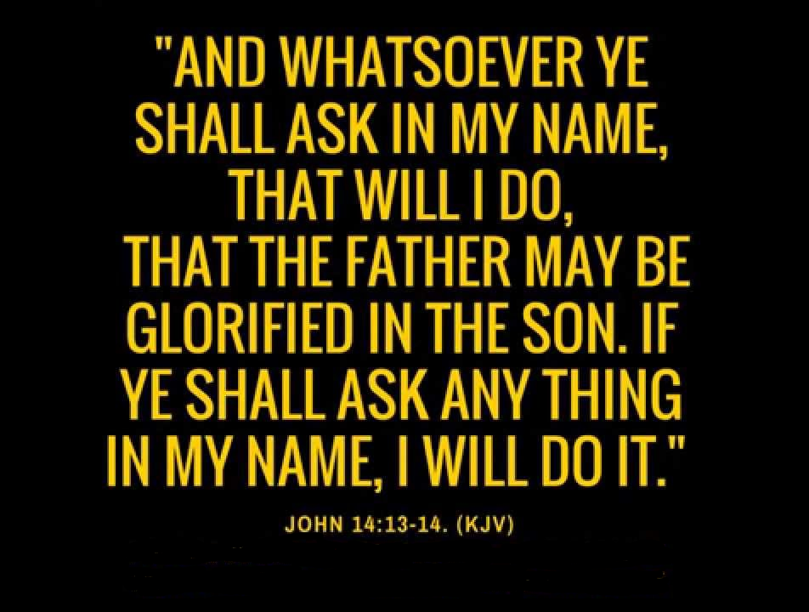
also 1 John 5:14-15

Slide 13
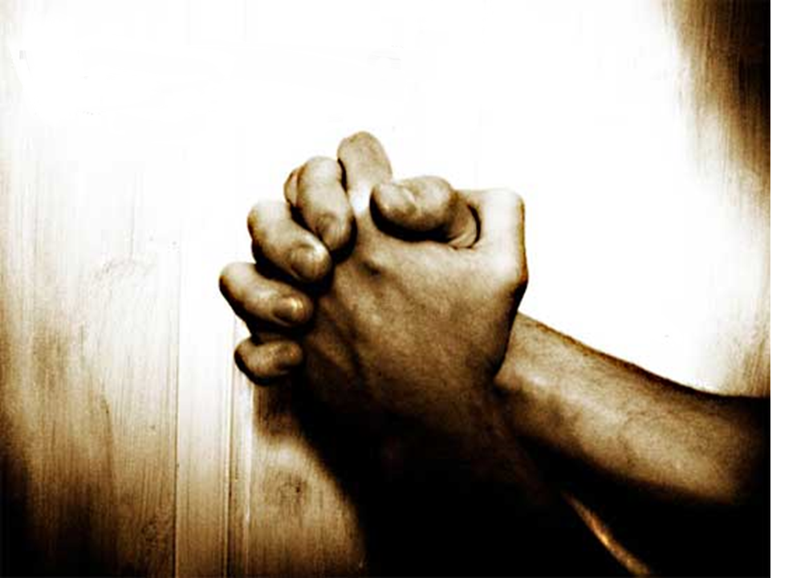
The Purpose of Prayer
Prayer should not be seen as our means of getting God to do our will on earth, but rather as a means of getting God's will done on earth.
We pray to overcome temptation.

Slide 14
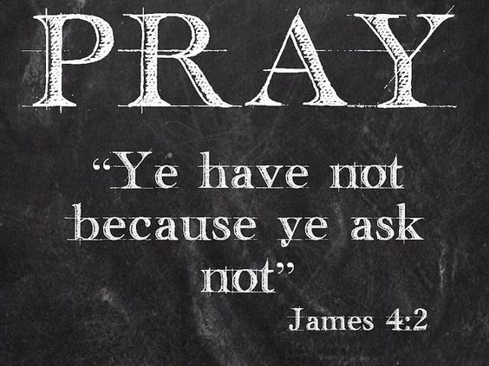

Slide 15
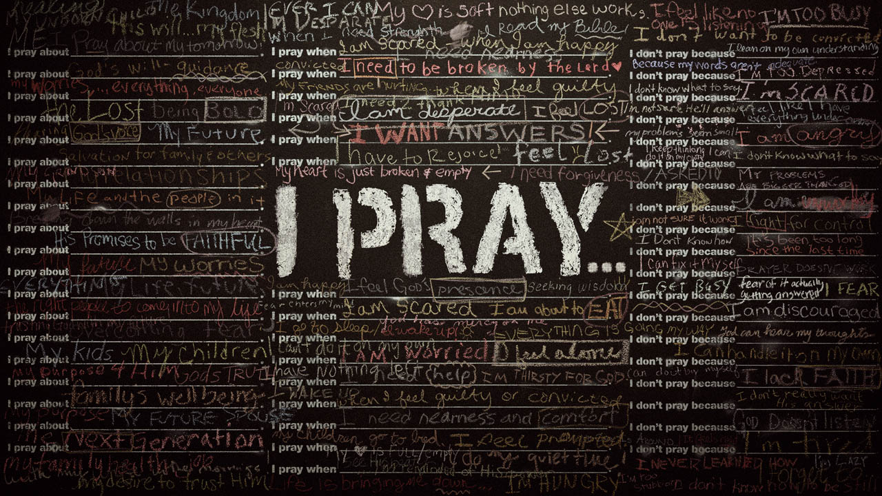
Why some don’t pray
more!

Slide 16
A lack of prayer demonstrates
a lack of faith.

Slide 17
Prayer allows us to see God at
work in our lives.

Slide 18
We see answered prayer because
We prayed.

Slide 19
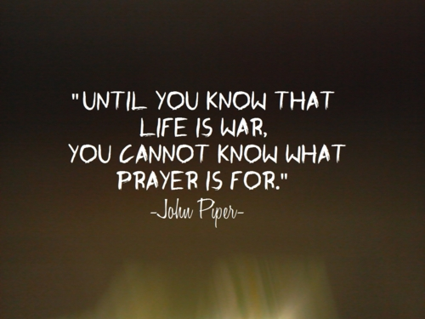

Slide 20
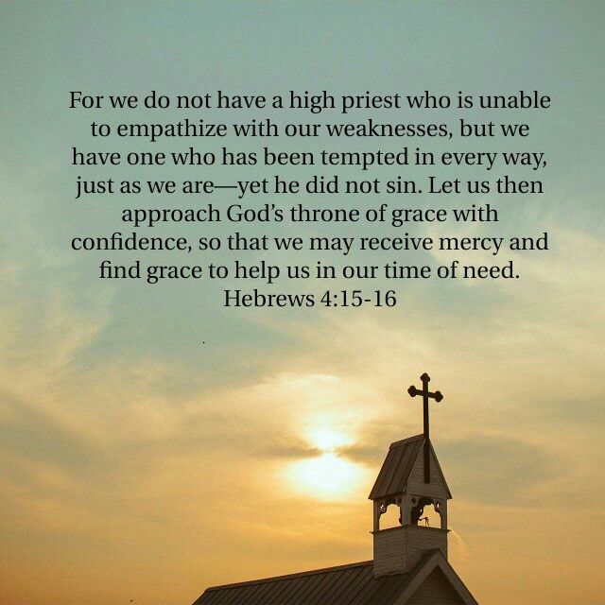

Slide 23
Prayerlessness is at the heart of
impatience and anxiety.

Slide 24
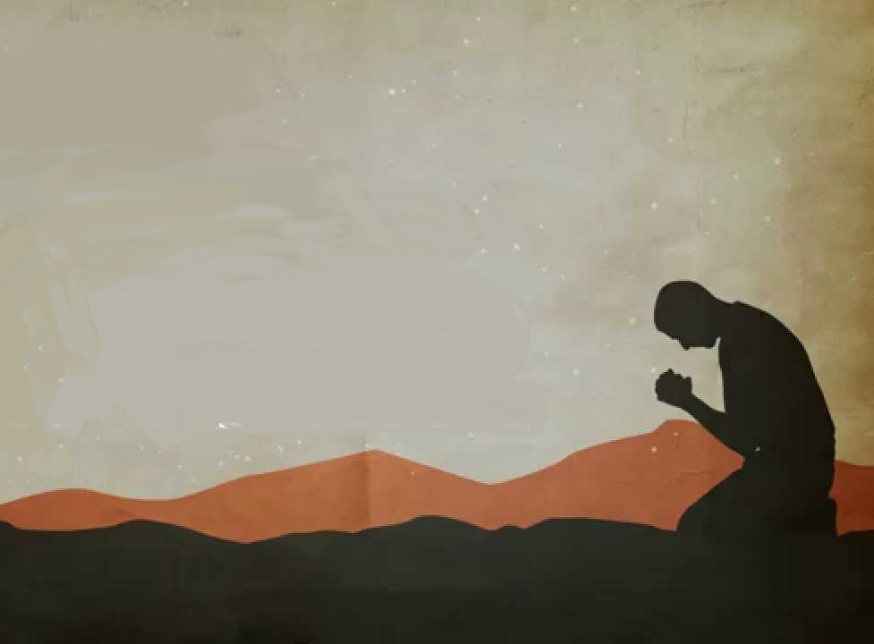
In God
We Rest!

Slide 25
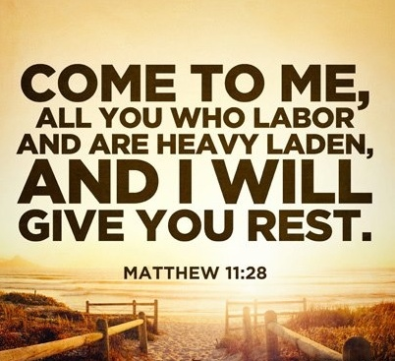

Slide 28
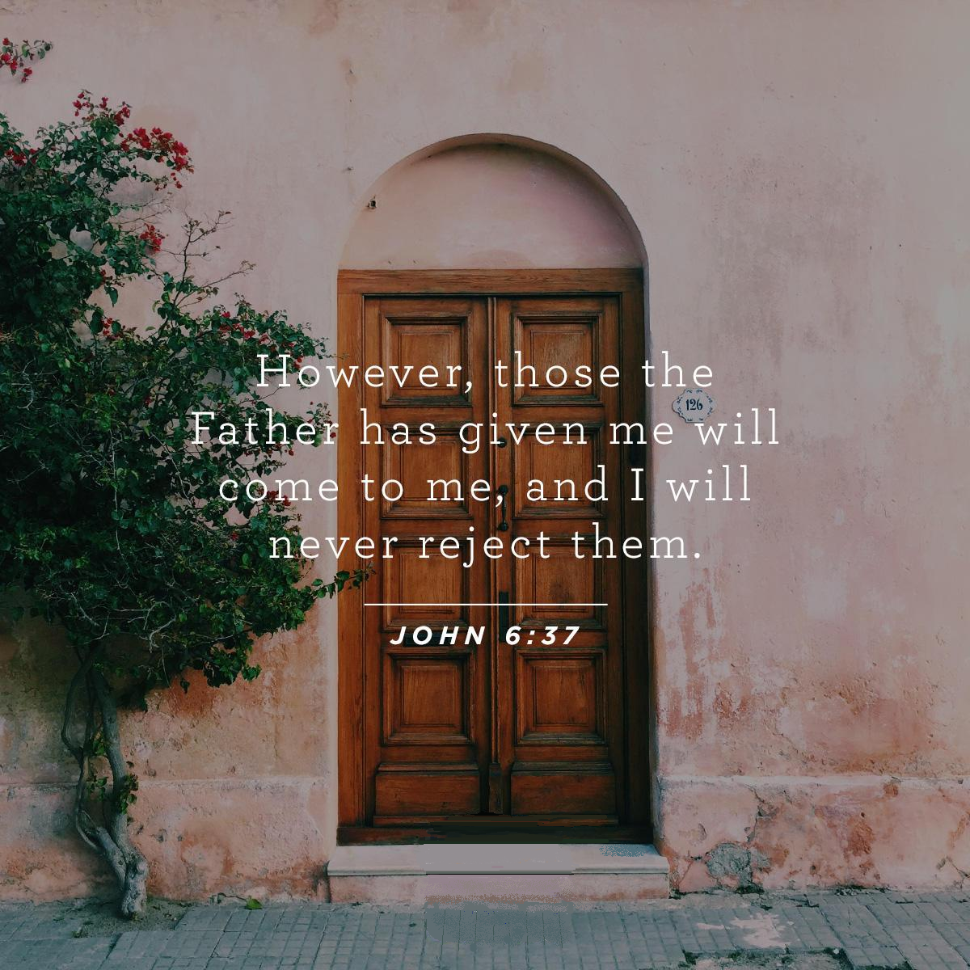

Slide 29
What constitutes prayer?

Slide 30
Is heartfelt relational communication with God.

Slide 31
Is fellowship and communion
with God.

Slide 32
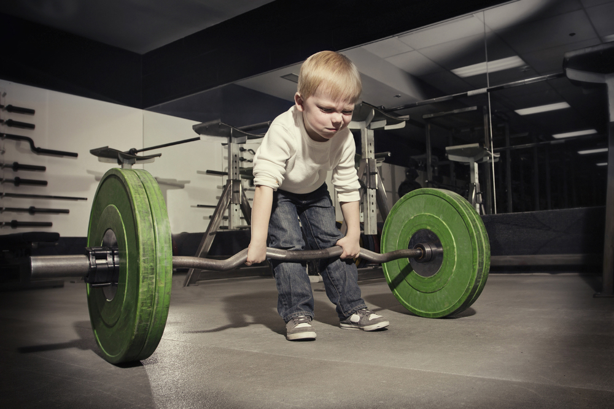
Matthew 26:41
The spirit is willing but the
flesh is weak.

Slide 34
¹Long ago God spoke many times and in many ways to our ancestors through the prophets. ²And now in these final days, he has spoken to us through his Son.
Hebrews 1:1-2 NLT

Slide 35
It’s hard to hear God speak
through a closed Bible!

Slide 36
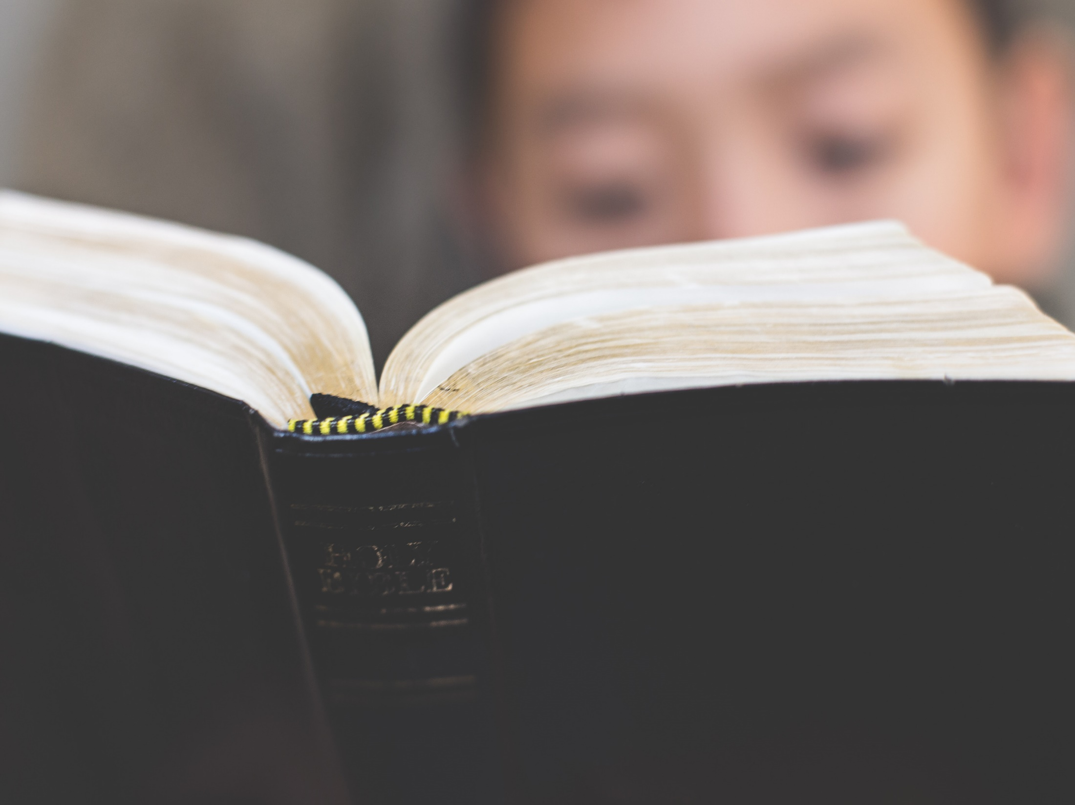
The first step in hearing God speak
is to read His Word FIRST!

Slide 37
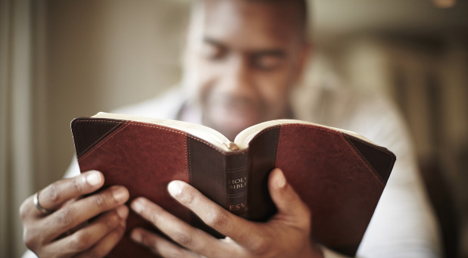
New Christians try to FIND time for God
Mature Christians MAKE time for God

Slide 38
God rarely speaks audibly to us. Most often it is through the written Word, and
sometimes through our circumstances.

Slide 39
Listening well involves…
REMOVING DISTRACTIONS

Slide 40
Listening well involves…
BEING STILL

Slide 41
Listening well involves…
EXERCISING PATIENCE

Slide 42
Listening well involves…

Slide 43
When you spend an hour in God’s Word, you begin to think like God. When you spend an hour watching T.V. you begin to think like the world.

Slide 44
CONFESSIONAL - Psalm 32:5-7
We acknowledge our need for forgiveness
- Philippians 4:6
- Exodus 32:11-14
- Psalm 138:1-2
- Psalm 103:1-2

Slide 45
THE IMPORTANCE OF

Slide 46
32:11-14

Slide 47
32:11-14
Deuteronomy 9:25-27
Numbers 14:13-19

Slide 48
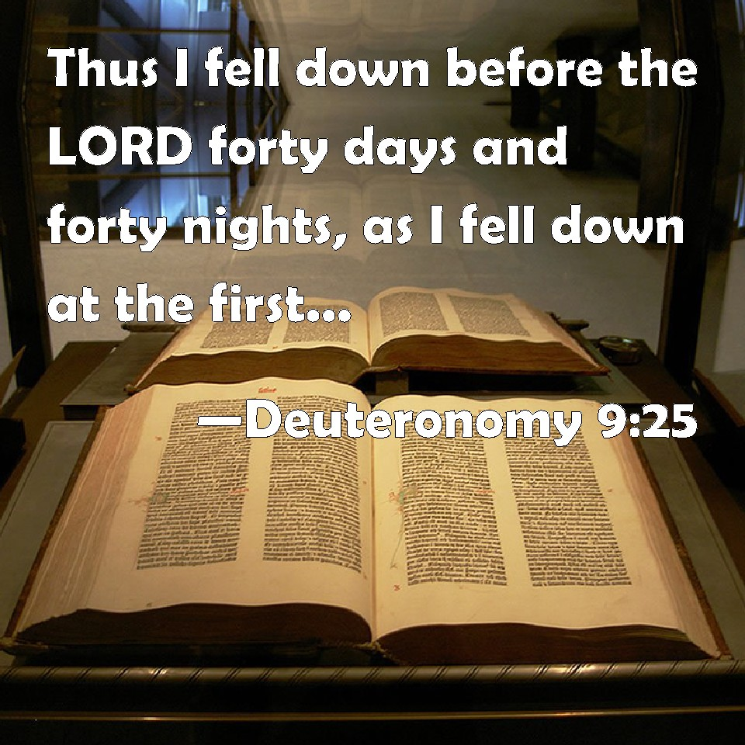

Slide 49
¹¹ Then Moses pleaded with the LORD his
God, and said: "LORD, why does Your wrath burn hot against Your people whom You have brought out of the land of Egypt with great power and with a mighty hand? ¹² Why should the Egyptians speak, and say, 'He brought them out to harm them, to kill them in the mountains, and to consume them
from the face of the earth'?

Slide 50
Turn from Your fierce wrath, and relent from this harm to Your people. ¹³ Remember Abraham, Isaac, and Israel, Your servants, to whom You swore by Your own self, and said to them, 'I will multiply your descendants as the stars of heaven; and all this land that I have spoken of I give to your descendants, and
they shall inherit it forever.' " ¹⁴ So
the LORD relented from the harm
which He said He would do
to His people.

Slide 54
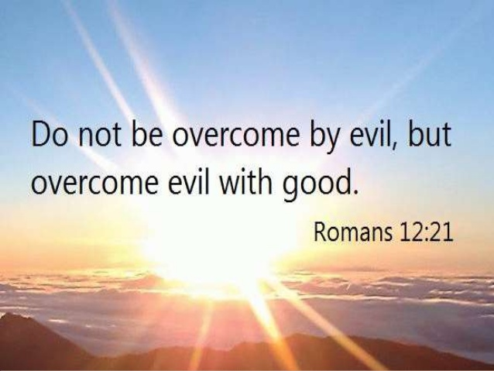

Slide 57
We are to intercede for…
The peace of Jerusalem (Psalm 122:6)
Our Fellow Countrymen (Romans 10:1)
For the sick (James 5:14)
For our enemies (Jeremiah 29:7)
For those who persecute Christians
(Matthew 5:44)

Slide 59
