Slide 1
“THE GOSPEL OF HOPE”

Slide 2
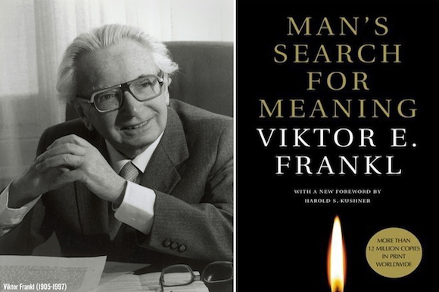

Slide 3
A person needs just three things to persevere in this world. We need someone to love, something to do, and something to hope for.
Viktor E. Frankl
paraphrased

Slide 4
“HOPE IN GOD”
His love for God
His love for God’s house and worshipping with God’s people.
His enduring hope and longing, for the day when he would appear before God.

Slide 5
“when I shall come and appear before God?”

Slide 8
He gave His one and only Son, that everyone who believes in Him shall not perish but have eternal life. For our God did not send His Son into the world to condemn the world, but to save the world through Him… for everyone who believes in Him may have eternal life.
John 3:15-17

Slide 9
“I know the plans I have for you, declares the LORD, plans to prosper you and not to harm you, plans to give you hope and a future”
(Jer. 29:11)

Slide 10
“Eye hath not seen, nor ear heard, neither have entered into the heart of man, the things which God hath prepared for them that love him”
1 Cor. 2; 9.

Slide 11
“God will wipe every tear from our eyes. A world where there will be no more death or mourning or crying or pain, for that world will have passed away.”
Revelation 21:3-5

Slide 12
Where God will live with us and we with Him. We will be His people and God himself will be our Father.
Revelation 21:3-5

Slide 13
“Behold, I will make all things new. Write these things down, for these words are faithful and true.”
Revelation 21:4

Slide 14
The gospel is the good news that there is someone to love, something worthwhile to do, and something really good to hope for.

Slide 15
"good" (II Thessalonians 2:16). "blessed" (Titus 2:13). "living" (1 Peter 1:3).
THE BEST
NEWS EVER

Slide 17
“We have this hope as an anchor for the soul, firm and secure. Because of Him who entered the inner sanctuary behind the curtain on our behalf and made atonement for all our sins.
HEBREWS 6:19-20

Slide 18
Jesus has gone before us, having become our eternal priest, who sits at the right Hand of God continually pleading with the Father on our behalf.
HEBREWS 6:19-20

Slide 19
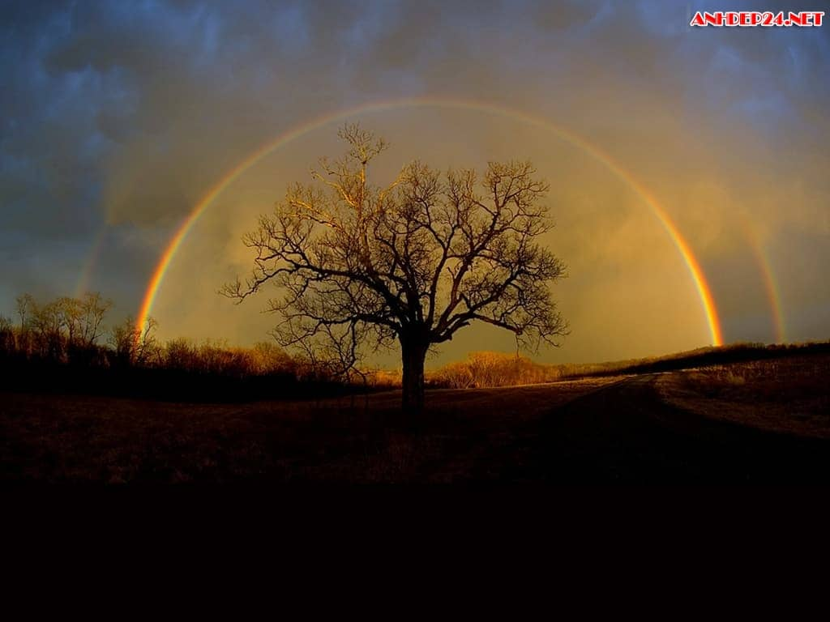
John 16:33 (NLT) Here on earth you will have many trials and sorrows. But take heart, because I have overcome the world.”

Slide 20
Isaiah 53:3

Slide 21
Romans 8:18
“The pain that you’ve been feeling,
can’t compare to the joy that’s coming.”

Slide 22
There’s more…

Slide 23
There’s more…
The Gospel of Hope means that Everything We Need to Overcome is Ours in Jesus Christ.

Slide 24
How do We overcome?

Slide 25
Through the power and presence
of the Holy Spirit

Slide 26
On the Path of Prayer we claim
the Promises in God’s Word

Slide 28
Just two verses latter…
Even though I am afflicted very much, You will revive me, O Lord according to Your Word. Psalm119:107

Slide 30
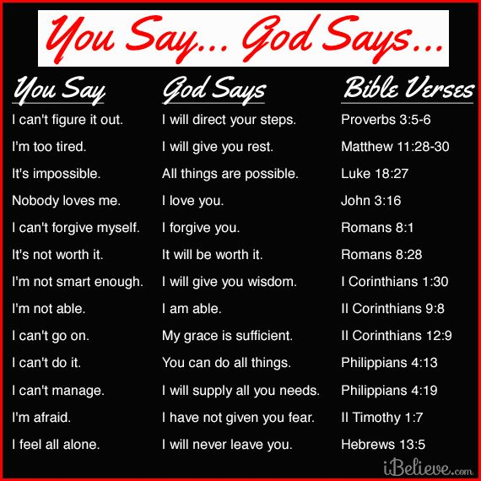

Slide 31
Don’t be
UNPREPARED!

Slide 32
By Trusting Him & His Word

Slide 35
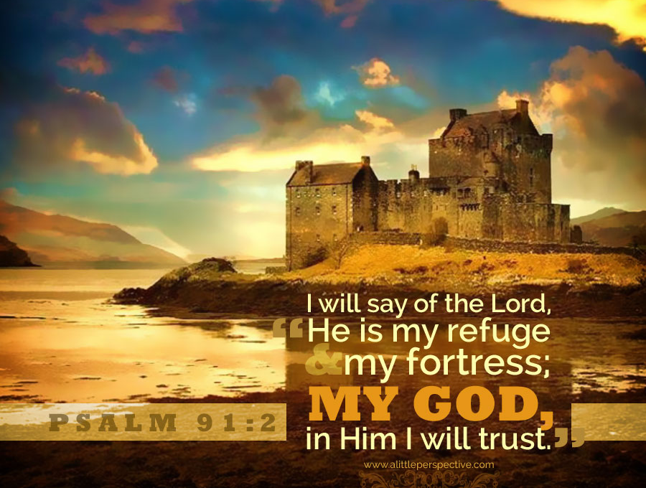

Slide 38
By Believing He Loves YOU!

Slide 39
GOD LOVES YOU!

Slide 40
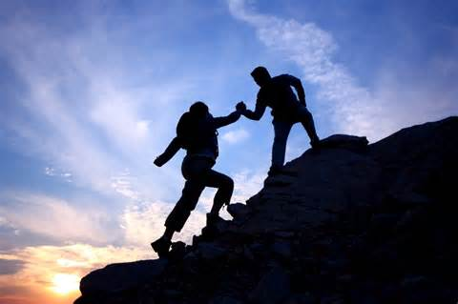
REACH OUT
TO OTHERS…

