Slide 3
Will the Real Mother
PLEASE STAND UP!

Slide 4
Will the “Real Mother” Please Stand Up!
1 Kings 3:16-27

Slide 5
¹⁶ Then two prostitutes came to the king and stood before him. ¹⁷ The one woman said, “Oh, my lord, this woman and I live in the same house, and I gave birth to a child while she was in the house. ¹⁸ Then on the third day after I gave birth, this woman also gave birth. And we were alone.

Slide 6
There was no one else with us in the house; only we two were in the house. ¹⁹ And this woman’s son died in the night, because she lay on him. ²⁰ And she arose at midnight and took my son from beside me, while your servant slept, and laid him at her breast, and laid her dead son at my breast.

Slide 7
²¹ When I rose in the morning to nurse my child, behold, he was dead. But when I looked at him closely in the morning, behold, he was not the child that I had borne.” ²² But the other woman said, “No, the living child is mine, and the dead child is yours.” The first said, “No, the dead child is yours, and the living child is mine.”

Slide 8
Thus they spoke before the king. ²³ Then the king said, “The one says, ‘This is my son that is alive, and your son is dead’; and the other says, ‘No; but your son is dead, and my son is the living one.’” ²⁴ And the king said, “Bring me a sword.” So a sword was brought before the king.

Slide 9
²⁵ And the king said, “Divide the living child in two, and give half to the one and half to the other.” ²⁶ Then the woman whose son was alive said to the king, because her heart yearned for her son, “Oh, my lord, give her the living child, and by no means put him to death.”

Slide 10
But the other said, “He shall be neither mine nor yours; divide him.” ²⁷ Then the king answered and said, “Give the living child to the first woman, and by no means put him to death; she is his mother.”

Slide 11
1. Real mothers have a self-sacrificing love for their children.

Slide 12
2. Real mothers do not have
to be perfect.

Slide 13
2. Real mothers do not have
to be perfect.

Slide 15
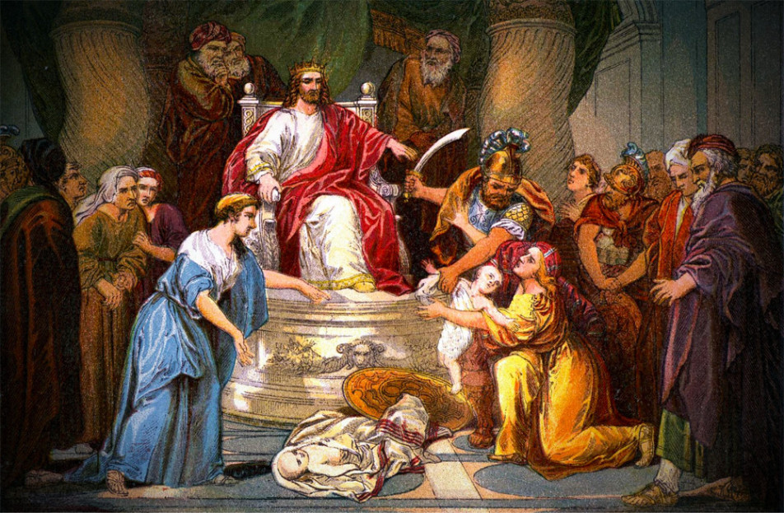

Slide 16
3. Real Mothers just keep
on giving.

Slide 17
4. Real mothers acknowledge they need God’s help.

Slide 18
James 1:5 (NKJV) ⁵ If any of you lacks wisdom, let him ask of God, who gives to all liberally and without reproach, and it will be given to him.

Slide 19
Real Mothers stand up for their children even in the face of evil opposition.

Slide 20
5. Real mothers are the
real teachers of life.

Slide 21
Things my mother taught me…

Slide 22
My Mother taught me about ANTICIPATION

Slide 23
My Mother taught me about MEDICAL SCIENCE

Slide 24
My Mother taught me about JUSTICE

Slide 25
My Mother taught me about RELIGION

Slide 26
My Mother taught me about CONTORTION

Slide 27
My Mother taught me about WEATHER

Slide 28
My Mother taught me about HYPOCRISY

Slide 29
My Mother taught me about THE CIRCLE OF LIFE

Slide 30
My Mother taught me about ENVY

Slide 32
Words of Encouragement

Slide 33
Words of Encouragement
1. Don’t look for stress-free motherhood, it doesn’t exist.

Slide 34
Words of Encouragement
2. Let God help!

Slide 35
Words of Encouragement
3. Be the Best You, You can be

Slide 36
Words of Encouragement
Know your purpose.
Know your limits.

Slide 37
Words of Encouragement

Slide 38
Words of Encouragement
I can do all things through Christ who gives me strength.
Philippians 4:13

Slide 39
Words of Encouragement
Know your purpose.
Know your limits.
Know God intimately.

Slide 40
Words of Encouragement

