Slide 1
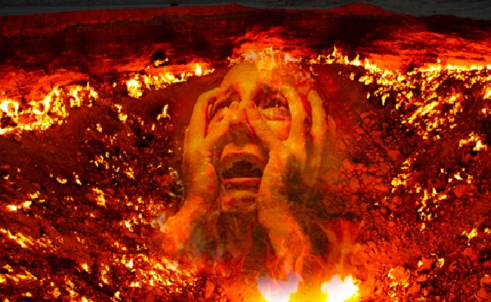
A Week From Hell
Matthew 26 & Luke 22

Slide 2
By Judith Viorst

Slide 4
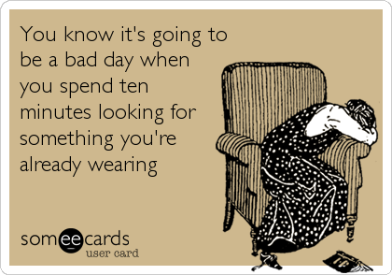

Slide 5
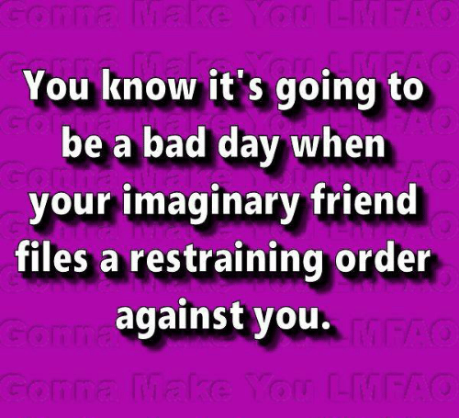

Slide 6
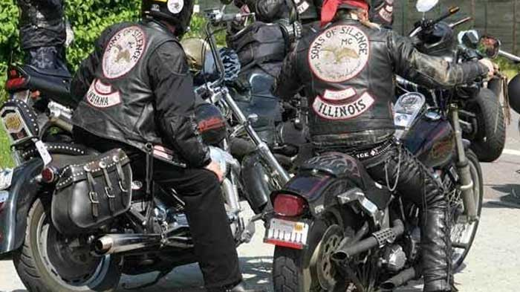
Motorcycle gang called the
Sons of Silence

Slide 7
You put both contacts
in the same eye!

Slide 8
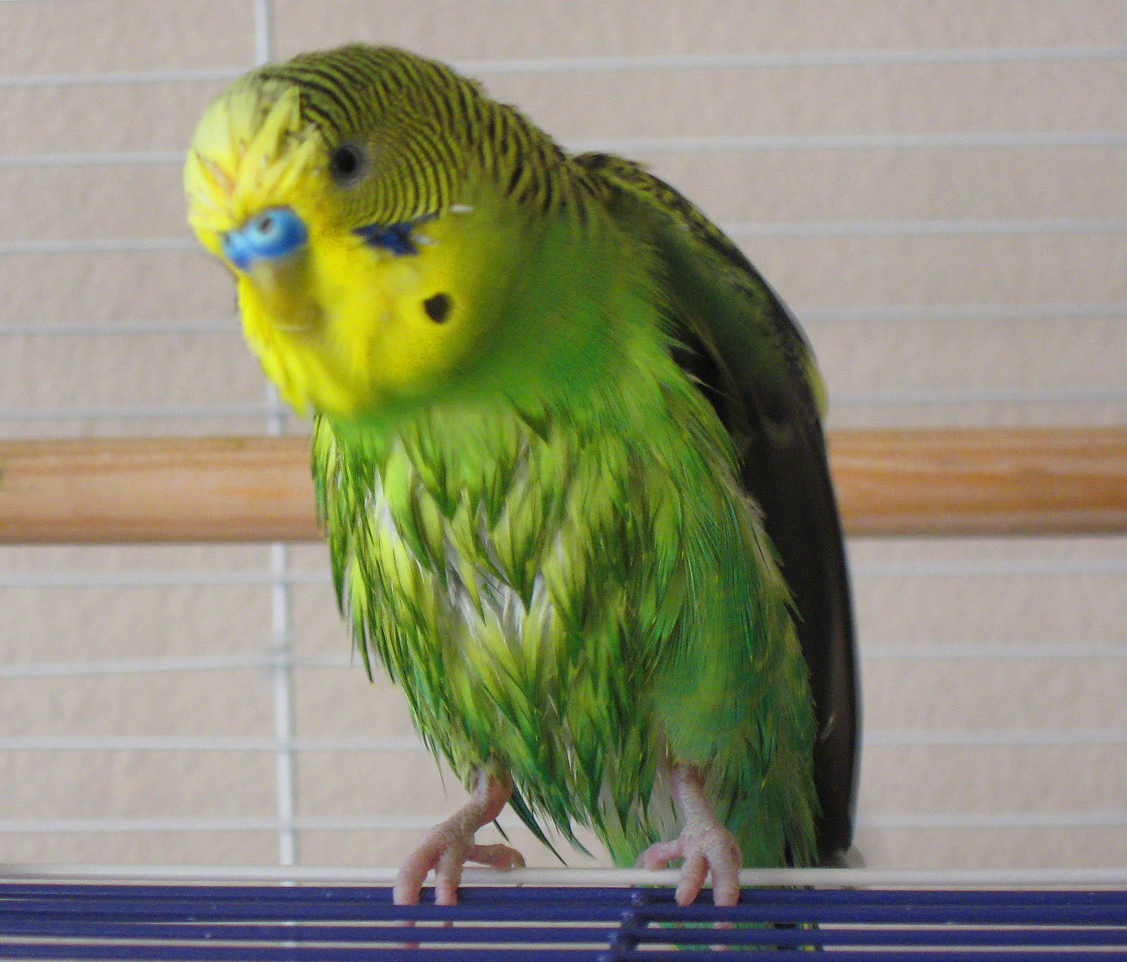

Slide 9
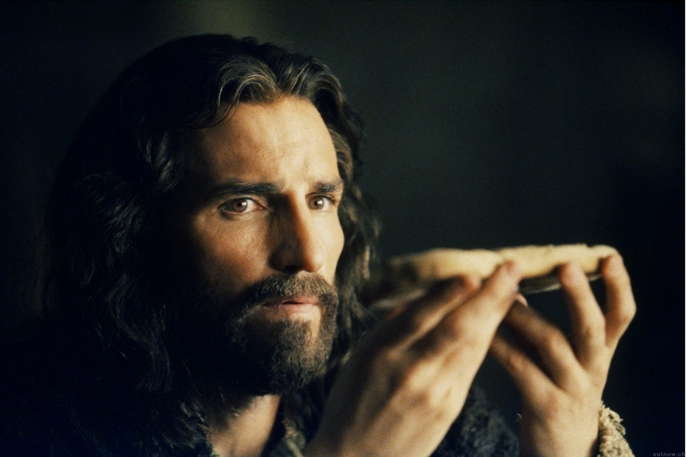
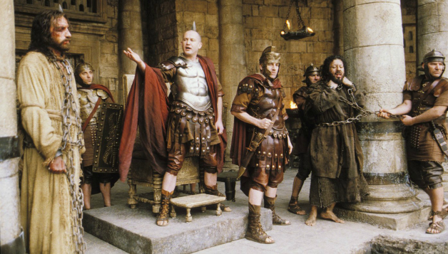
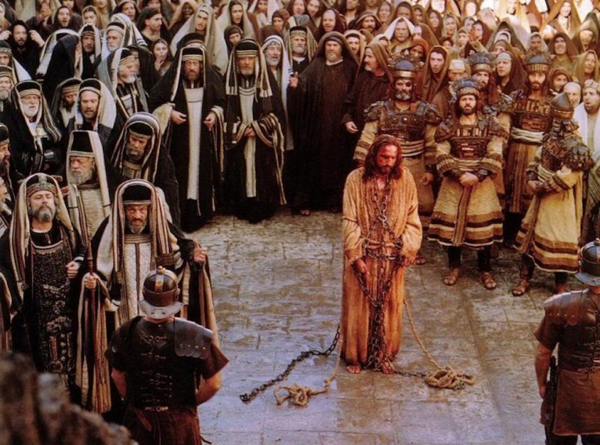
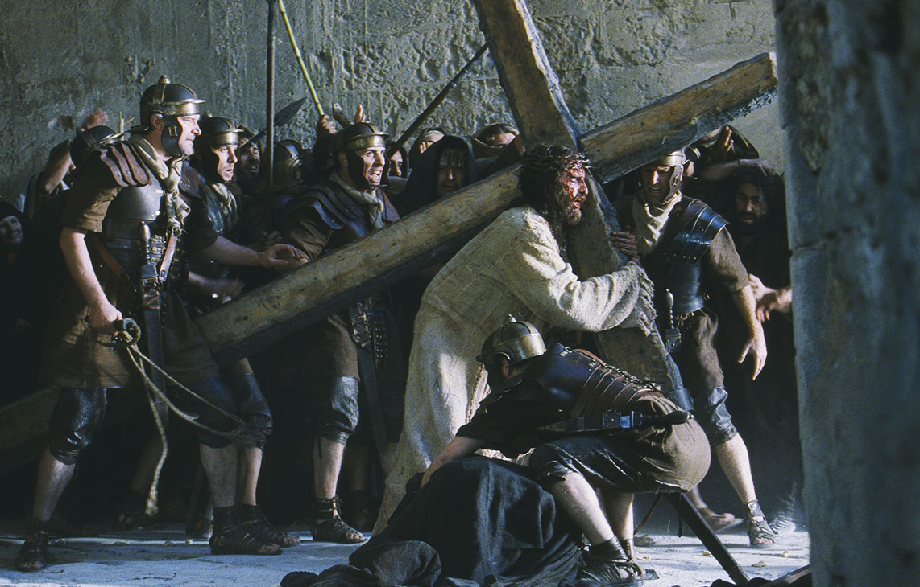
Jesus experienced a Week From Hell…

Slide 10
Matthew 26:36-46
Luke 22:7-20

Slide 11
Saturday – Bethany

Slide 12
Saturday – Bethany
Monday – Jerusalem

Slide 13
Saturday – Bethany
Monday – Jerusalem
Thursday – Passover

Slide 14
Saturday – Bethany
Monday – Jerusalem
Thursday – Passover
Friday – Crucifixion

Slide 15
Saturday – Bethany
Monday – Jerusalem
Thursday – Passover
Friday – Crucifixion
Saturday – Despair, Confusion…

Slide 16
SUNDAY

Slide 17
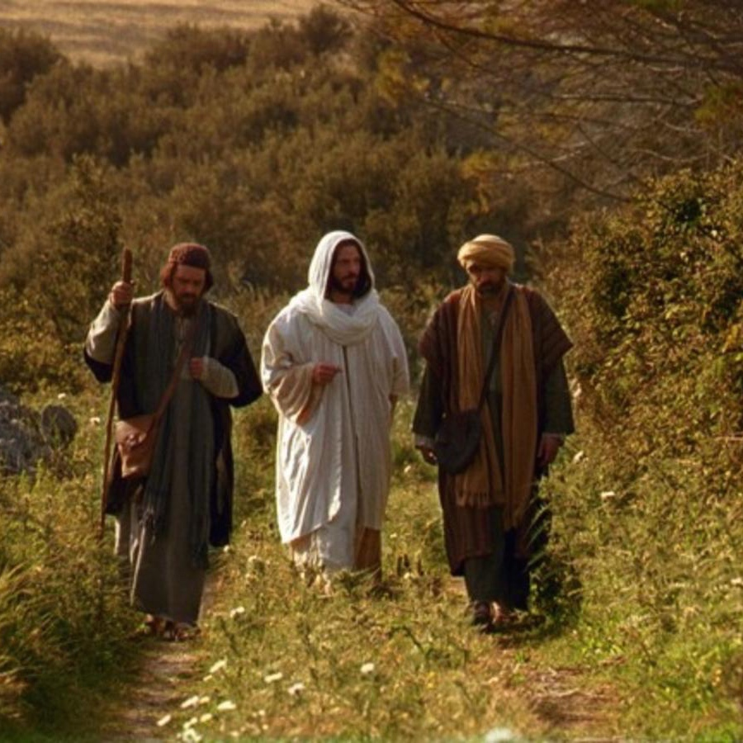

Slide 19
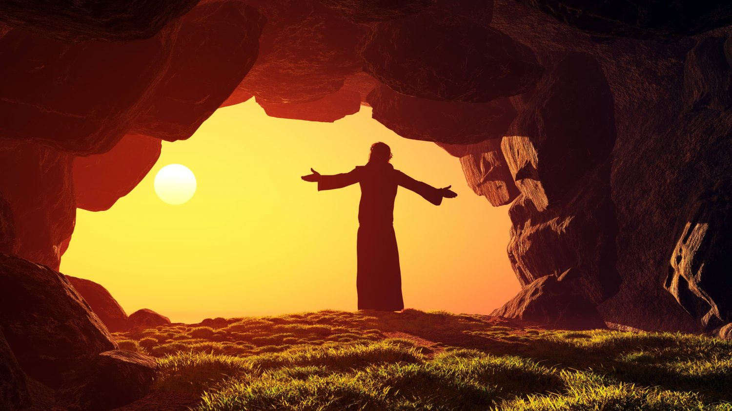
God can take a terrible, horrible, no good, very bad day and bring something good out of it.

Slide 20
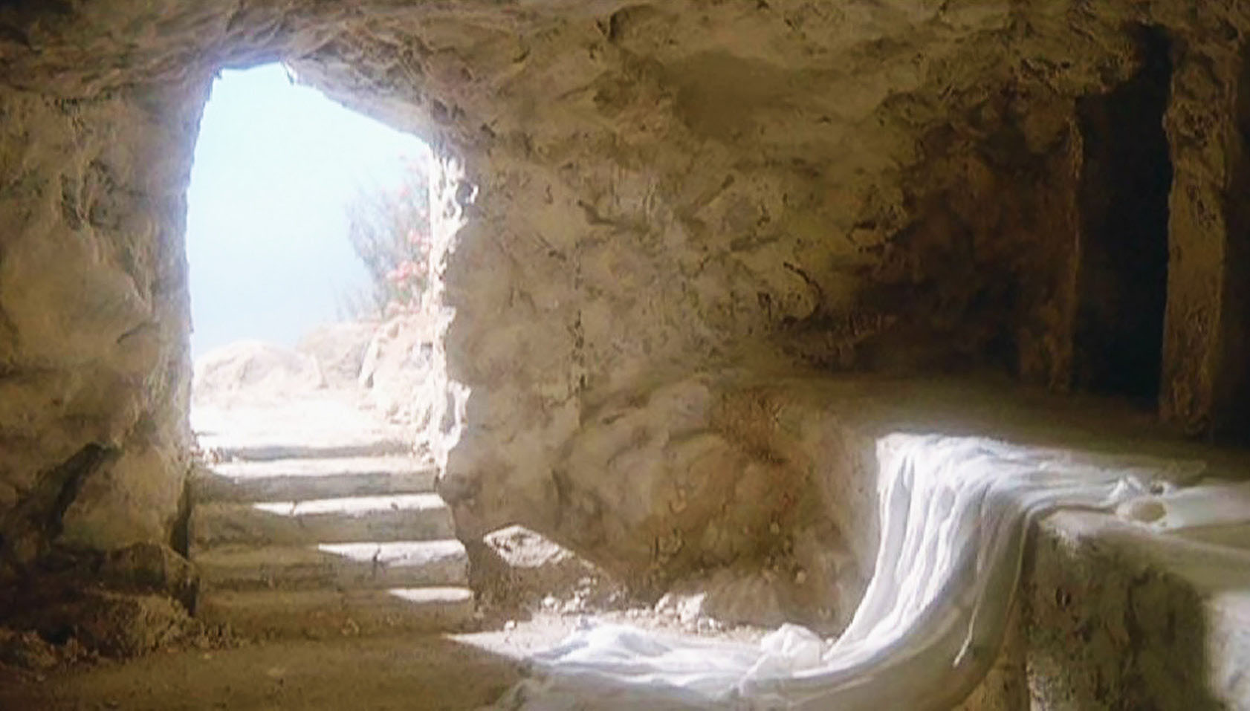
God can turn
Black Friday
into
Good Friday!

Slide 21
The Steps
Jesus took

Slide 22
Jesus
didn’t
go it
alone

Slide 23
¹³ No temptation has overtaken you except what is common to humanity. God is faithful, and He will not allow you to be tempted beyond what you are able, but with the temptation He will also provide a way of escape so that you are able to bear it.
1 Corinthians 10:13

Slide 24
Adversity

Slide 25
Jesus found
a solitary
place
to pray

Slide 26
Jesus turned
to His
disciples

Slide 27
Jesus turned
to His
Father

Slide 28
Jesus fully
surrendered

Slide 29
Adversity
exposes our
vulnerabilities

Slide 30
Adversity
is a call for
self-examination

Slide 31
Adversity
Exposes
Pride.

Slide 32
Adversity
Reveals what’s
On the inside.

Slide 33
Adversity
Tests our
Friendships.

Slide 34
Adversity invites us
To experience the
Power of God

Slide 35
Adversity prepares us
To help others.

Slide 36
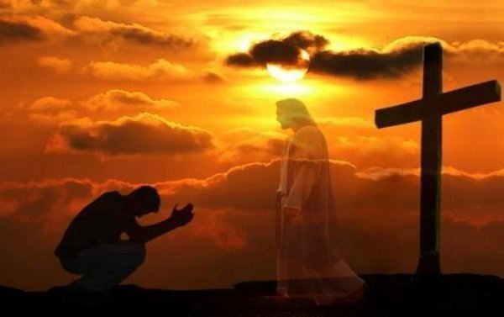
Surrender

