Slide 1
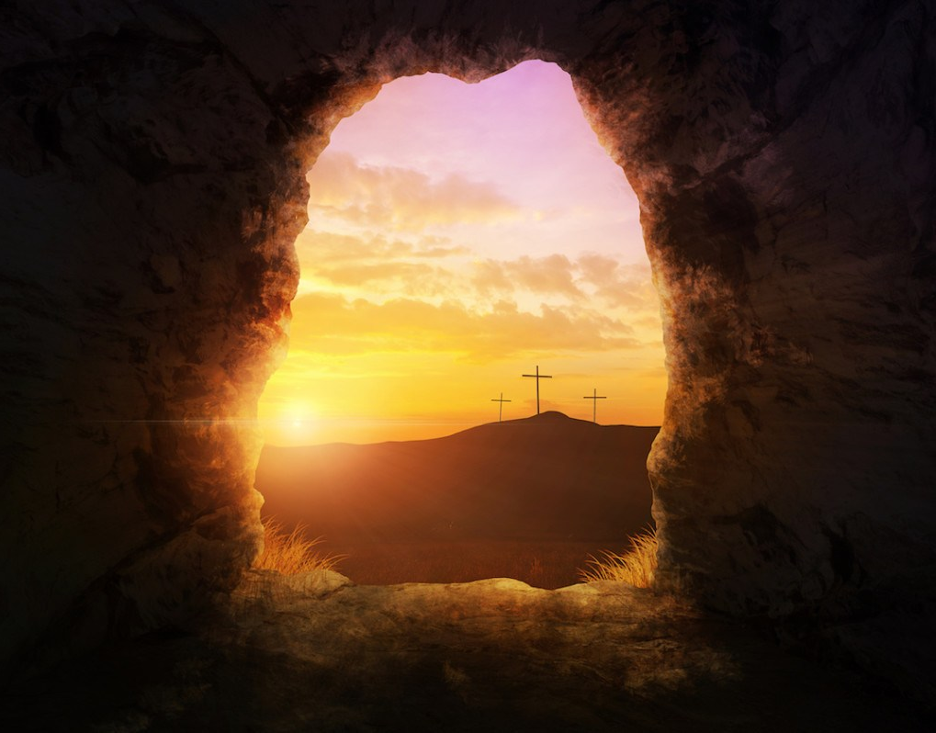
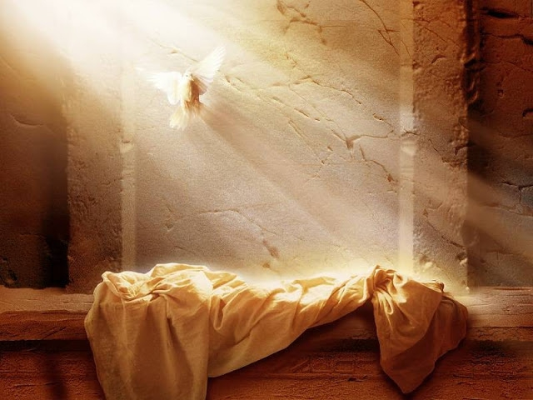
1 Corinthians 15:12-19
HOPELESS
O R…
HOPEFUL

Slide 2
Easter is about
HOPE!

Slide 3
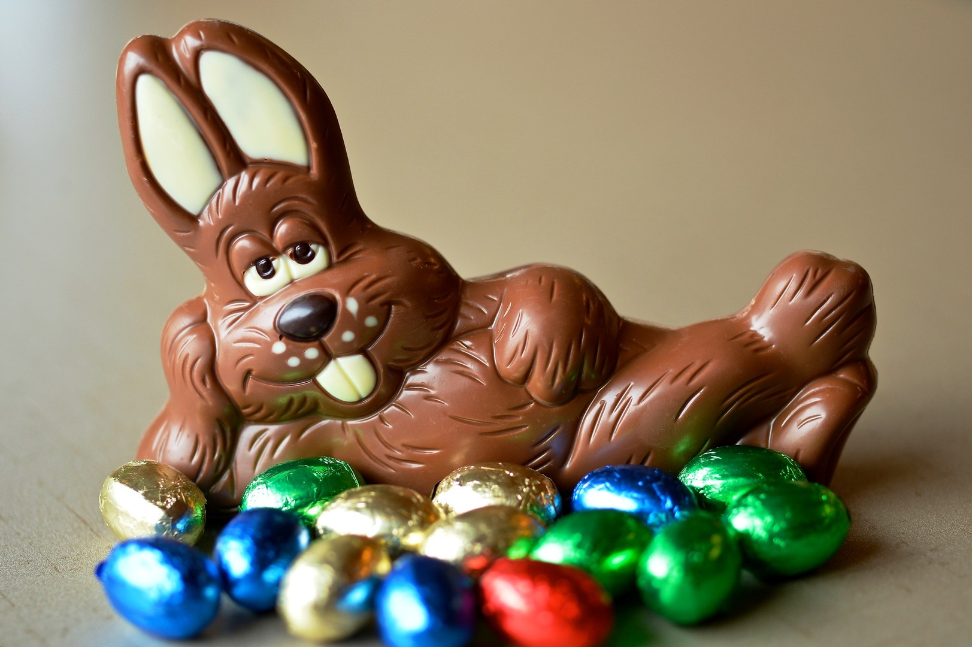

Slide 6
Jesus existed,
Jesus of Nazareth, was crucified.

Slide 7
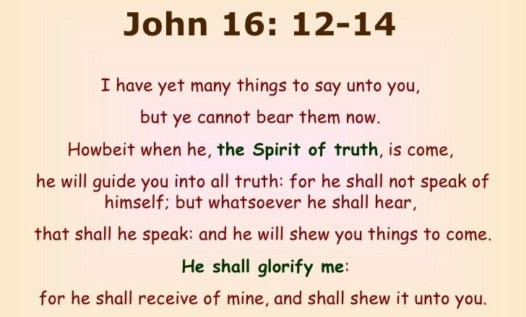

Slide 8
“If in this life only we have hope in Christ,
we are of all men
the most pitiable”
1 Corinthians 15:18

Slide 9
THE PURPOSE BEHIND
THE DEATH OF JESUS

Slide 10
WHY?

Slide 11
Genesis 2:16-17 (NKJV) ¹⁶ And the LORD God commanded the man, saying, "Of every tree of the garden you may freely eat; ¹⁷ but of the tree of the knowledge of good and evil you shall not eat, for in the day that you eat of it you shall surely die."

Slide 13
2. What Jesus said about
Death and the Resurrection

Slide 19
3. The Message
of Easter
Death is not
The END!

Slide 22
Easter is about Christ in your Heart!

Slide 26
“The cable of faith casts out the anchor of hope and lays hold of the steadfast rock of God’s promises.”

Slide 27
1 John 3:3
“And everyone who has this hope in Him purifies himself, just as He is pure.”

Slide 28
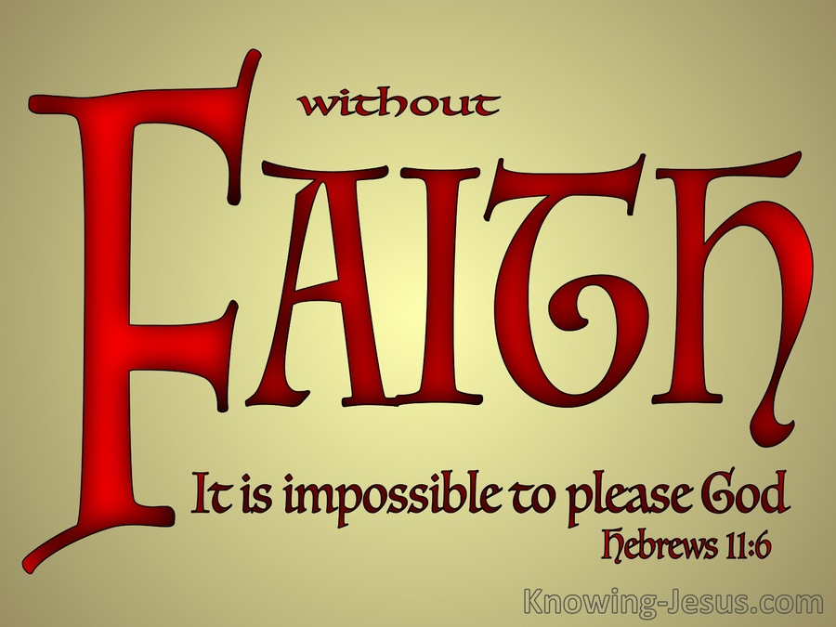

Slide 29
HOPEFUL
O R…
HOPELESS

