Slide 1
What Does “Faith” Look Like?
Romans 4:13-25

Slide 2
TWO KINDS OF
ORDINARY
&
EXTRAORDINARY

Slide 4
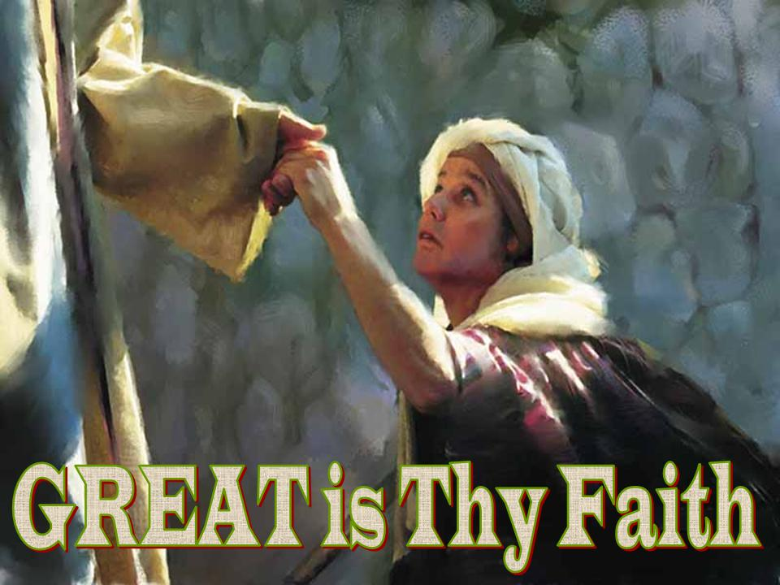

Slide 5
2. Examples of ordinary faith that over time
was transformed into extraordinary faith

Slide 6
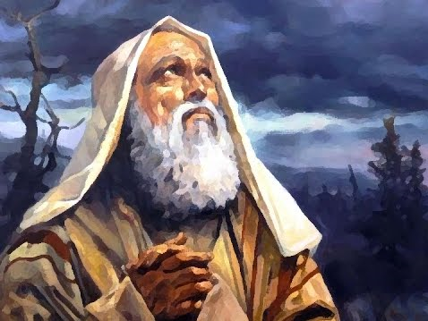
ABRAHAM

Slide 7
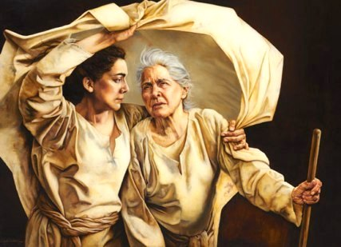
RUTH & NAOMI

Slide 8
3. THE BENEFITS
OF FAITH IN GOD

Slide 9
is the CONFIDENCE that what we HOPE for will actually happen.

Slide 11
Luke 7:9
“I haven’t seen faith like this in all the land of Israel”

Slide 12
in action…

Slide 13
WHAT ARE YOU
TRUSTING IN?

Slide 14
IN WHOM DO YOU TRUST

Slide 15
Be strong and courageous! Do not be afraid; Do not be discouraged, the Lord your God will be with you wherever you go.
Joshua 1:9

