Slide 1
Longing For a Better World
Hebrews 11:13-16

Slide 3
Hebrews 11:13-16 (NKJV)
¹³ These all died in faith, not having received the promises, but having seen them afar off were assured of them, embraced them and confessed that they were strangers and pilgrims on the earth.

Slide 4
Hebrews 11:13-16 (NKJV)
¹⁴ For those who say such things declare plainly that they seek a homeland. ¹⁵ And truly if they had called to mind that country from which they had come out, they would have had opportunity to return.

Slide 5
Hebrews 11:13-16 (NKJV)
¹⁶ But now they desire a better, that is, a heavenly country. Therefore God is not ashamed to be called their God, for He has prepared a city for them.

Slide 6
55 times in Matthew; 20 times in Mark,
46 times in Luke
5 times in John.

Slide 7
Matthew 3:2 ² and saying, "Repent, for the kingdom of heaven is at hand!" Matthew 4:17 ¹⁷ From that time Jesus began to preach and to say, "Repent, for the kingdom of heaven is at hand." Matthew 10:7 ⁷ And as you go, preach, saying,
'The kingdom of heaven is at hand.'

Slide 8
The Kingdom of God

Slide 9
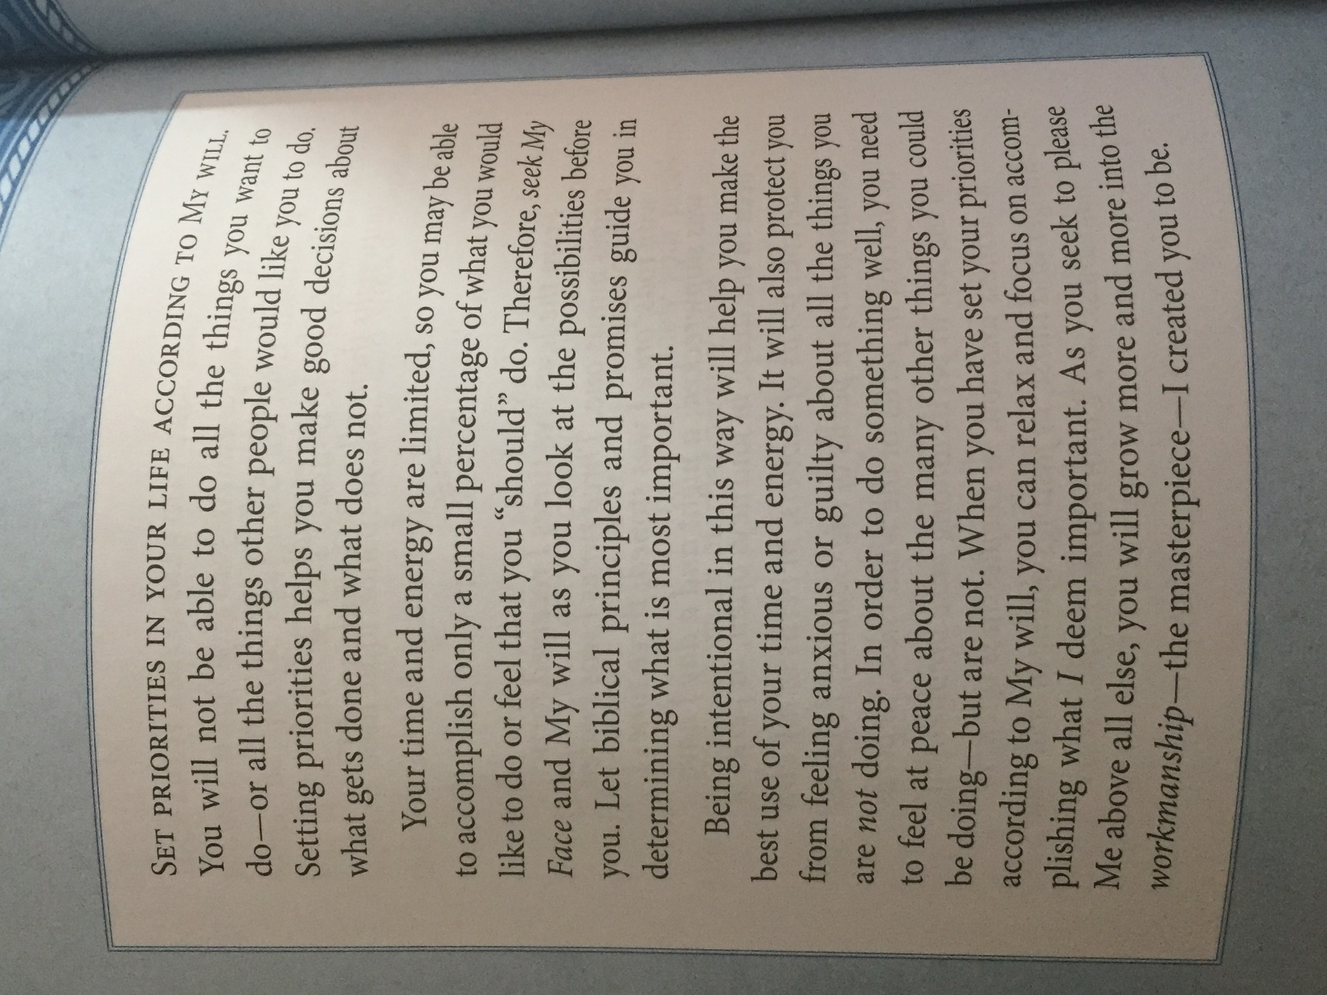

Slide 10
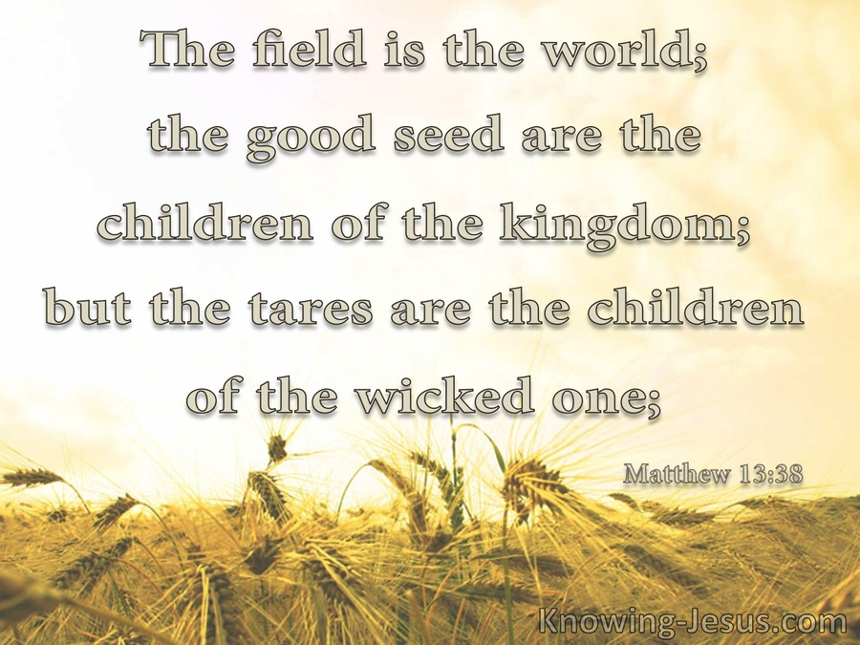

Slide 11
2 Peter 3:9 (NKJV) ⁹ The Lord is not slack concerning His promise, as some count slackness, but is longsuffering toward us, not willing that any should perish but that all should come to repentance.

Slide 12
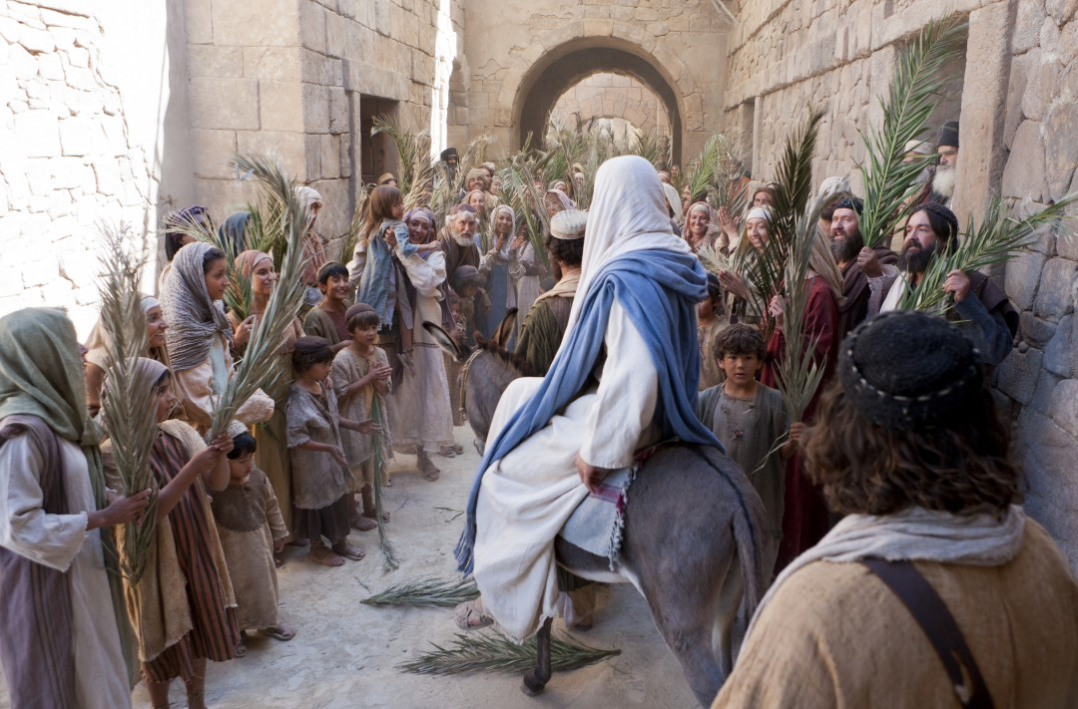

Slide 17
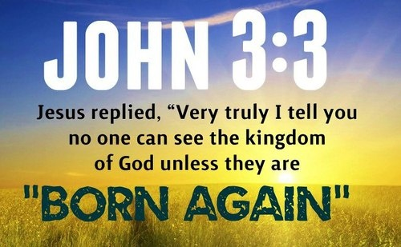

Slide 18
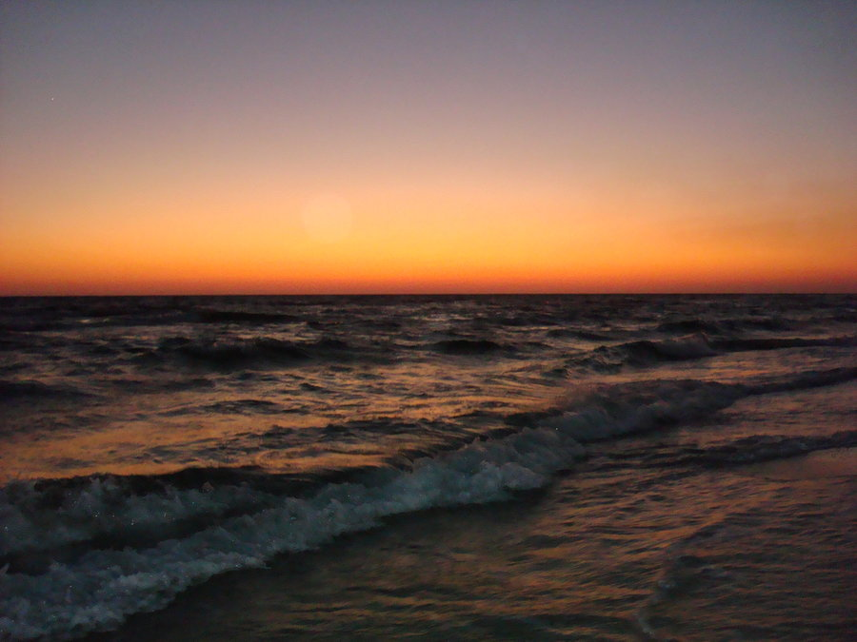
We all long for a better world, both in this present time and in the future.

Slide 19
How to enter this better world

Slide 20
THROUGH FAITH IN CHRIST

Slide 21
THROUGH FAITH IN,
AND OBEDIENCE TO
JESUS CHRIST

Slide 22
ABRAHAM

