Slide 1
Message
Pastor Walt Kellcy

Slide 2
The Benefits of Spending Time in God’s Word
Psalm 19

Slide 3
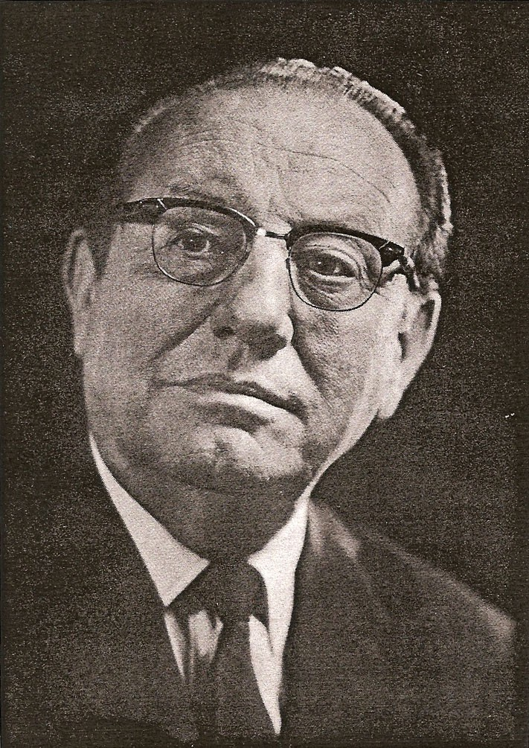
Emile Cailliet

Slide 4
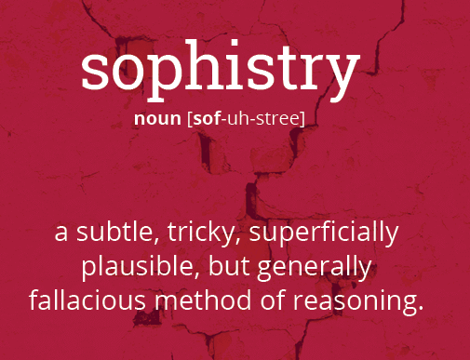
Zondervan, 1968

Slide 5
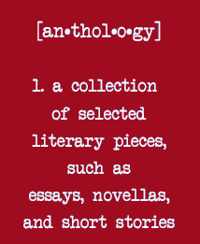
Zondervan, 1968

Slide 6
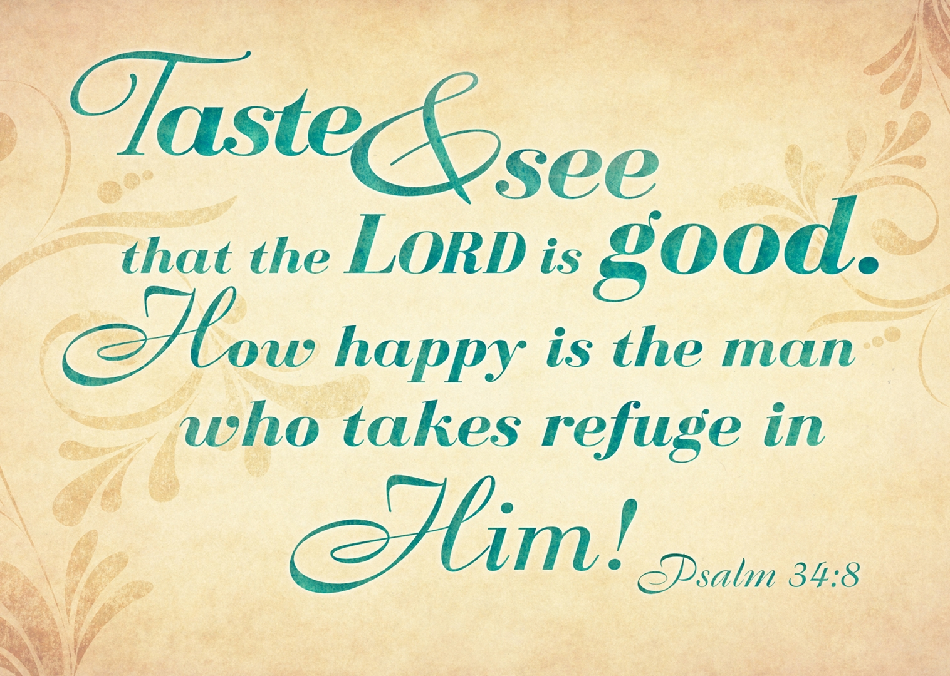

Slide 7
PSALM 19

Slide 8
86% of the households own or have a Bible
http://www.americanbible.org/uploads/content/state-of-the-bible-data-analysis-american-bible-society-2014.pdf
65 page report

Slide 9
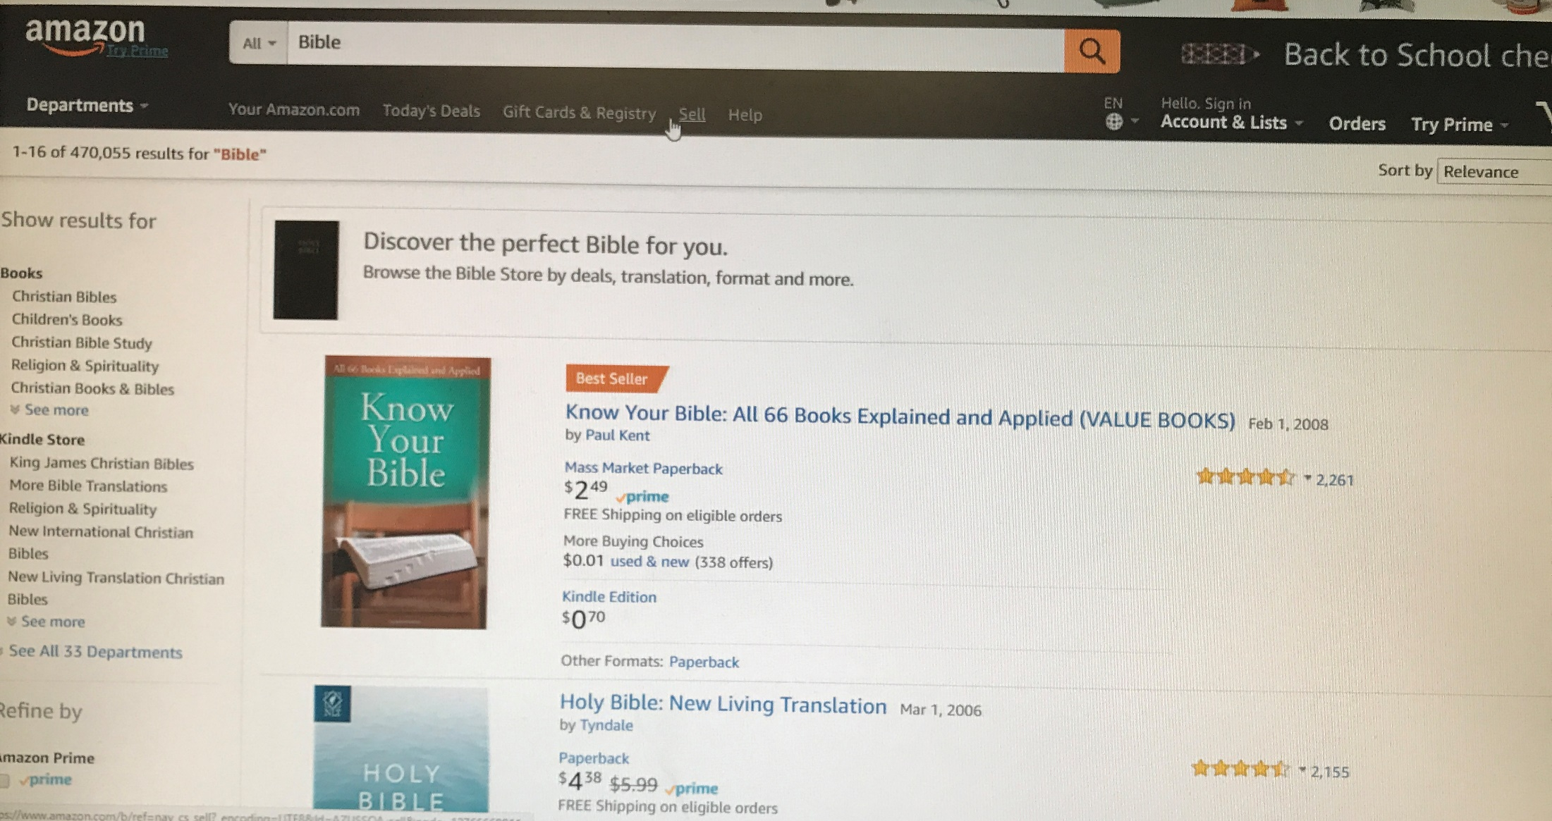

Slide 10
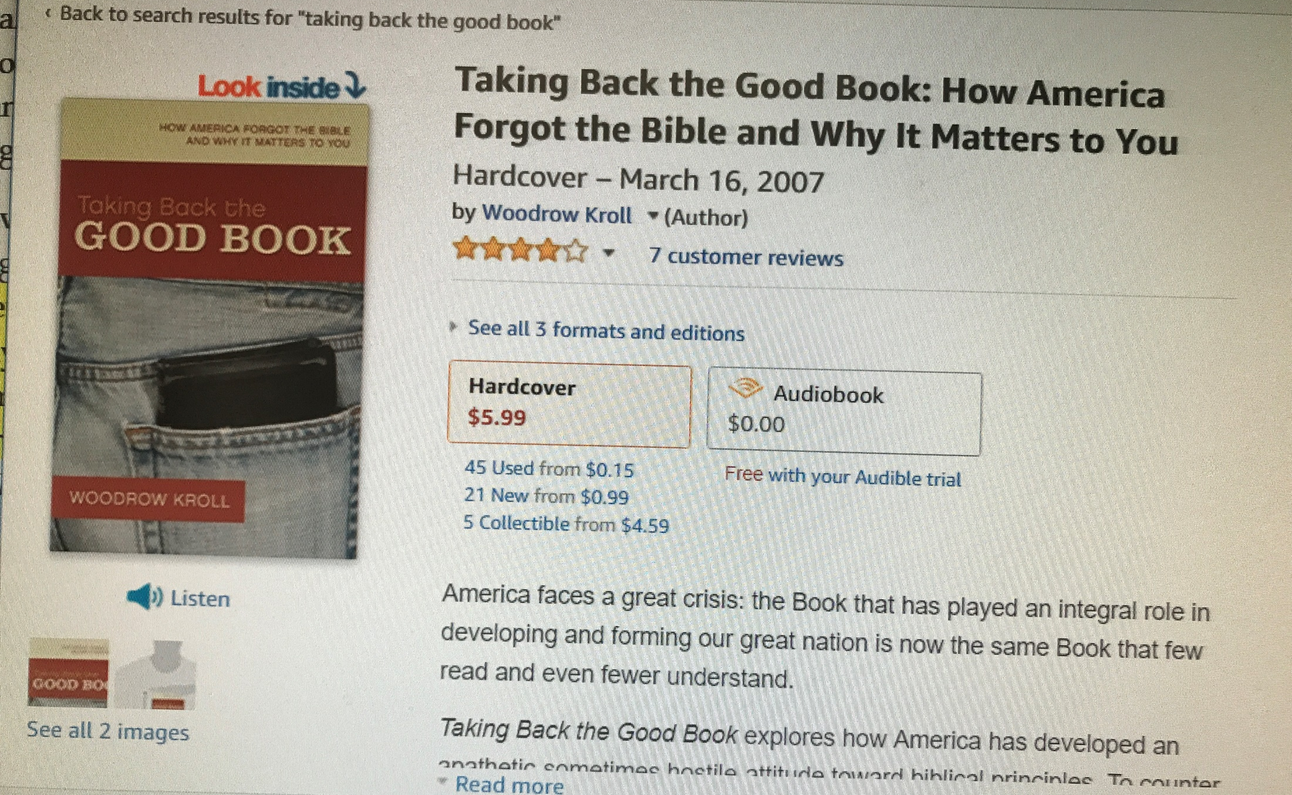

Slide 11
Where do you see yourself
In all this?

Slide 12
The Psalmist would have you know the benefit, the impact, the Word of God can have upon your life, if you’ll spend some time in the Word of God.

Slide 13
Psalm 19:7 (NKJV) ⁷ The law of the LORD is perfect, converting the soul; The testimony of the LORD is sure, making wise the simple;

Slide 14
Psalm 19:8 (NKJV) ⁸ The statutes of the LORD are right, rejoicing the heart; The commandment of the LORD is pure, enlightening the eyes;

Slide 15
Psalm 19:9 (HCSB) ⁹ The fear of the LORD is pure, enduring forever; the ordinances of the LORD are reliable and altogether righteous.

Slide 16
PSALM 19:10-14
Seven additional blessings

Slide 17
Psalm 19:10 (NKJV) ¹⁰ More to be desired are they than gold, Yea, than much fine gold; Sweeter also than honey and the honeycomb.

Slide 18
Psalm 19:11 (NKJV) ¹¹ Moreover by them Your servant is warned, And in keeping them there is great reward.

Slide 19
Psalm 19:12 (NKJV) ¹² Who can understand his errors? Cleanse me from secret faults.

Slide 20
Psalm 19:13 (NKJV) ¹³ Keep back Your servant also from presumptuous sins; Let them not have dominion over me. Then I shall be blameless, And I shall be innocent of great transgression.

Slide 21
Many today are neglecting the Bible

Slide 22
Let the word of Christ
dwell in you richly.
Colossians 3:16

Slide 23
PSALM 19

Slide 24
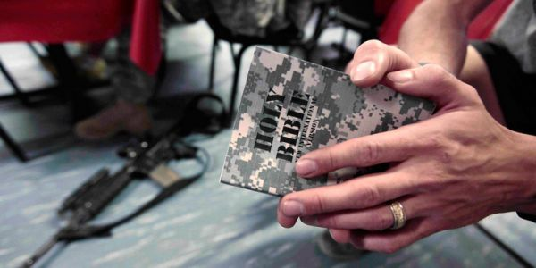
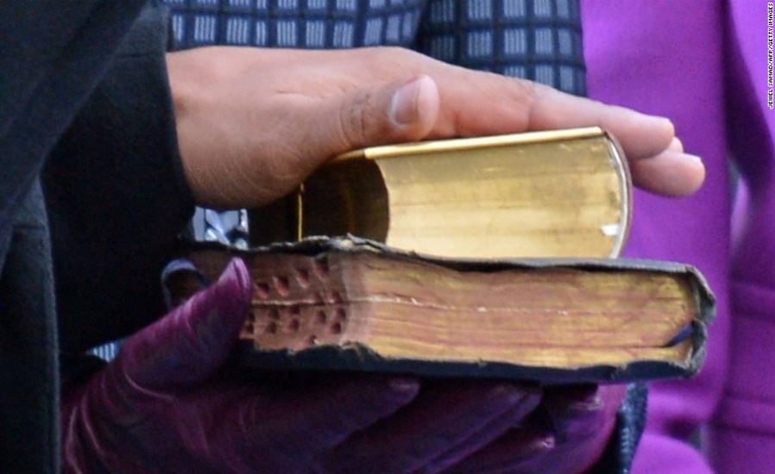
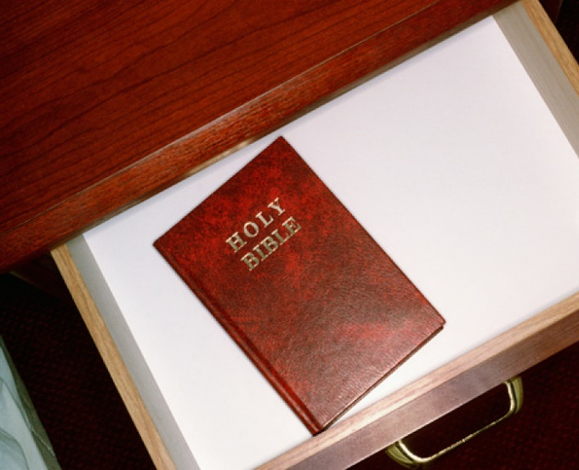

Slide 25
A warning and a reward!

Slide 26
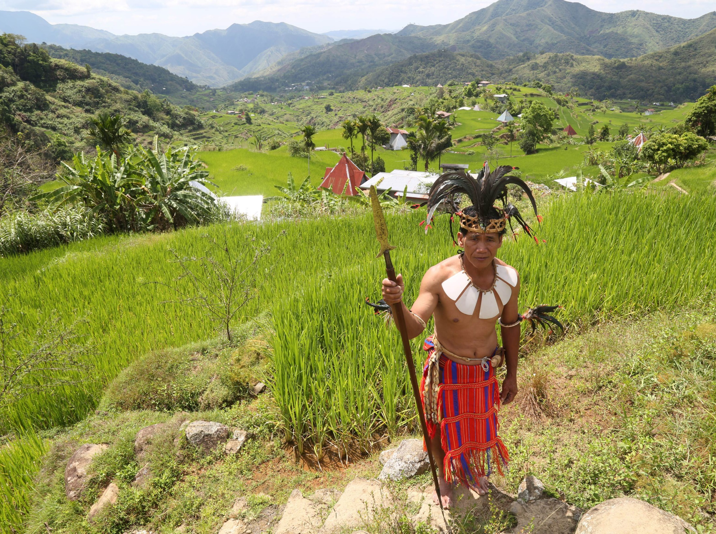
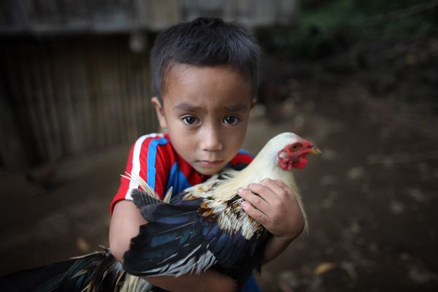

Slide 27
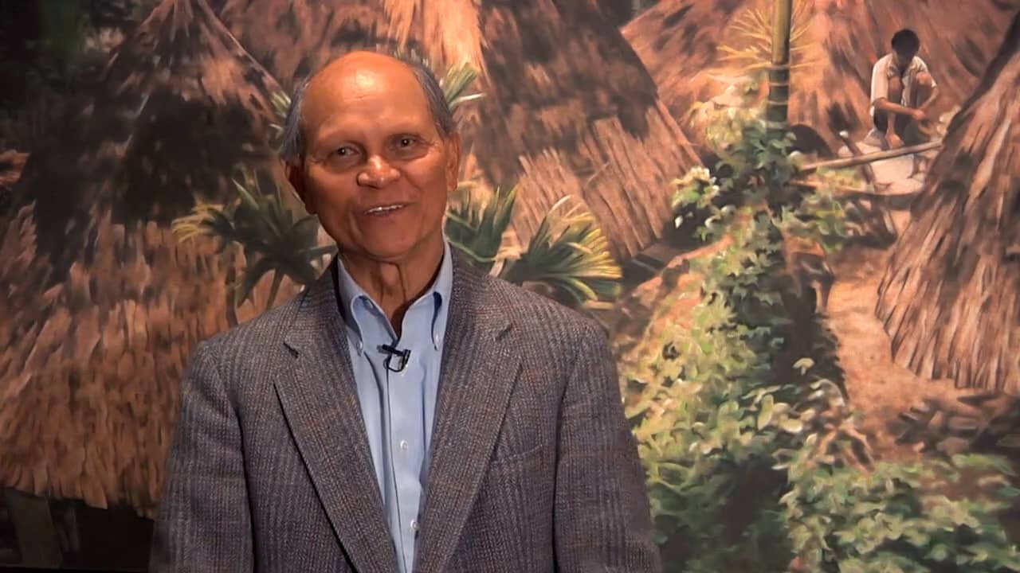
(Nard Pugyao, "Penetrating Power," Decision, July-August 2006, p. 18.)

Slide 28
As The Deer
As the deer panteth for the water
So my soul longeth after Thee
You alone are my heart's desire
And I long to worship Thee

Slide 29
As The Deer
You alone are my strength my shield
To You alone may my spirit yield
You alone are my heart's desire
And I long to worship Thee

Slide 30
As The Deer
You're my friend
And You are my brother
Even though You are a King
I love You more than any other
So much more than anything

Slide 31
As The Deer
You alone are my strength my shield
To You alone may my spirit yield
You alone are my heart's desire
And I long to worship Thee

Slide 32
As The Deer
I want You more than gold or silver
Only You can satisfy
You alone are the real joygiver
And the apple of my eye

Slide 33
As The Deer
You alone are my strength my shield
To You alone may my spirit yield
You alone are my heart's desire
And I long to worship Thee

Slide 34
Announcements & Offering

Slide 35
Closing Prayer

