Slide 1
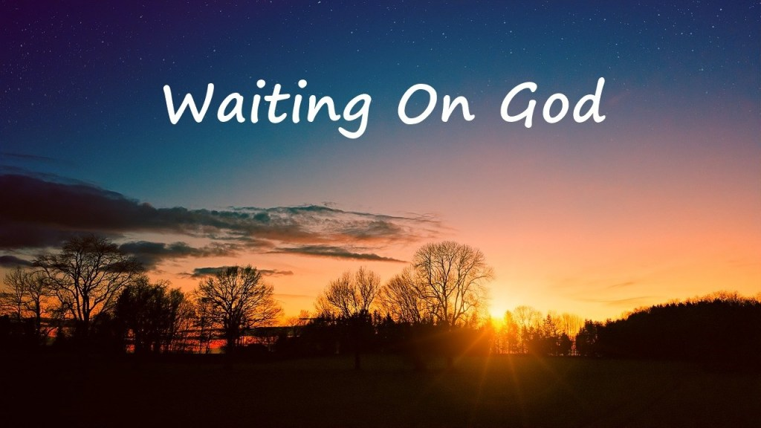
Isaiah 30:18

Slide 2
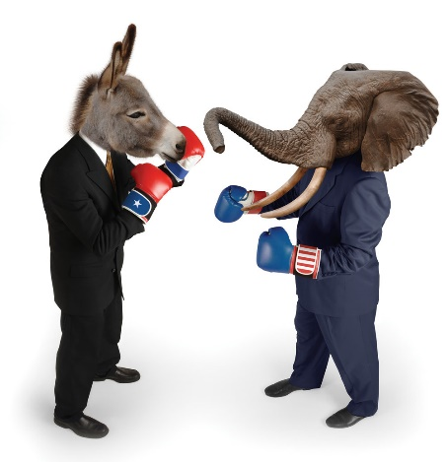
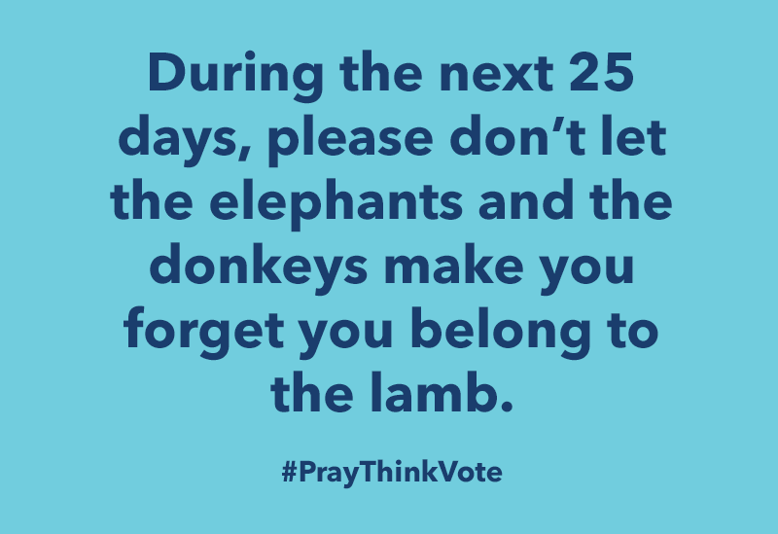

Slide 3
Critical Issues that matter to God
and should matter to us!
PRAYWENGAGEWVOTE
5. CAPITALISM –VS- SOCIALISM
6. THE JUDICIAL SYSTEM
7. THE NATION OF ISRAEL

Slide 5
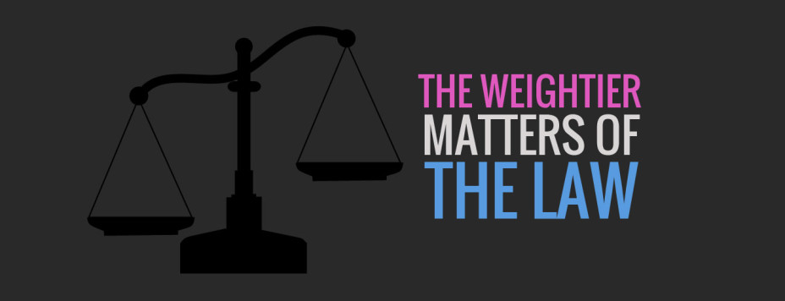
JESUS SAID…
Matthew 23:23 (NLT2) “What sorrow awaits you teachers of religious law and you Pharisees. Hypocrites! For you are careful to tithe even the tiniest income from your herb gardens, but you ignore the more important aspects of the law—justice, mercy, and faith. You should tithe, yes, but do not neglect the more important things.

Slide 6
Knowing the laws of God
and living out the principles
of God are two different things.

Slide 7
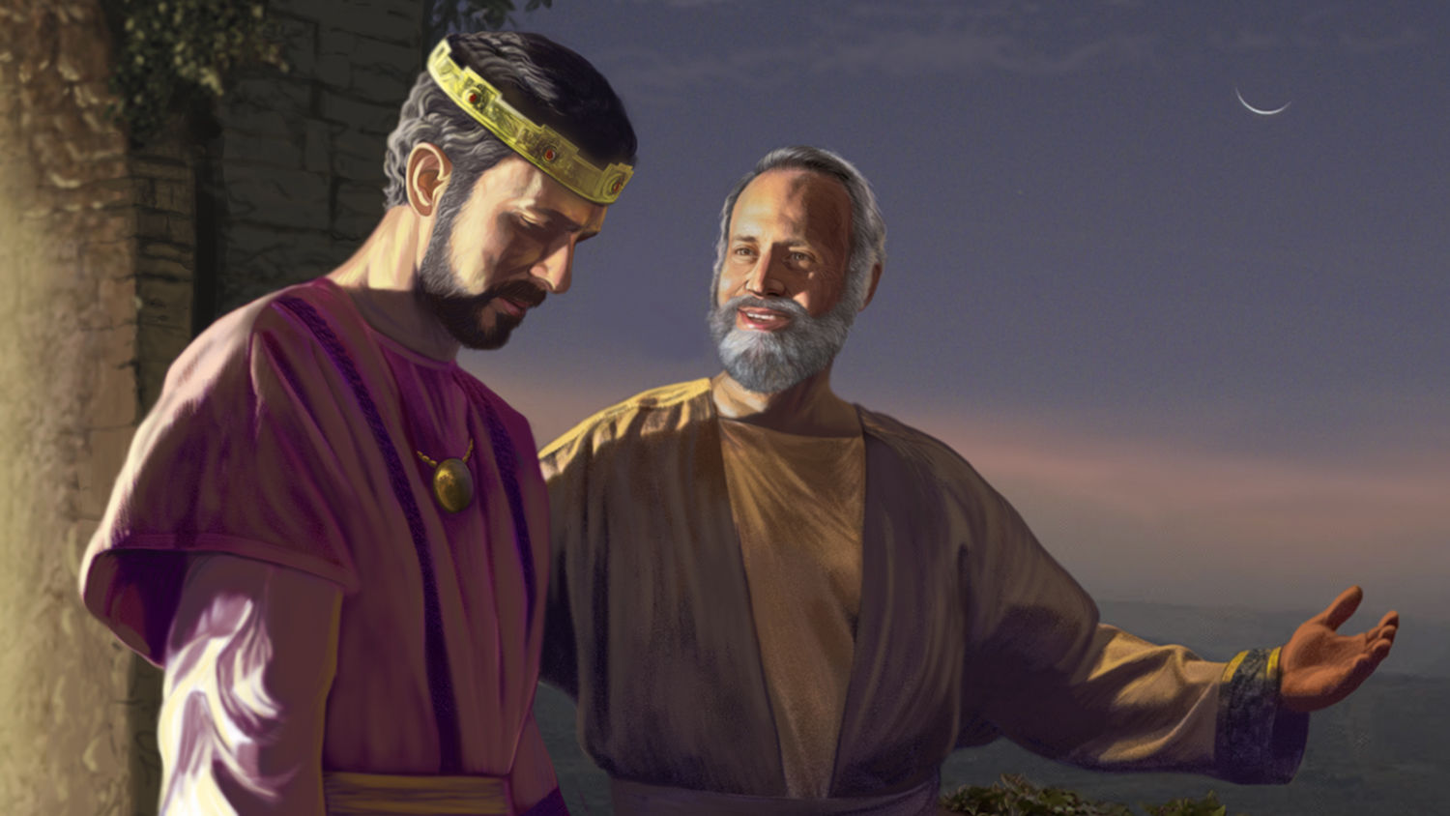
Isaiah warns
King Hezekiah

Slide 8
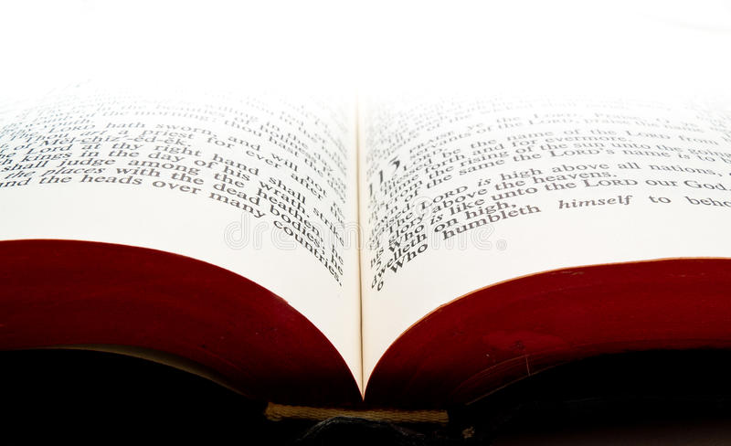
“And so the Lord says, “These people say they are mine. They honor me with their lips, but their hearts are far from me. And their worship of me is nothing but man-made rules learned by rote. ¹⁴ Because of this, I will once again astound these hypocrites with amazing wonders. The wisdom of the wise will pass away, and the intelligence of the intelligent will disappear.”
Isaiah 29:13-14

Slide 9
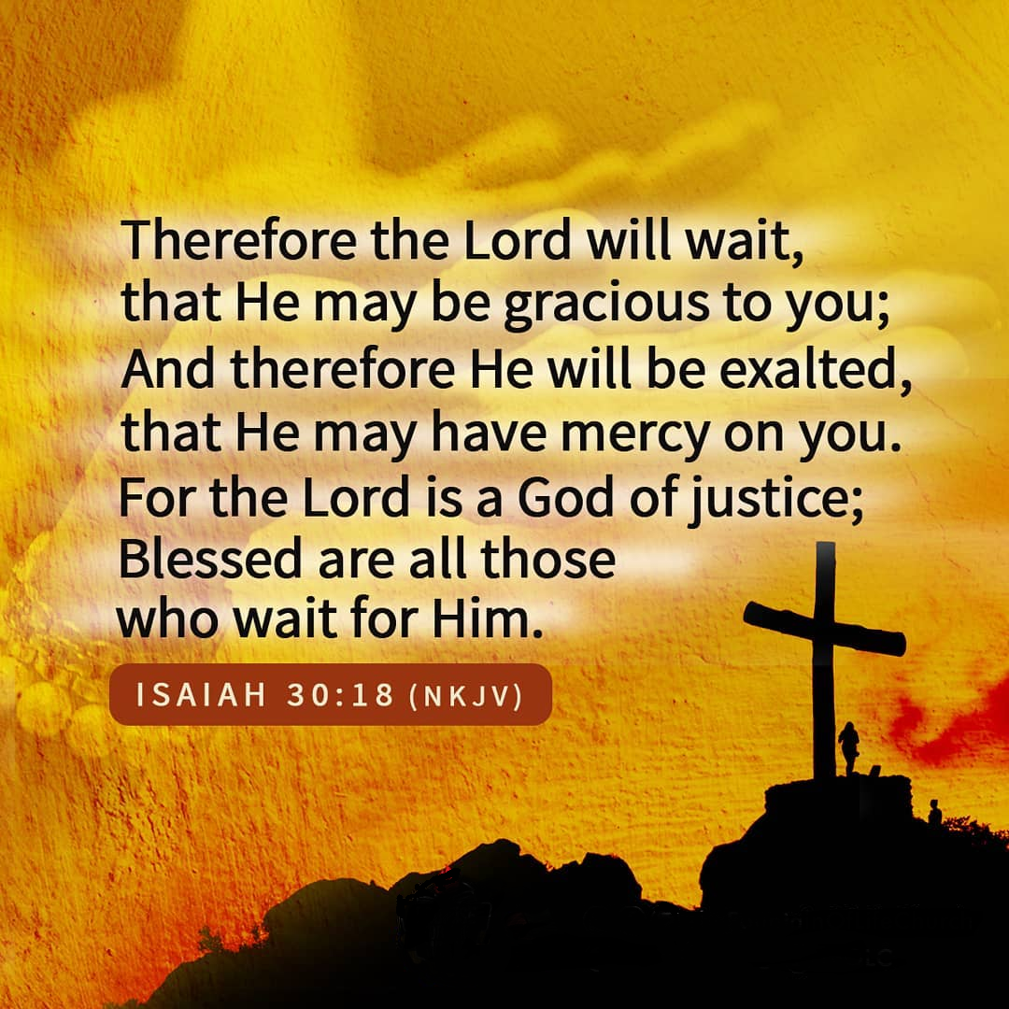

Slide 10
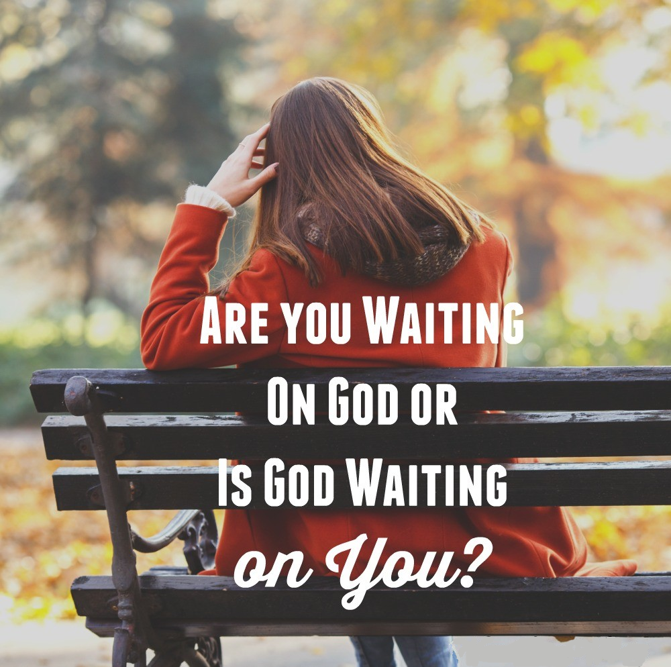

Slide 11
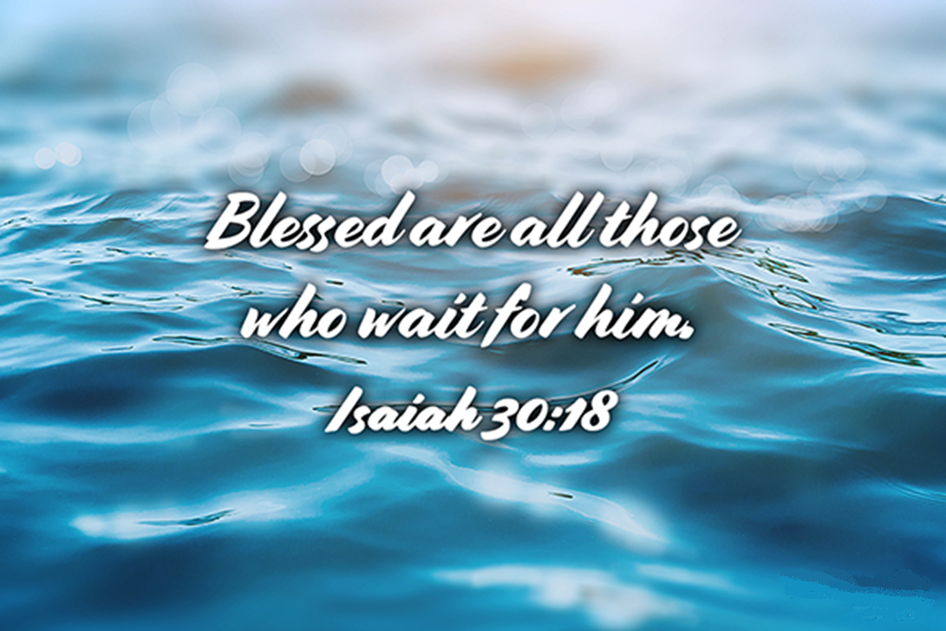

Slide 12
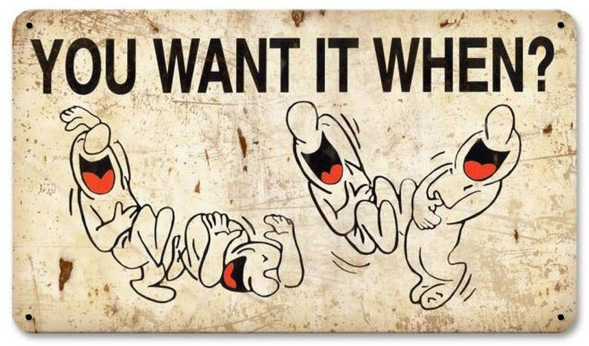

Slide 17
Ultimately, they would lose the one thing that mattered most in their relationship with God. TRUST!

Slide 20
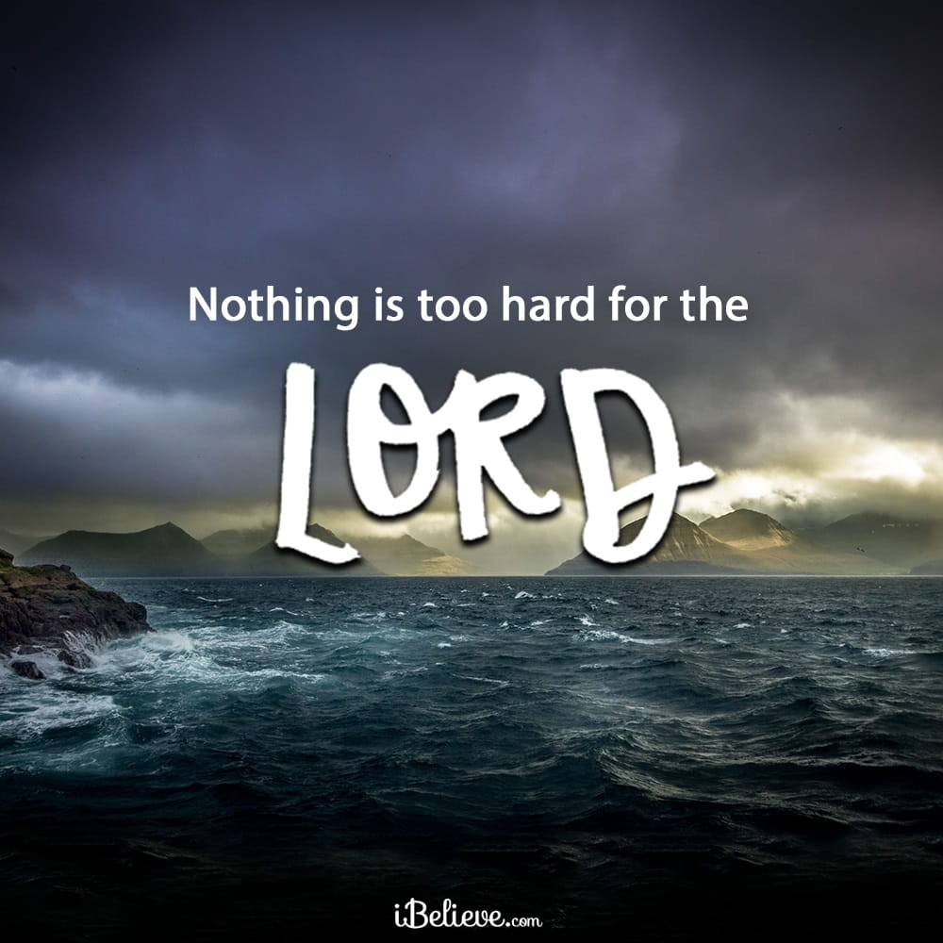
Abraham & Sarah
Learned through waiting on God that

Slide 21
¹⁸ Christ also suffered for our sins once and for all,
the righteous for the unrighteous, that he might bring
us to God. He was put to death in the flesh
but made alive by the Spirit,
1 Peter 3:18-20

Slide 22
¹⁹ in which he also went and made proclamation to the spirits in prison ²⁰ who in the past were disobedient, that God patiently waited in the days of Noah
while the ark was being prepared.
1 Peter 3:18-20

Slide 23
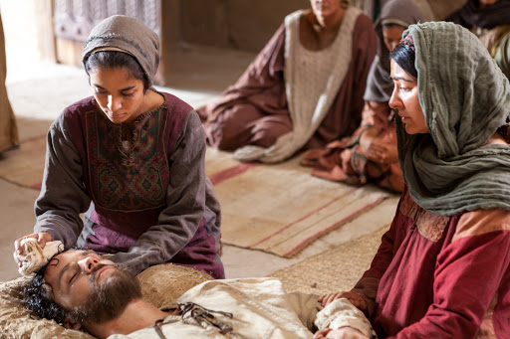
Mary, Martha & Lazarus

Slide 24
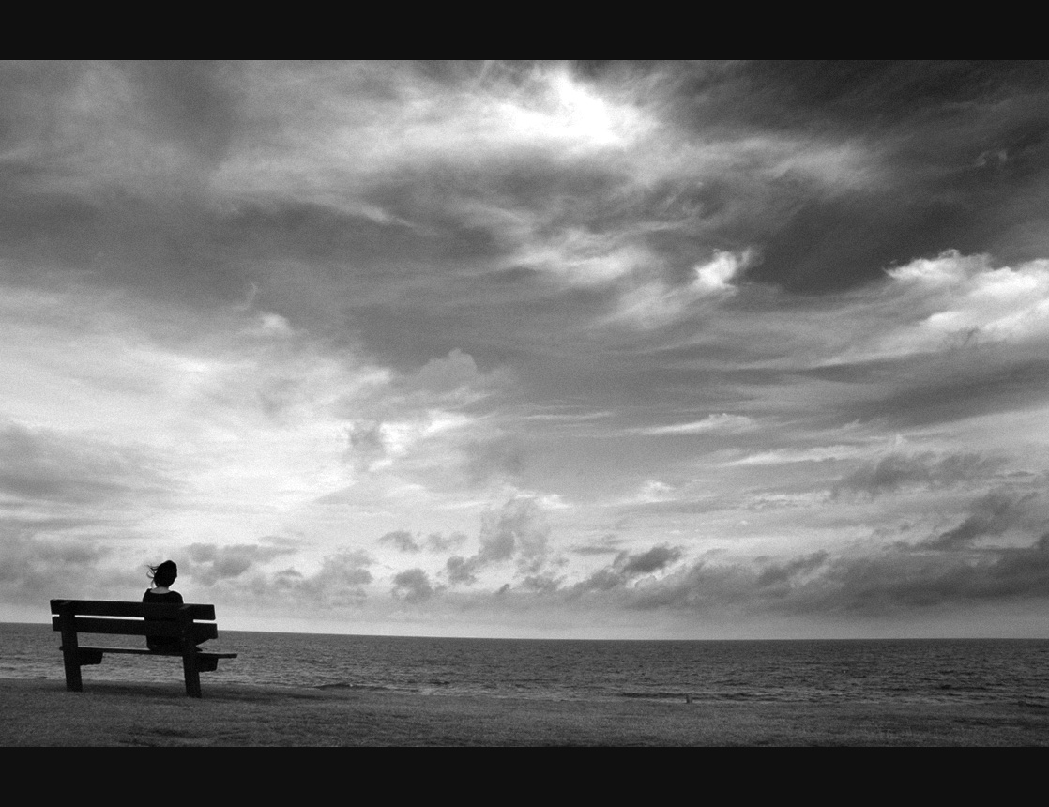
Why is waiting on God so important?

Slide 25
Waiting reveals who and what we put our trust in!

Slide 26
Waiting reveals who and what we put our trust in!
Waiting demonstrates trust!

Slide 27
Waiting reveals who and what we put our trust in!
Waiting demonstrates trust!
Waiting develops unity!

Slide 28
Waiting reveals who and what we put our trust in!
Waiting demonstrates trust.
Waiting develops unity.
Waiting develops contentment.

Slide 29
The work of waiting is the way of God,
for God’s work involves waiting!

Slide 31
Remember, there is purpose in waiting,
there is value in waiting..

Slide 32
Partaking of the Lord’s Supper

Slide 33
Psalm 27:14 Wait for the Lord; be strong, and let your heart take courage; wait for the Lord!
Psalm 33:20 Our soul waits for the Lord; he is our help and our shield.
Psalm 37:7 Be still before the Lord and wait patiently for him;
Psalm 39:7 “And now, O Lord, for what do I wait? My hope is in you.

Slide 34
Psalm 130:5-6 I wait for the Lord, my soul waits, and in his word I hope; my soul waits for the Lord more than watchmen for the morning, more than watchmen for the morning.
Lamentations 3:25 The Lord is good to those who wait for him, to the soul who seeks him.
Isaiah 26:8 In the path of your judgments, O Lord, we wait for you; your name and remembrance are the desire of our soul.

Slide 35
Isaiah 40:31 But they who wait for the Lord shall renew their strength; they shall mount up with wings like eagles; they shall run and not be weary; they shall walk and not faint.

Slide 36
Luke 12:36 And be like men who are waiting for their master to come home from the wedding feast, so that they may open the door to him at once when he comes and knocks.
Luke 2:25 Now there was a man in Jerusalem, whose name was Simeon, and this man was righteous and devout, waiting for the consolation of Israel, and the Holy Spirit was upon him.

Slide 37
James 5:7 Be patient, therefore, brothers, until the coming of the Lord. See how the farmer waits for the precious fruit of the earth, being patient about it, until it receives the early and the late rains.
Acts 1:4 And while staying with them he ordered them not to depart from Jerusalem, but to wait for the promise of the Father, which, he said, “you heard from me;
Philippians 3:20 And now let us remember that “our citizenship is in heaven, and from it we await a Savior, the Lord Jesus Christ.”

