Slide 1
PALM SUNDAY 2020
COMING IN MEEKNESS,
Romans 5:15-21

Slide 2
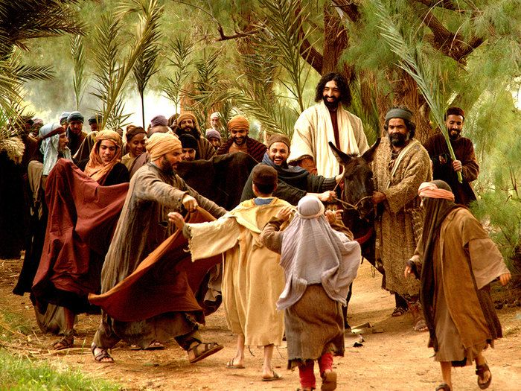

Slide 3
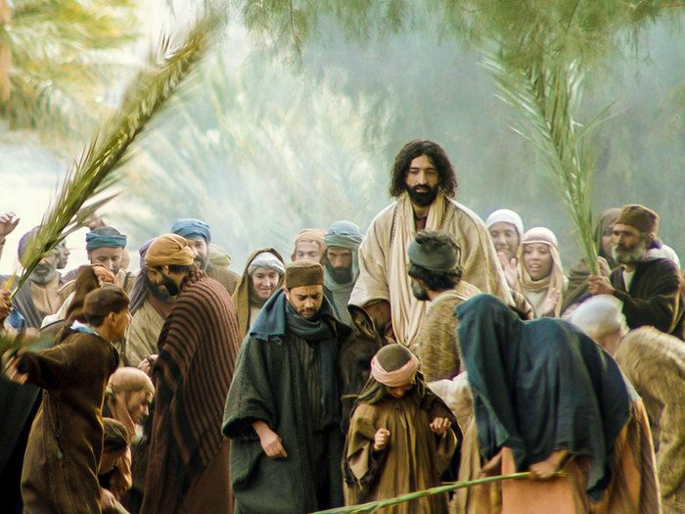
"Rejoice greatly, O daughter of Zion! Shout,
O daughter of Jerusalem! Behold, your King is coming to you; He is just and having salvation, lowly and riding on a donkey”
Zechariah 9:9

Slide 4
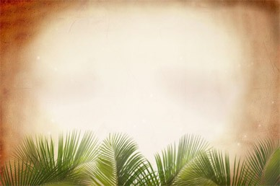
“Hosanna to the Son of David!
Blessed is He who comes
in the name of the Lord.
Hosanna in the Highest.”
Matthew 21:9
(Psalm 118:25-26)

Slide 5
THE SYMBOLISM OF THE DONKEY
The donkey was an animal of peace. In ancient times, a king would have ridden a horse when he was bent on war, and ridden a donkey to symbolize his arrival in peace.

Slide 6
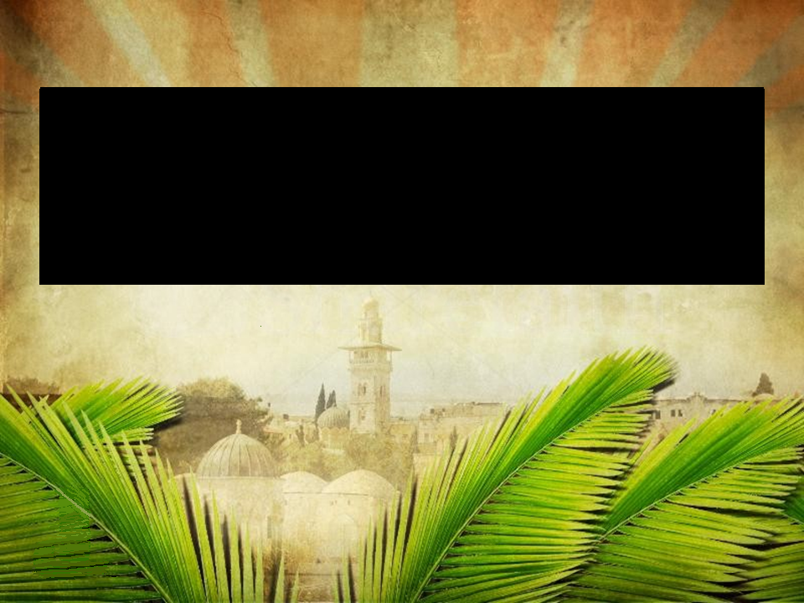
“humble”
He is just and having salvation, lowly and riding on a donkey, a colt, the foal of a donkey.
Zechariah 9:9

Slide 7
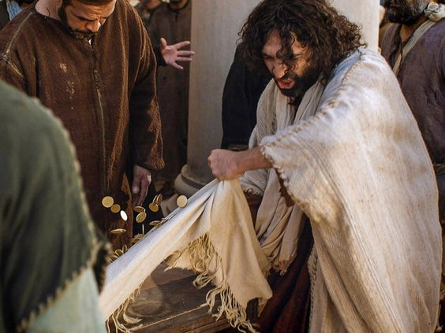
JEUS THROWS OUT THE MONEY CHANGERS

Slide 8
The Submissive,
The Surrendered!
“Thy will be done on earth,
as it is in Heaven.”
Mathew 6:10

Slide 9
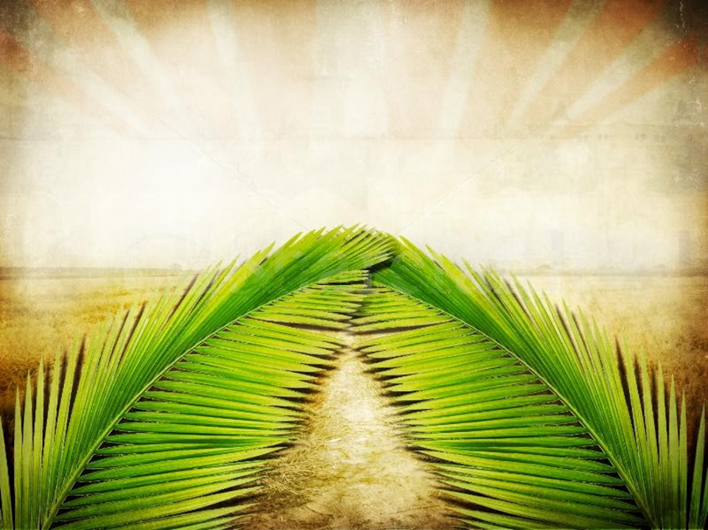
Matthew 5:5
“Blessed are the meek,
for they shall inherit the earth.”

Slide 11
¹ “Is anyone thirsty? Come and drink— even if you have no money! Come, take your choice of wine or milk— it’s all free! ² Why spend your money on food that does not give you strength? Why pay for food that does you no good?
ISAIAH 55:1-3

Slide 12
Listen to me, and you will eat what is good. You will enjoy the finest food. ³ “Come to me with your ears wide open. Listen, and you will find an abundant life. I will make an everlasting covenant with you. I will give you all the unfailing love I promised to David.
ISAIAH 55:1-3

Slide 13
GRACE

Slide 16
To reject God’s grace is an unforgiveable sin.

Slide 17
Where sin multiplied,
GRACE multiplied
even more!
Romans 5:20 CSB

Slide 18
GRACE IS EVERYTHING FOR NOTHING
TO THOSE WHO
DON'T DESERVE ANYTHING

Slide 19
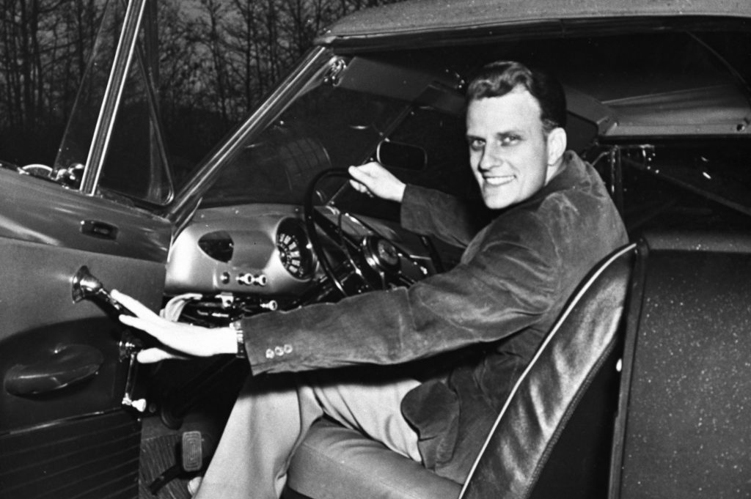

Slide 20
Palm Sunday is a time to reflect upon what “meekness” looked like in the life of Jesus and to remember that the meek are the lowly who with the help of the Holy Spirit, have fully surrendered to Christ, and are submissive to the will of God. These will inherit the earth.

Slide 21
Palm Sunday is a time to reflect upon the impact of God’s grace upon our own lives, and to remember that this grace we have received, when we offer this same grace, to others through our own lives, this distinguishes “Christianity” from all other religions on earth.

Slide 22
Palm Sunday is a time to ask,
“How do we treat the repentant?”
I hope that we respond as Jesus did to the thief on the cross.
I hope that we respond with the
same grace we have received!

